Slide 1
THE GOSPEL AND THE CHURCH’S MINISTRY
TO THE POOR
Living out Pure Religion
Jason S. DeRouchie, PhD
Professor of Old Testament and Biblical Theology
Bethlehem College & Seminary
Elder, Bethlehem Baptist Church
www.jasonderouchie.com

Slide 2
THIS IS OUR GOD
Chris Tomlin on The Noise We Make (2000)
From Isaiah 25
A refuge for the poor,
A shelter from the storm––
This is our God.
He will wipe away your tears
And return your wasted years.
This is our God.

Slide 3
So call upon his name,
He is mighty to save,
This is our God.

Slide 4
A father to the orphan,
A healer to the broken––
This is our God.
He brings peace to our madness
And comfort in our sadness.
This is our God

Slide 5
So call upon his name,
He is mighty to save,
This is our God.
This is the one we have waited for (3x)
Jesus, Lord and Savior.
This is our God.

Slide 6
A fountain for the thirsty,
A lover for the lonely––
This is our God.
He brings glory to the humble
And crowns for the faithful.
This is our God.

Slide 7
So call upon his name,
He is mighty to save,
This is our God.
(2x)
You are the one we have waited for (3x)
Jesus, Lord and Savior.
This is our God.

Slide 8
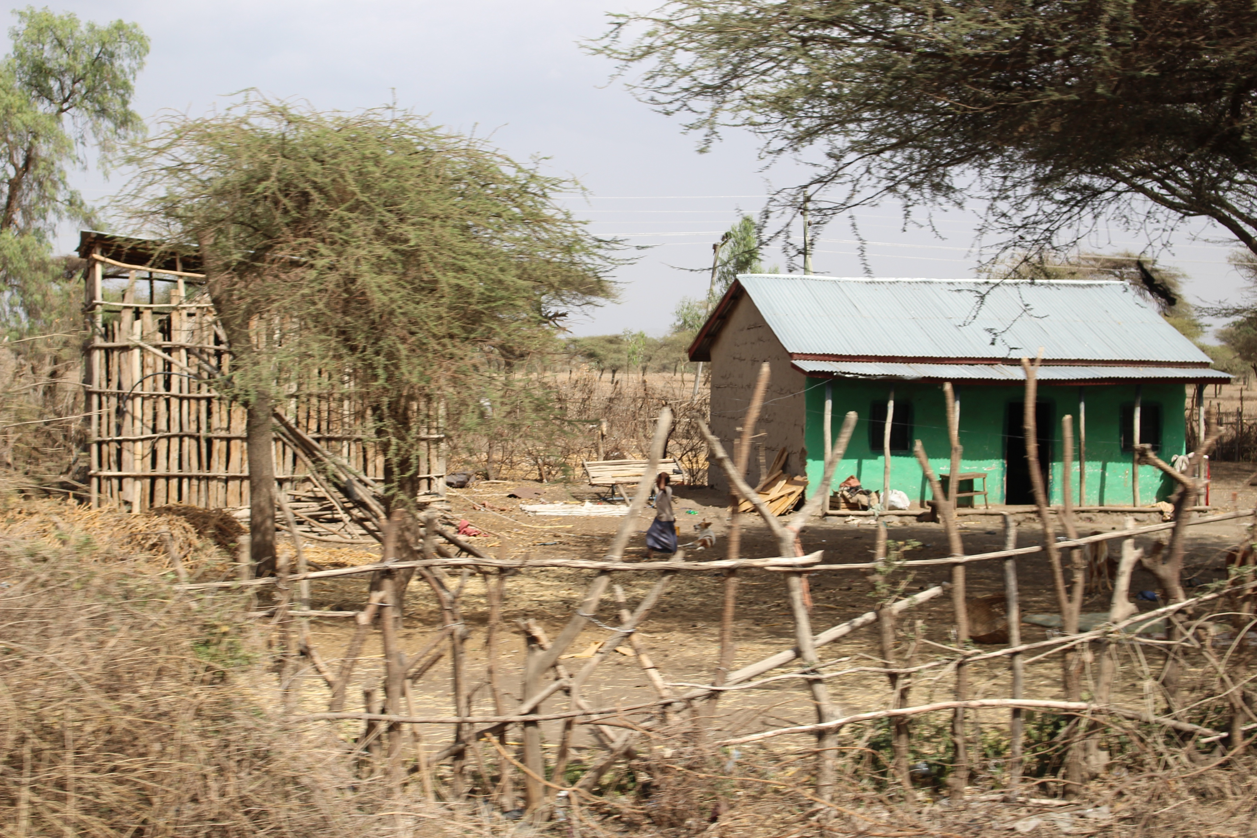

Slide 9
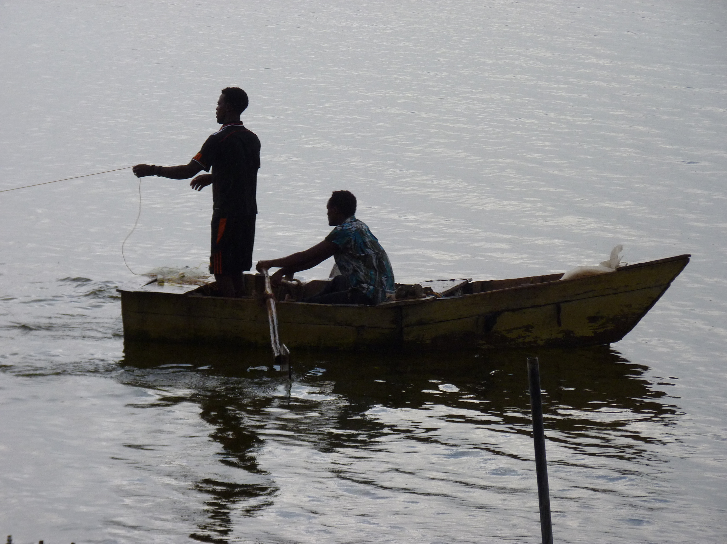

Slide 10
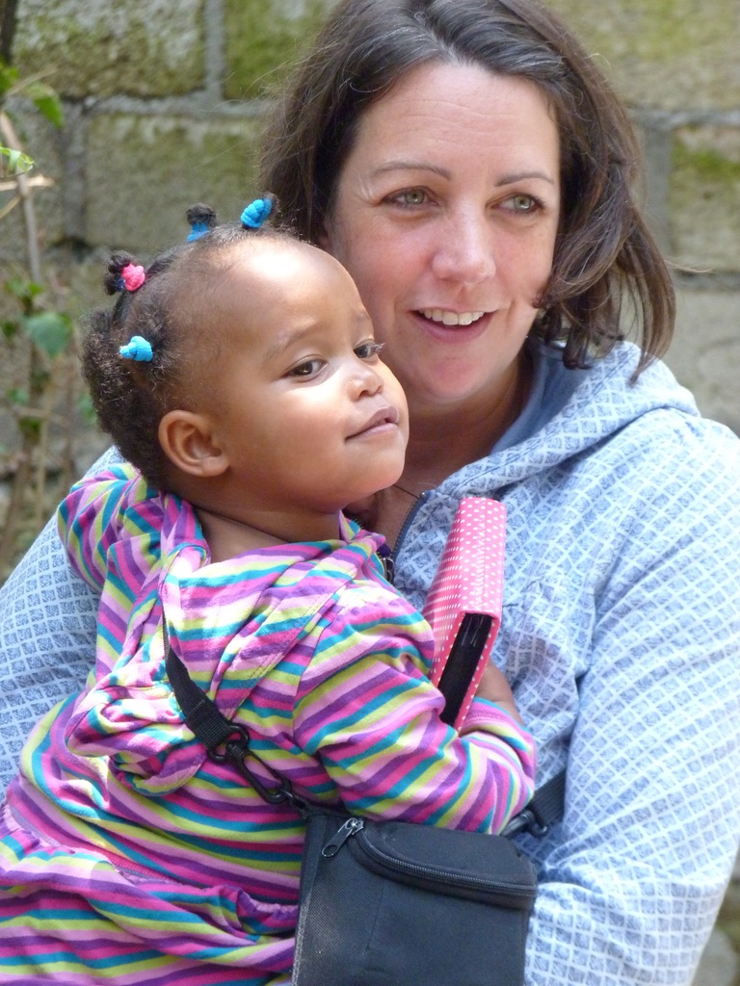
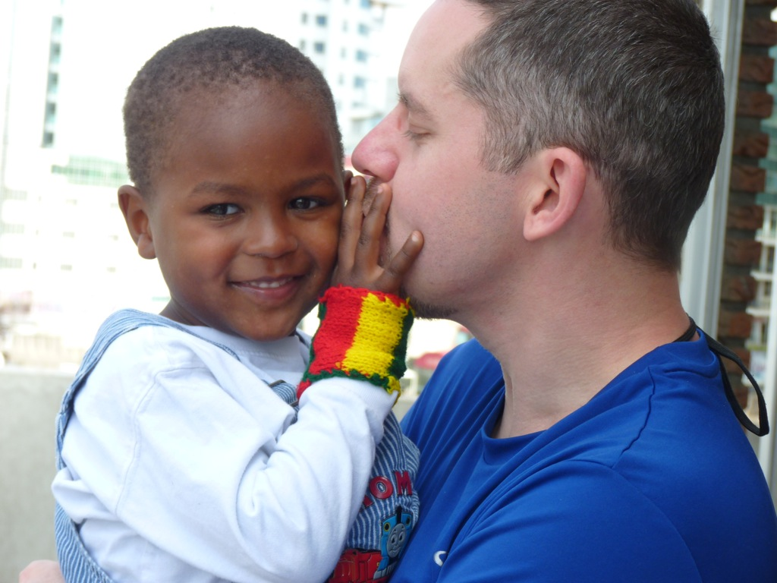

Slide 11
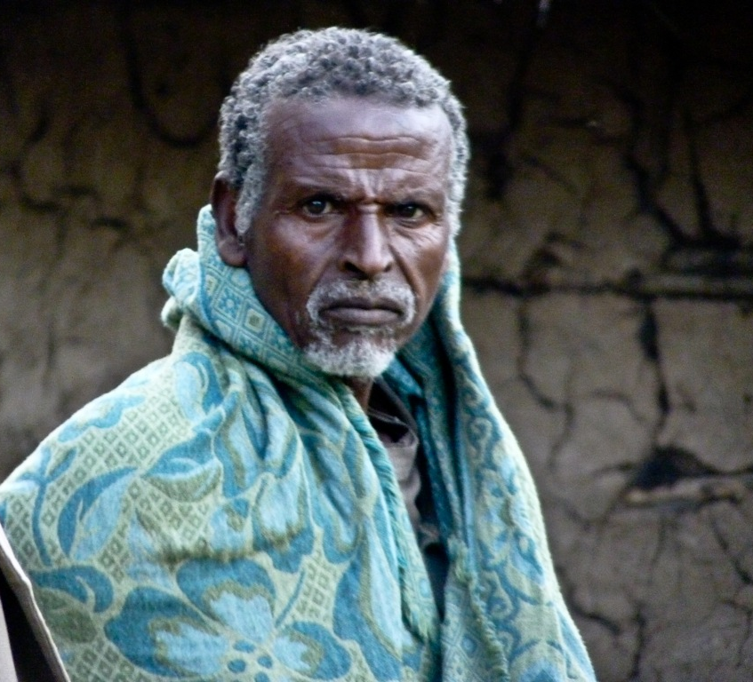

Slide 12
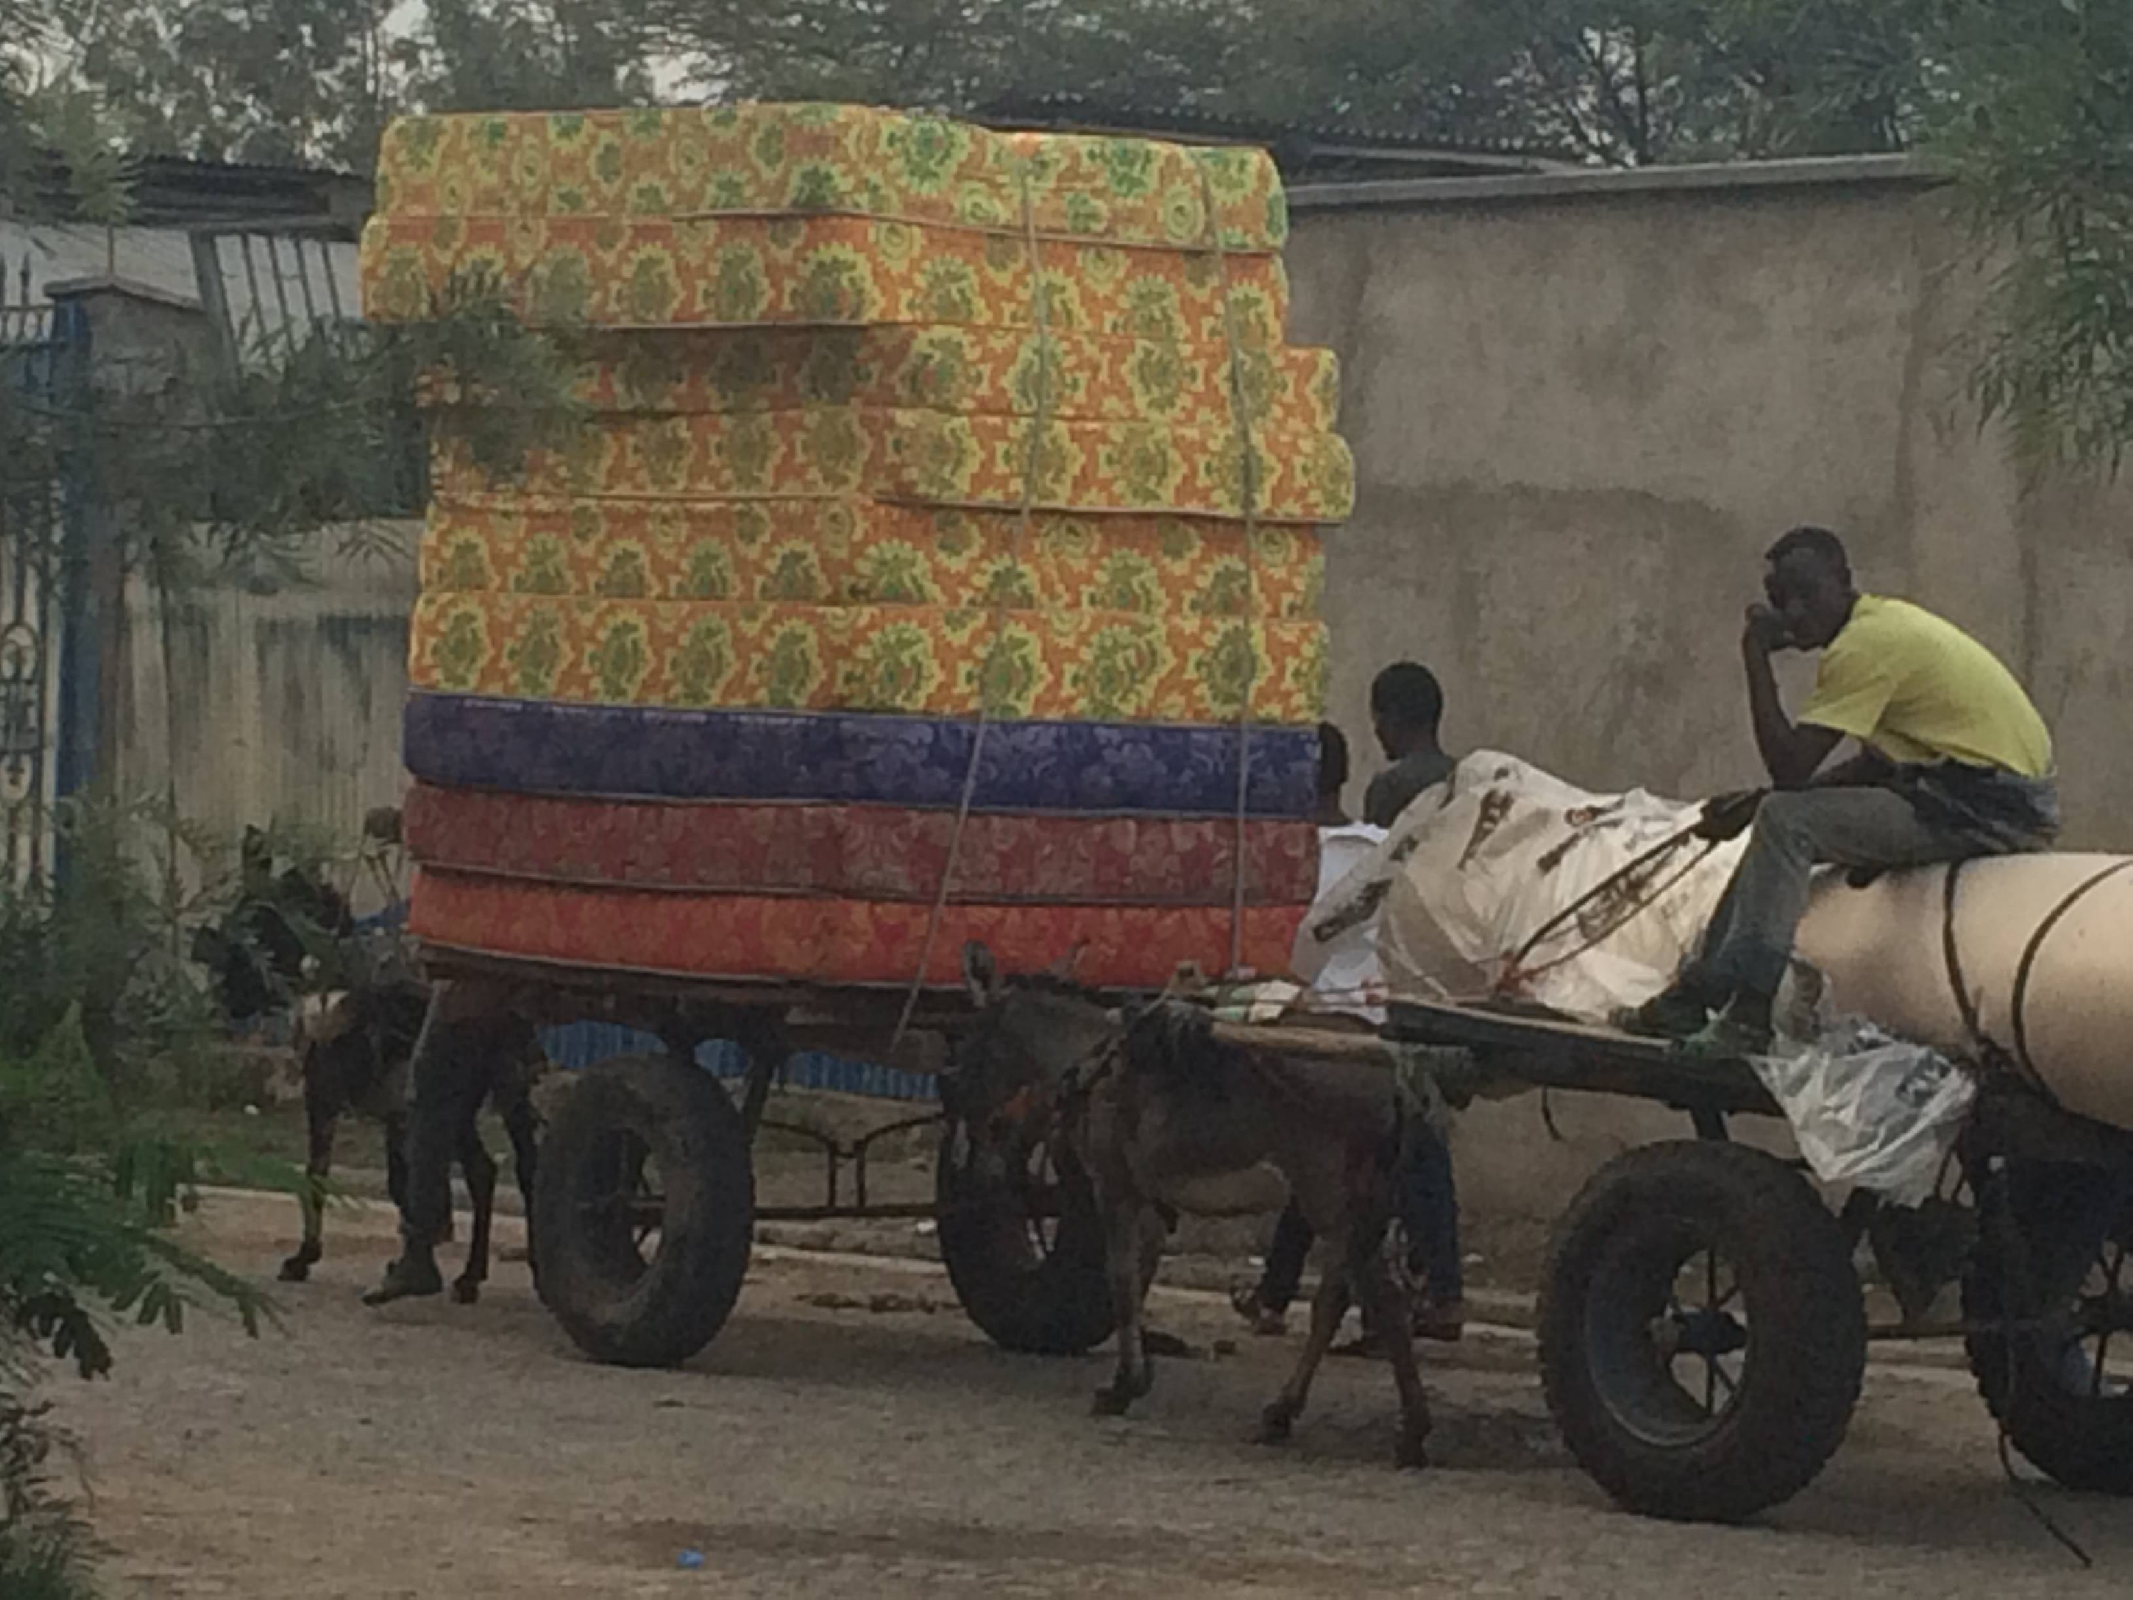

Slide 13
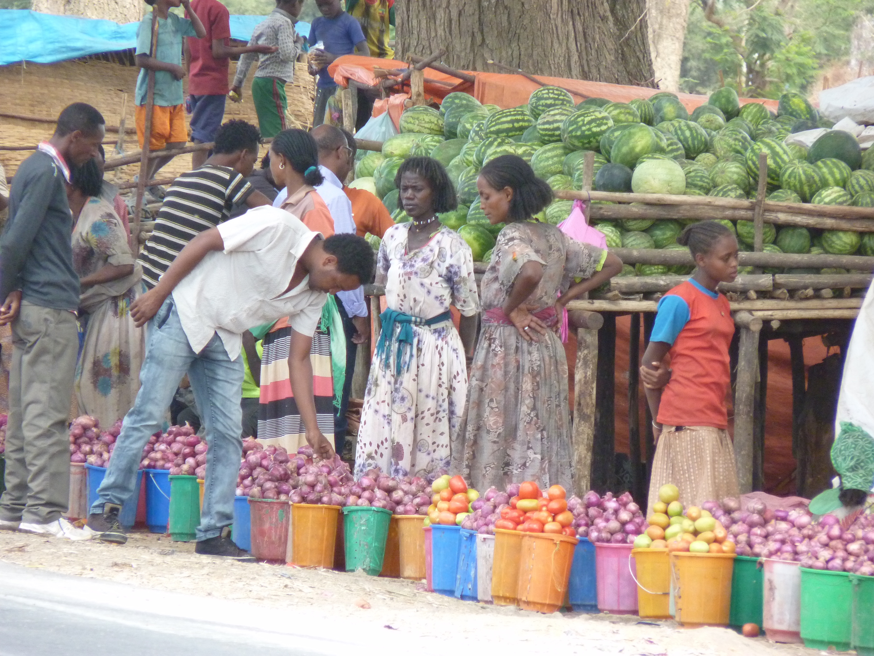

Slide 14
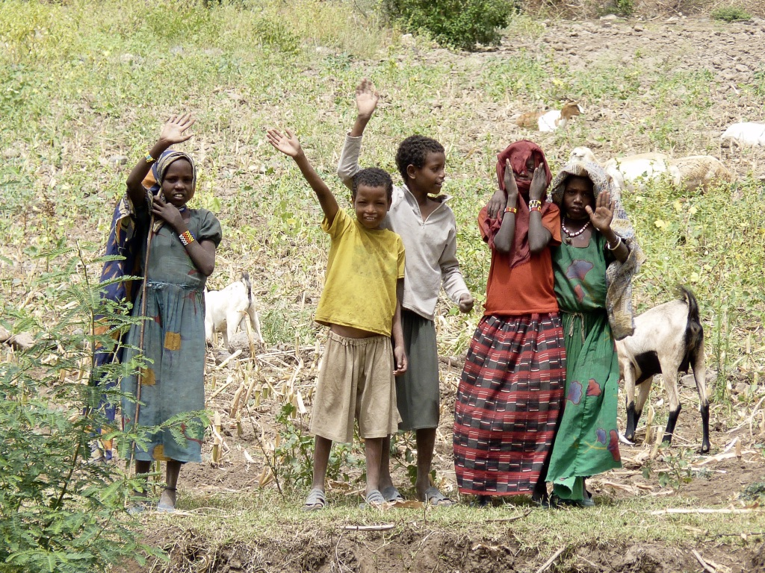

Slide 15
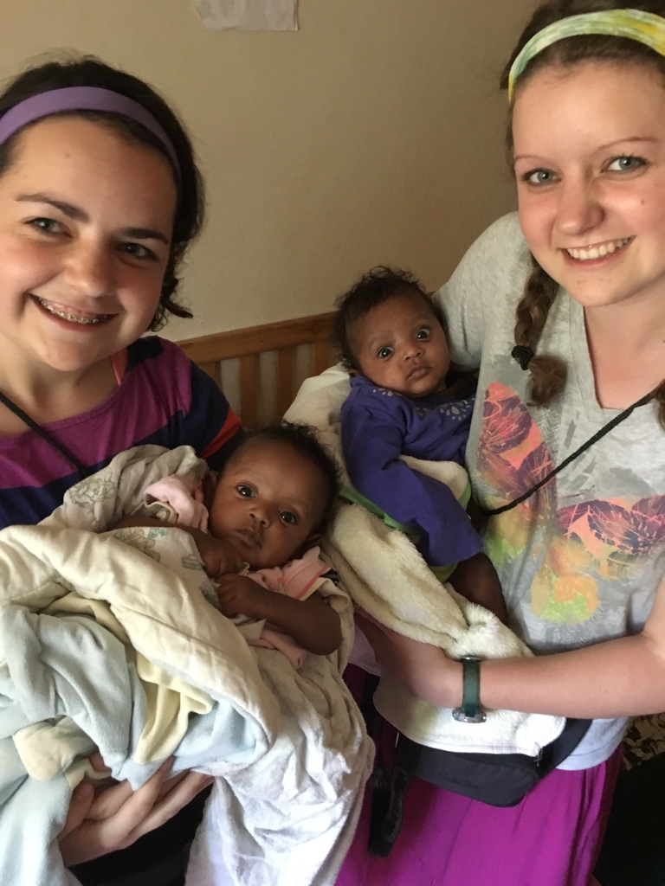

Slide 16
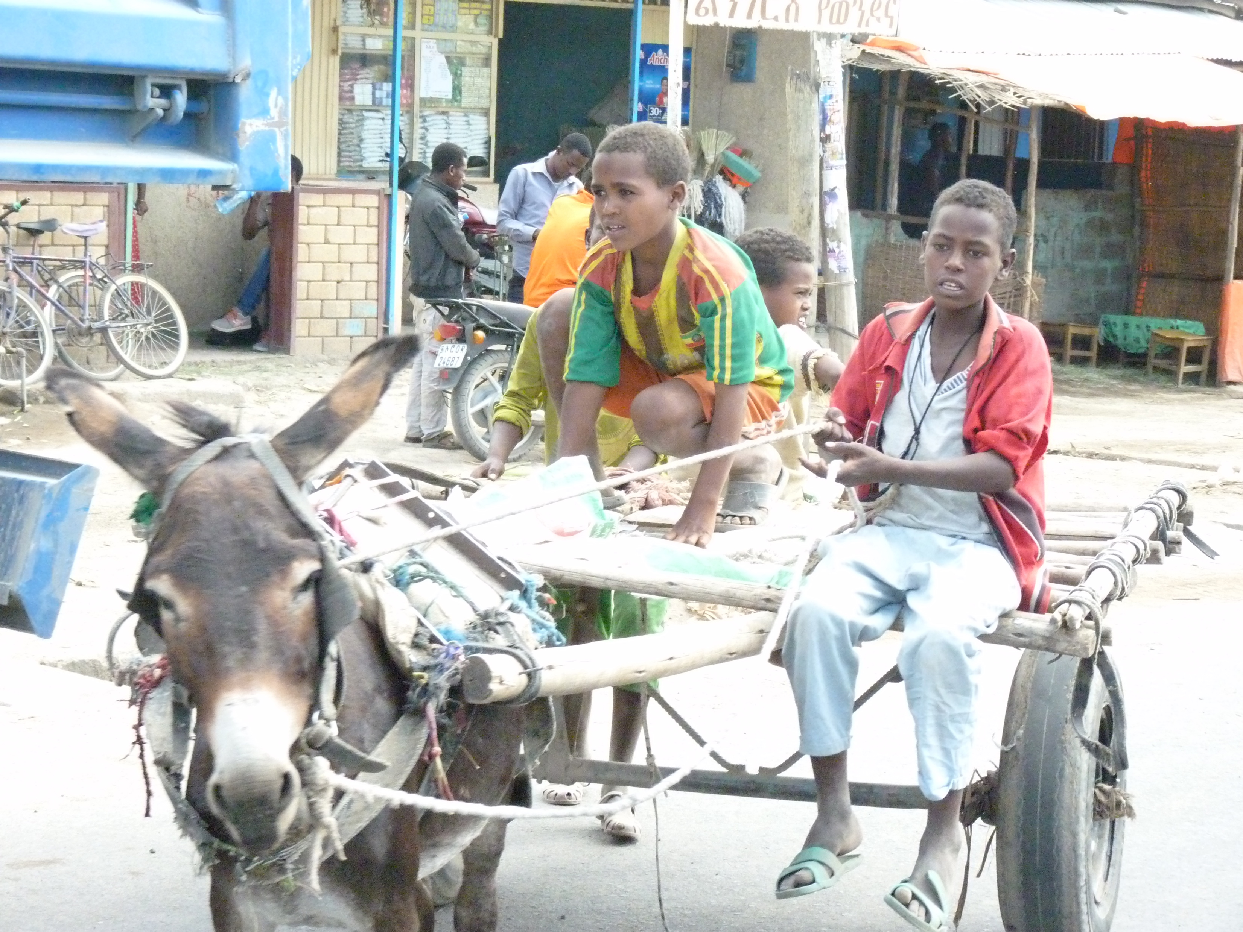

Slide 17
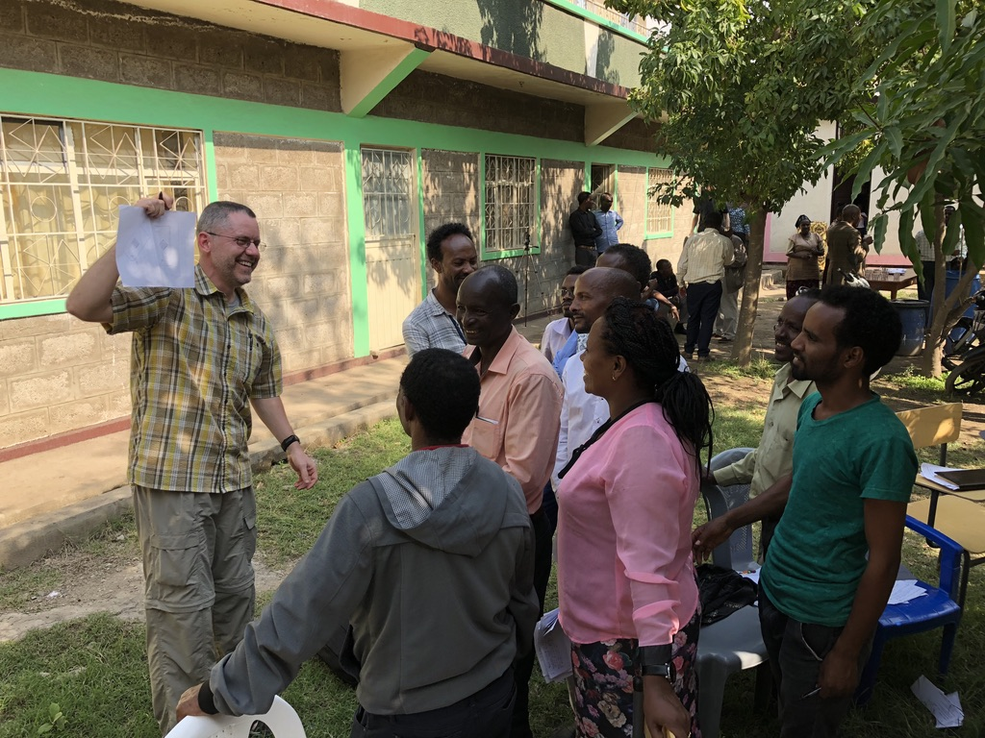

Slide 18
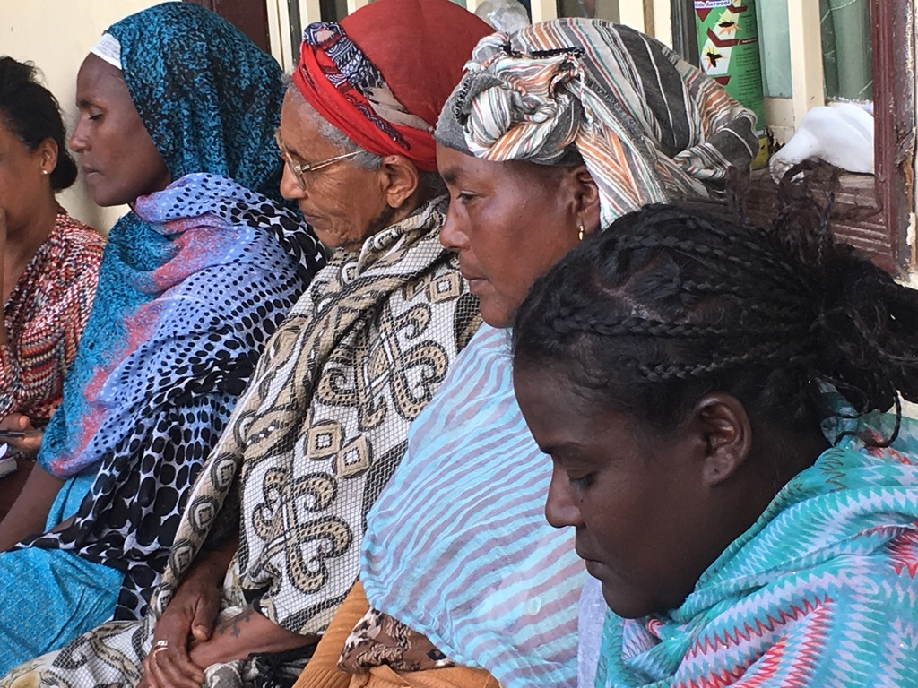

Slide 19
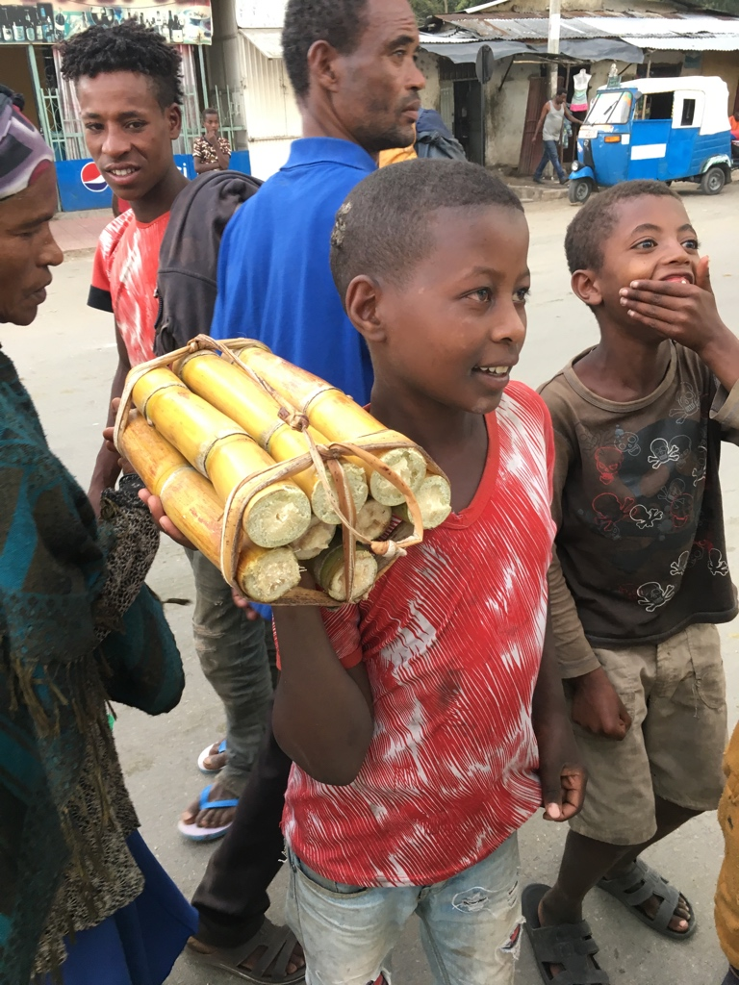
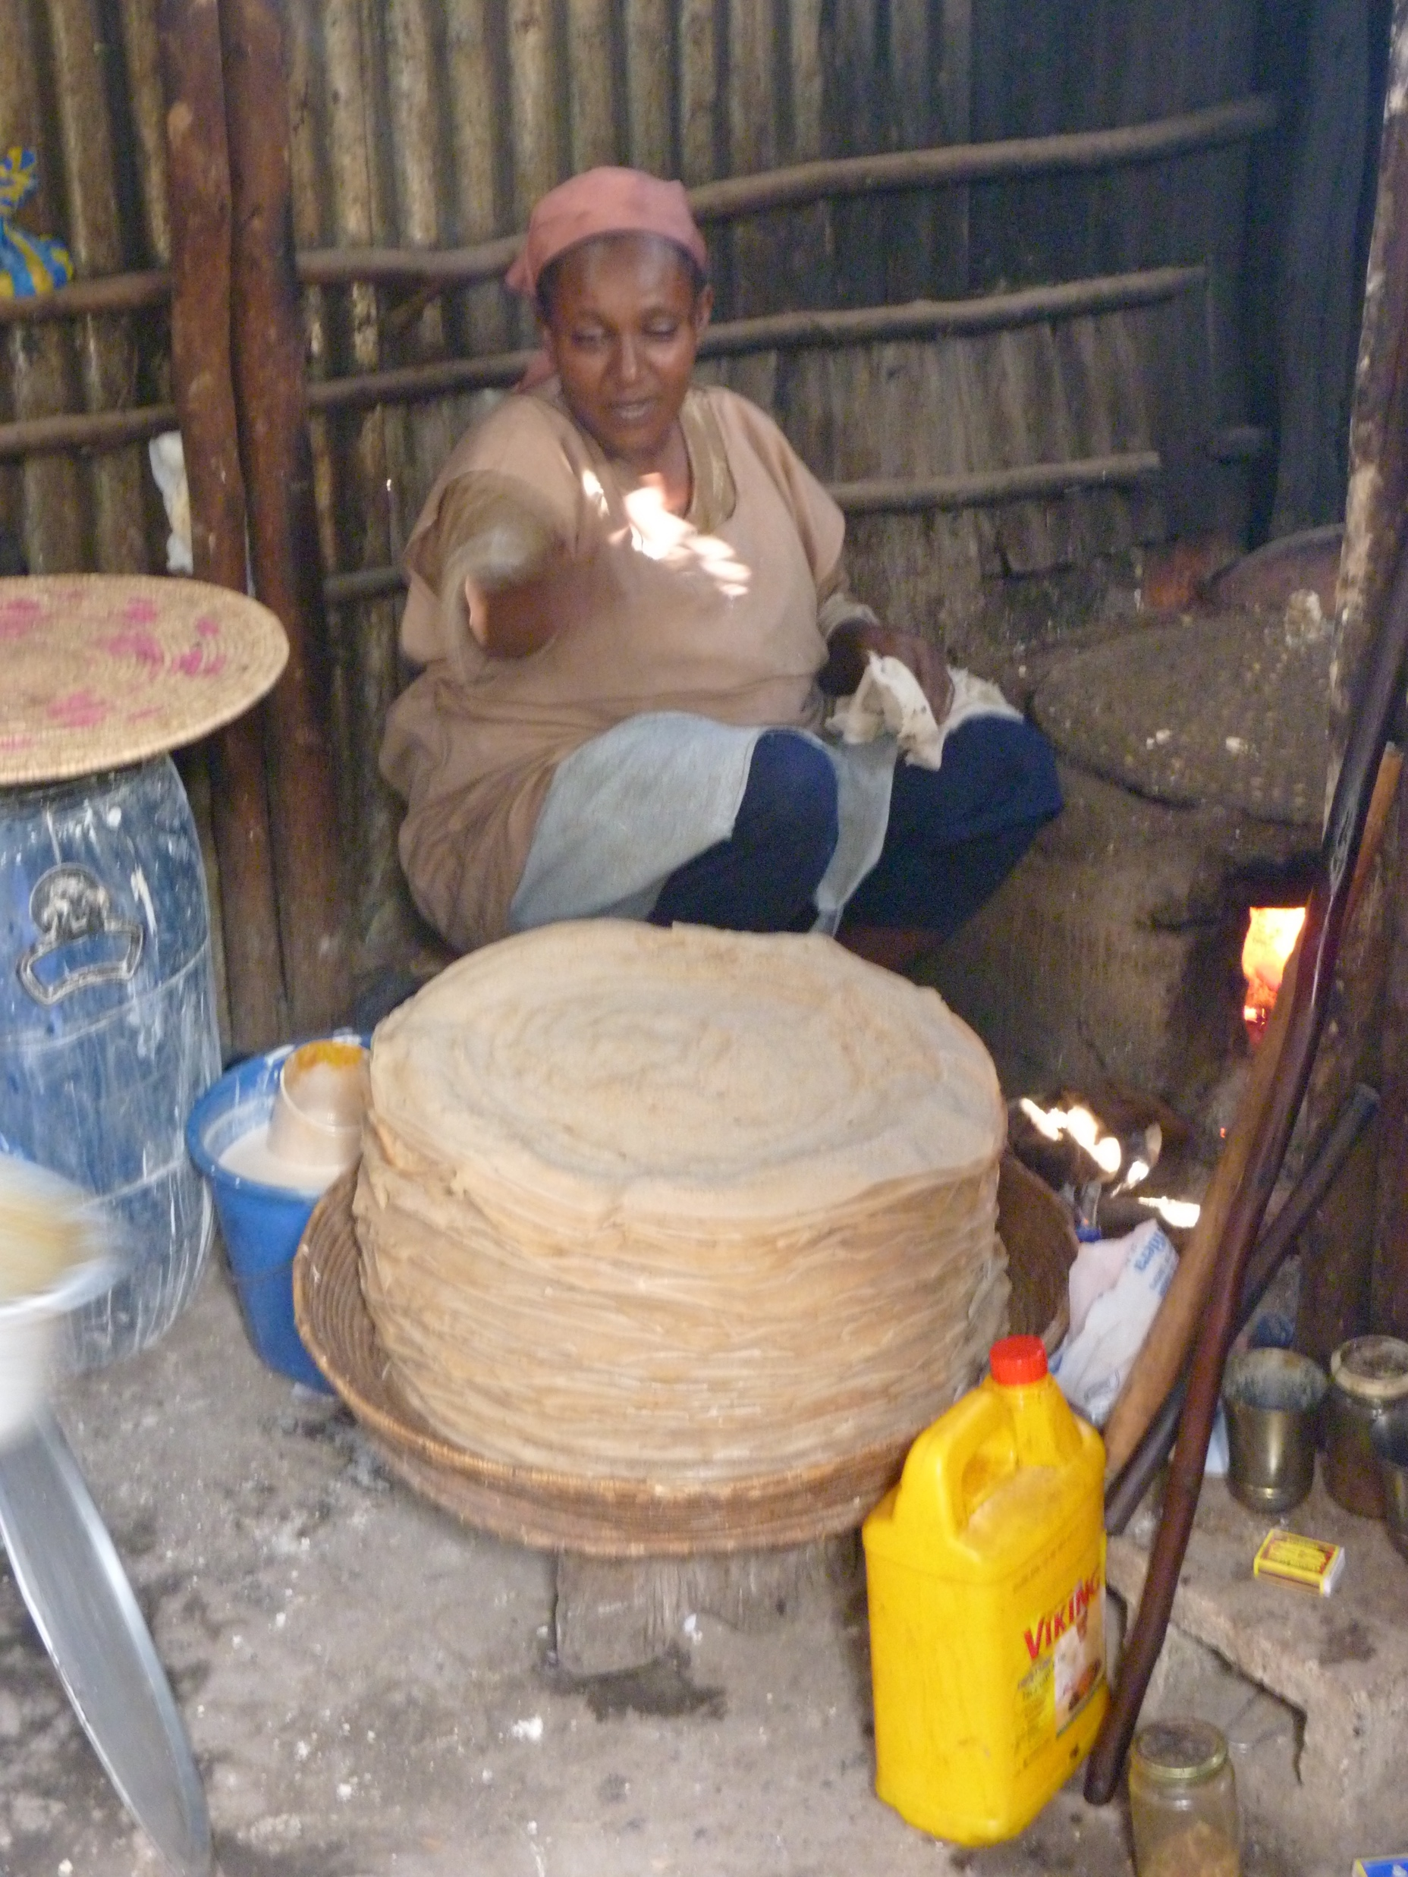

Slide 20
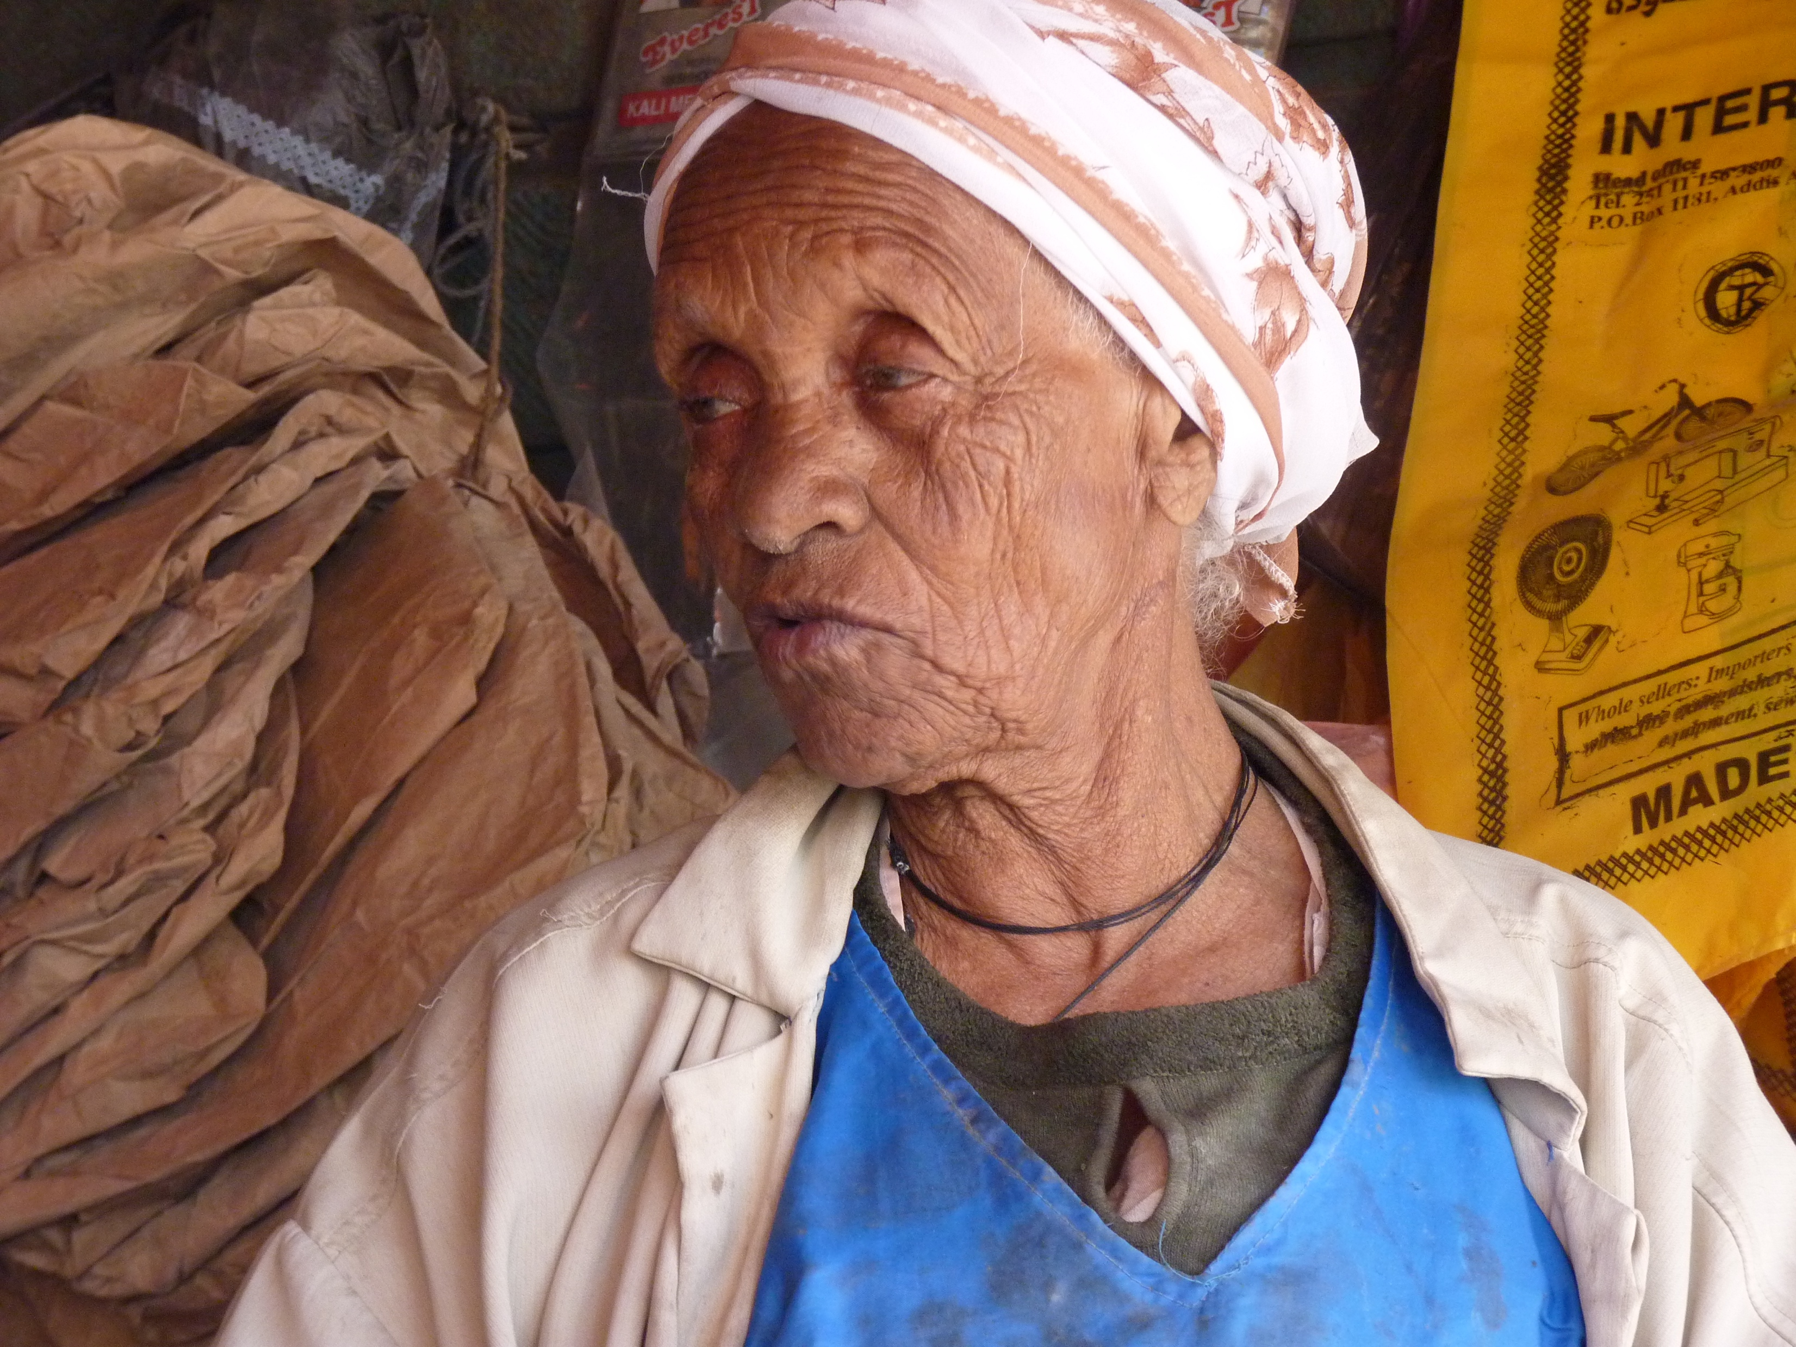

Slide 21
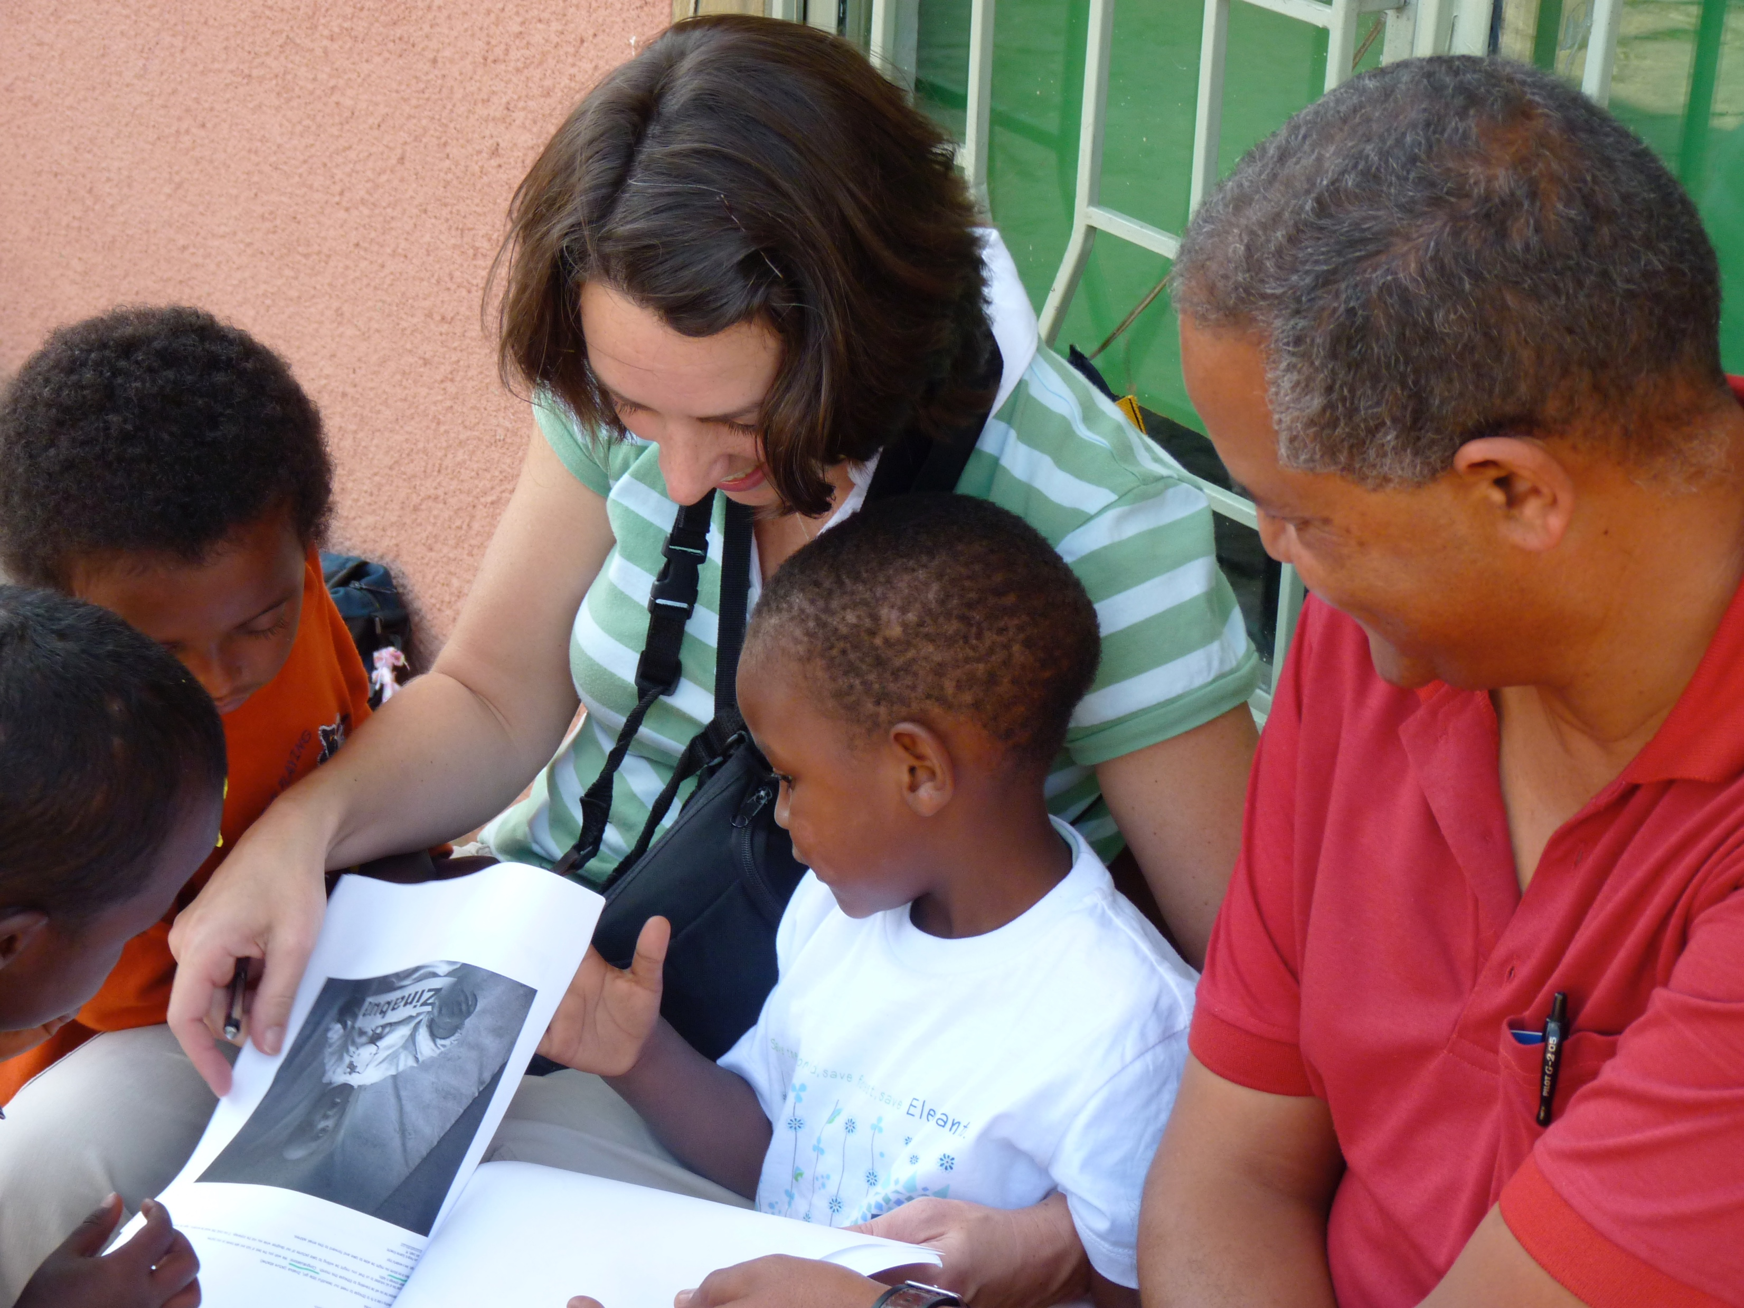

Slide 22
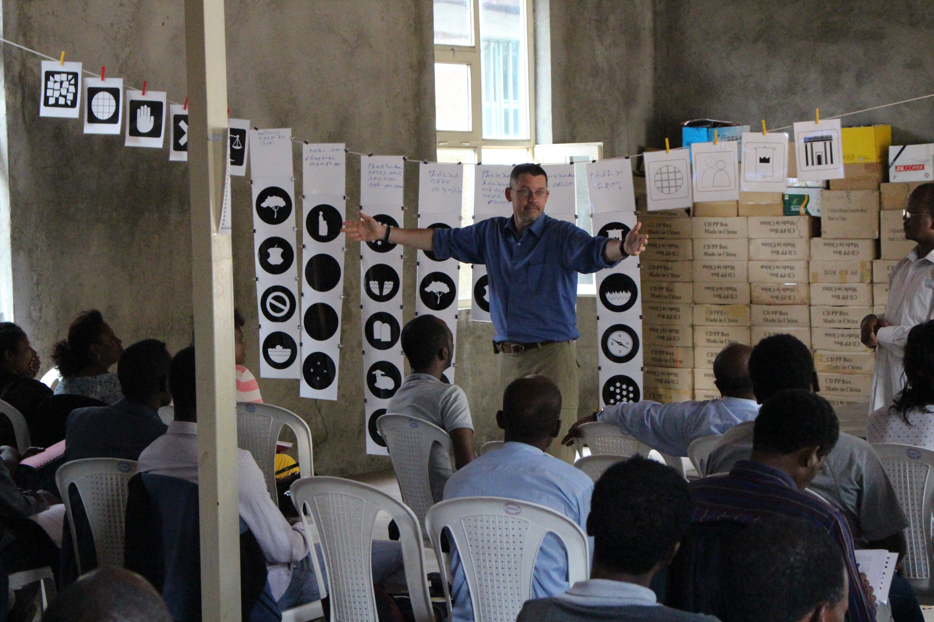

Slide 23
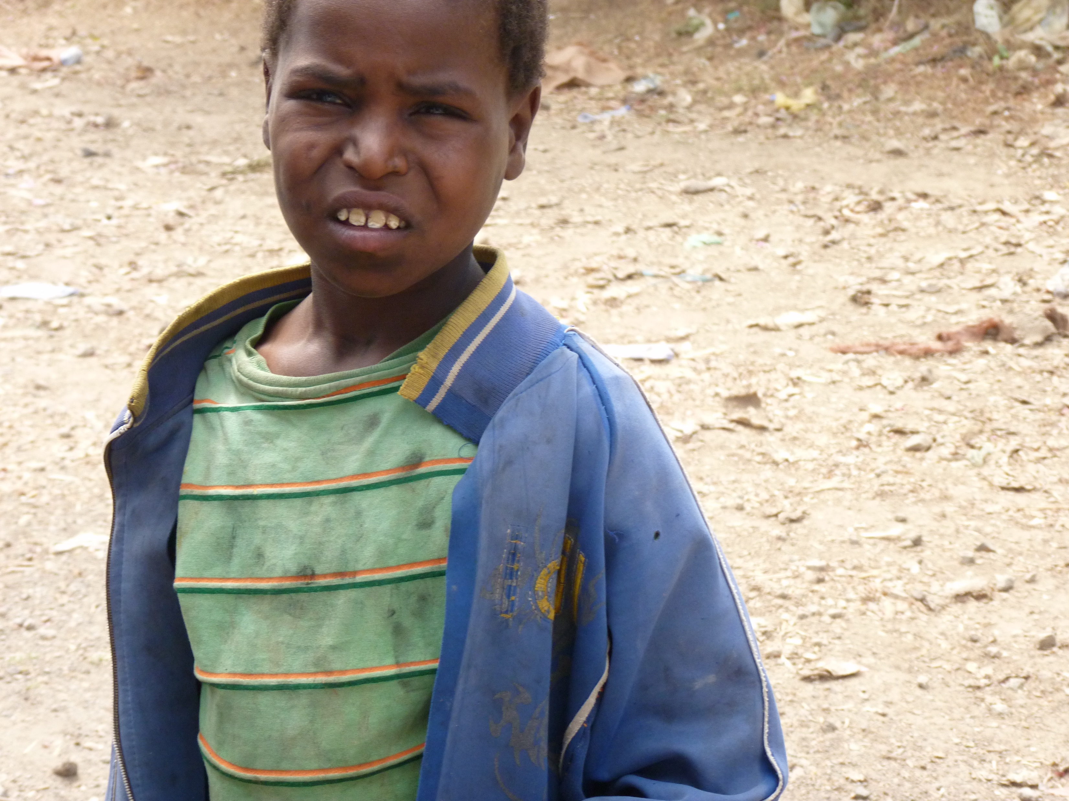

Slide 24
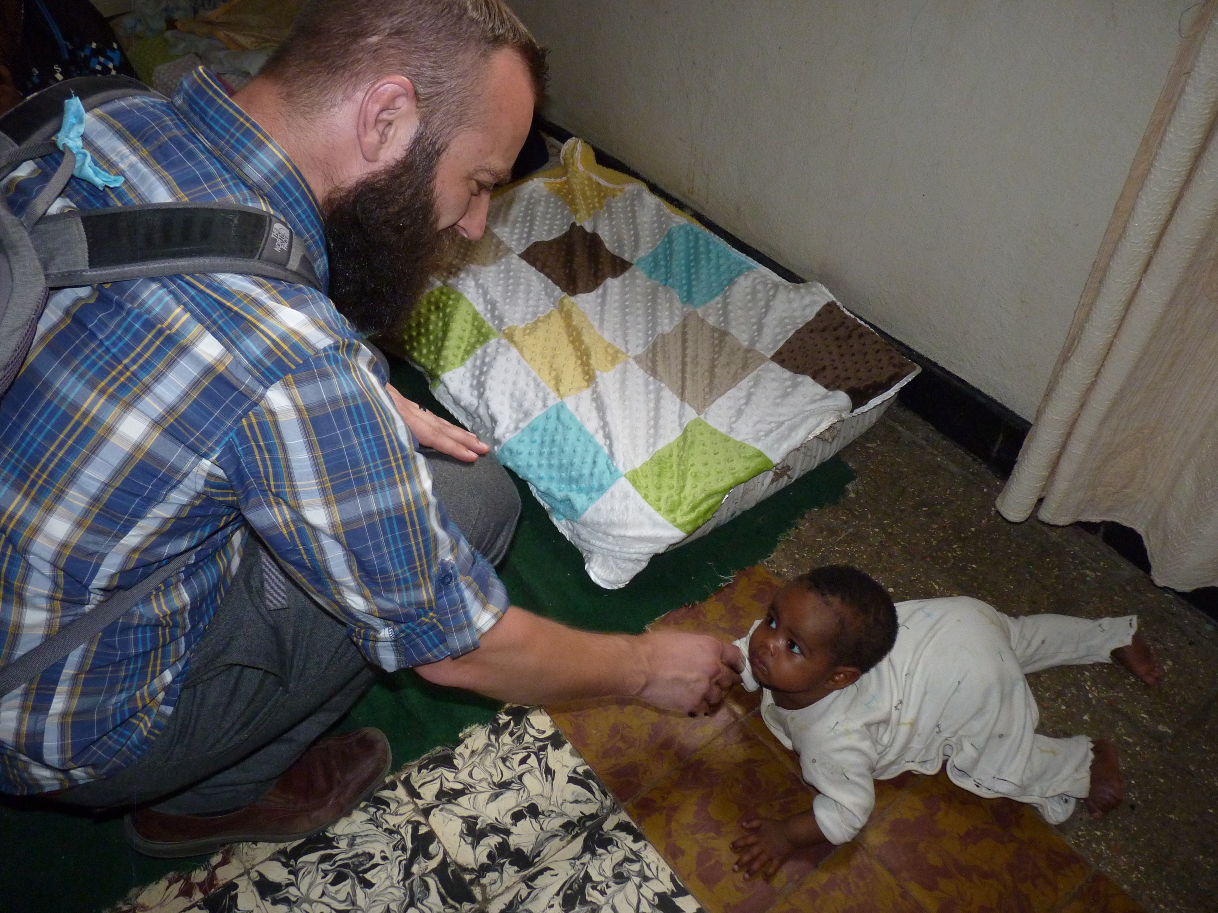

Slide 25
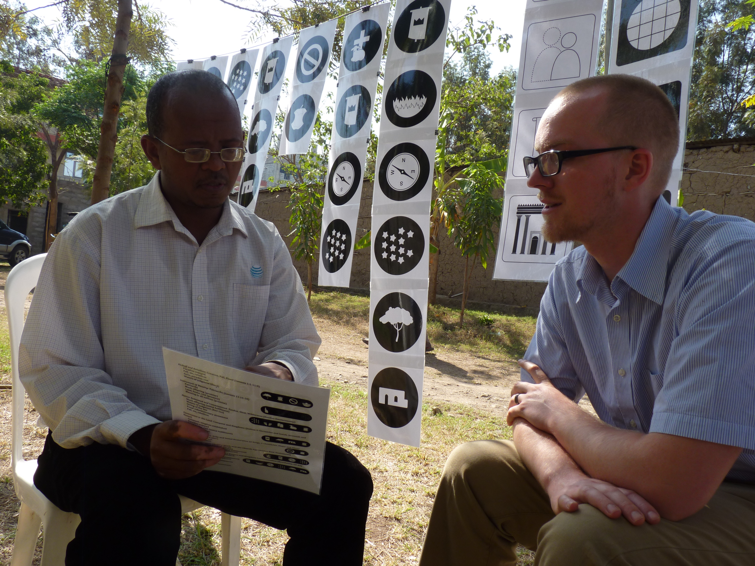

Slide 26
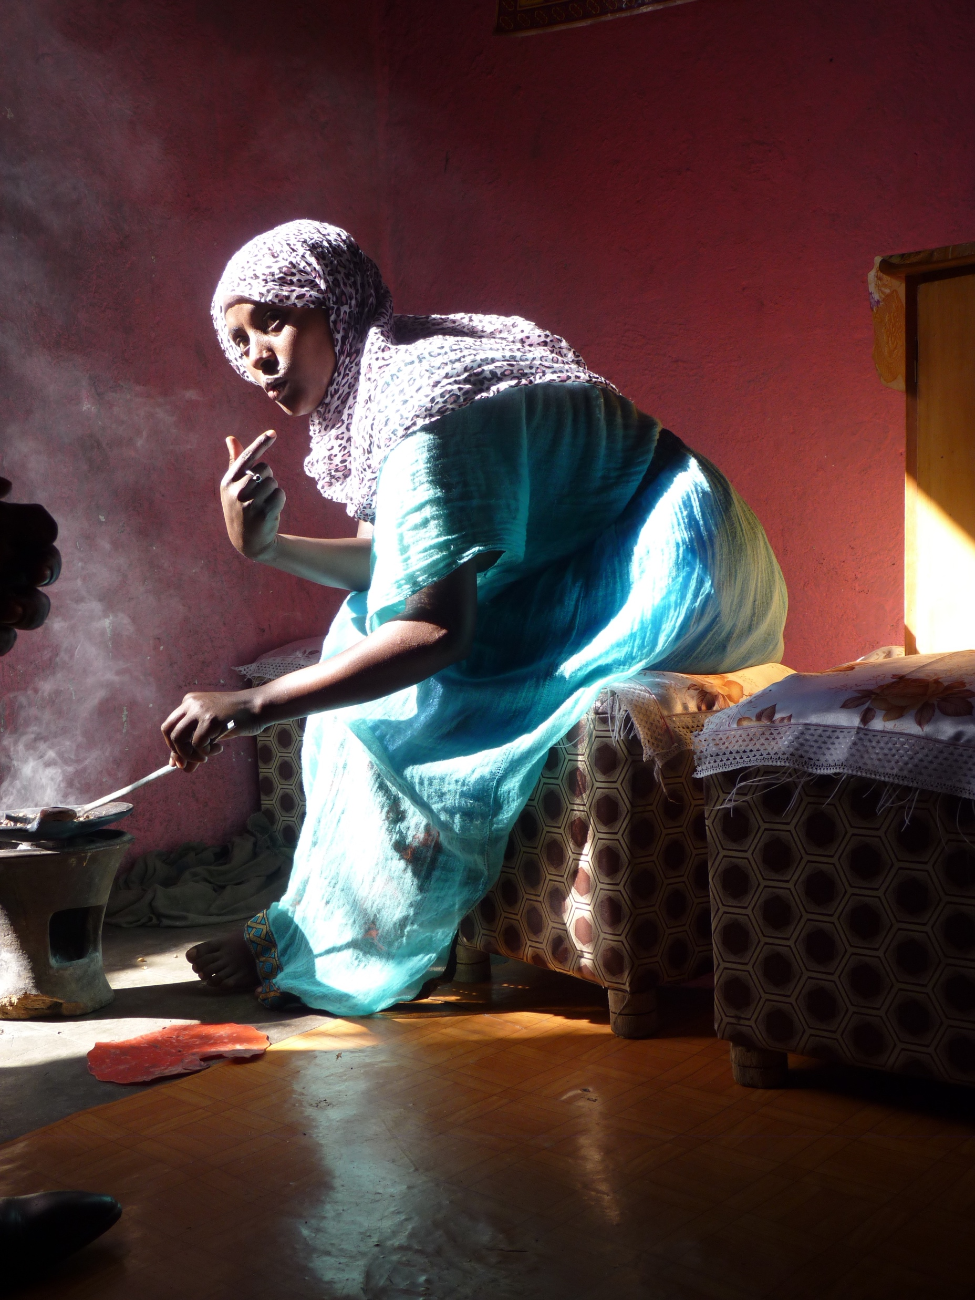

Slide 27
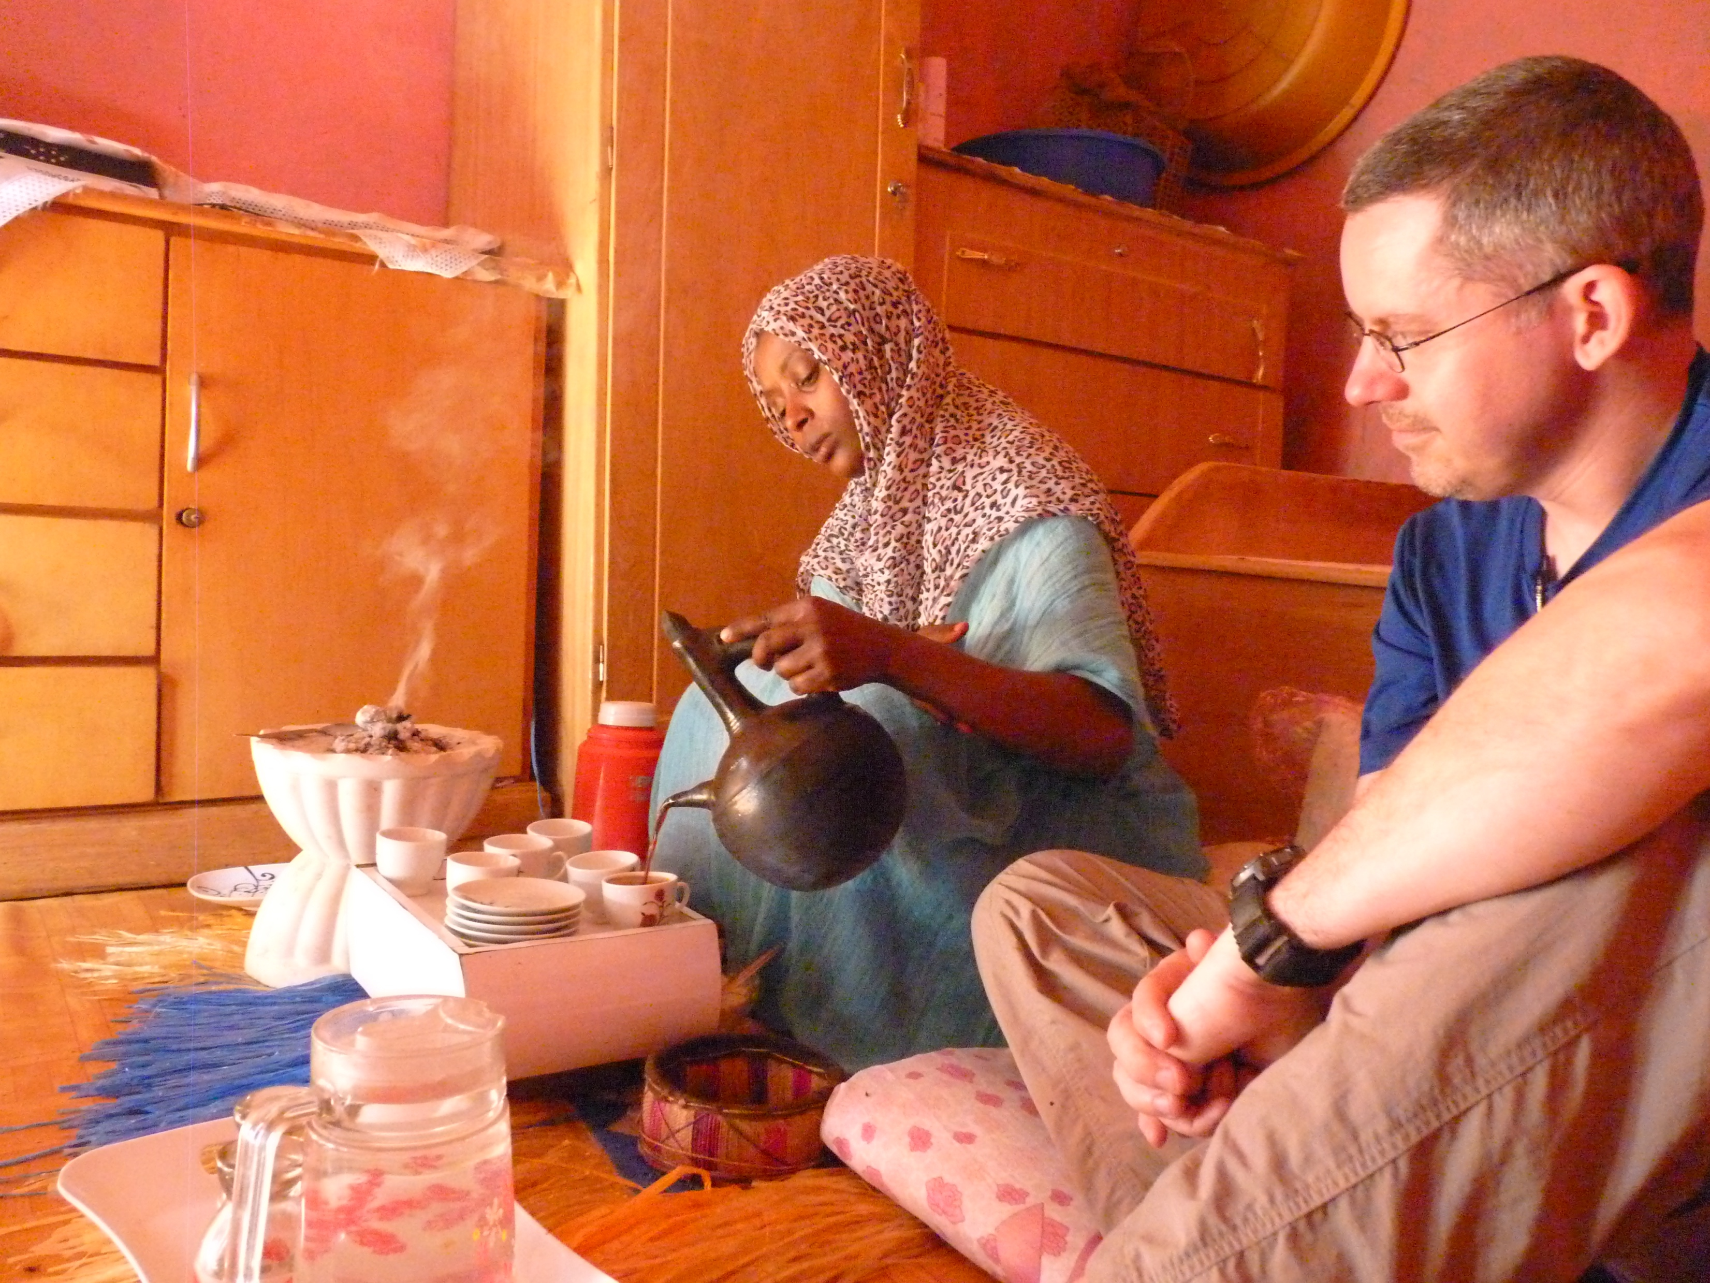

Slide 28
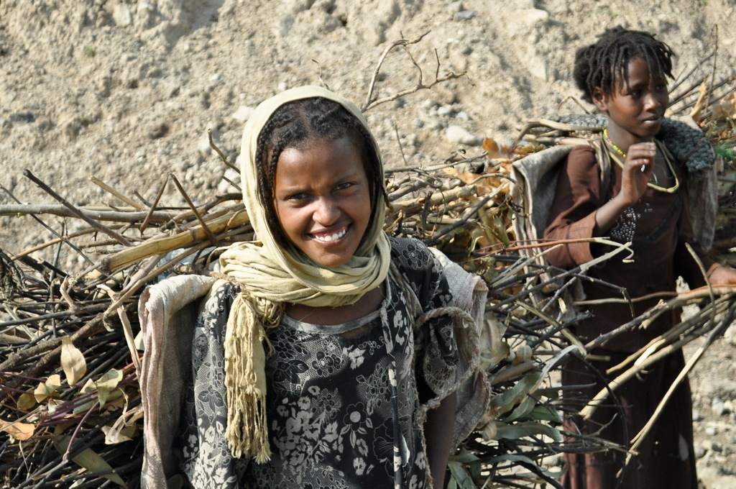

Slide 29
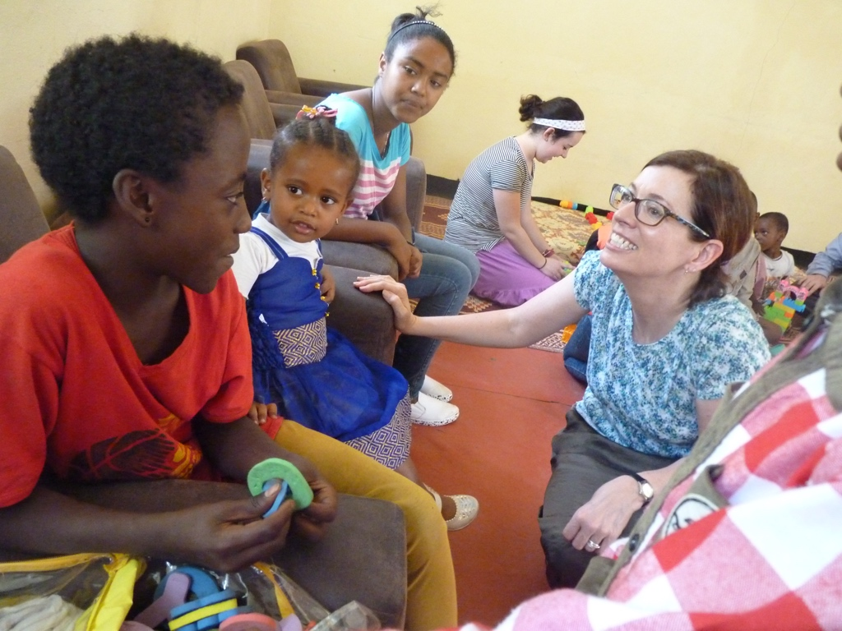

Slide 30
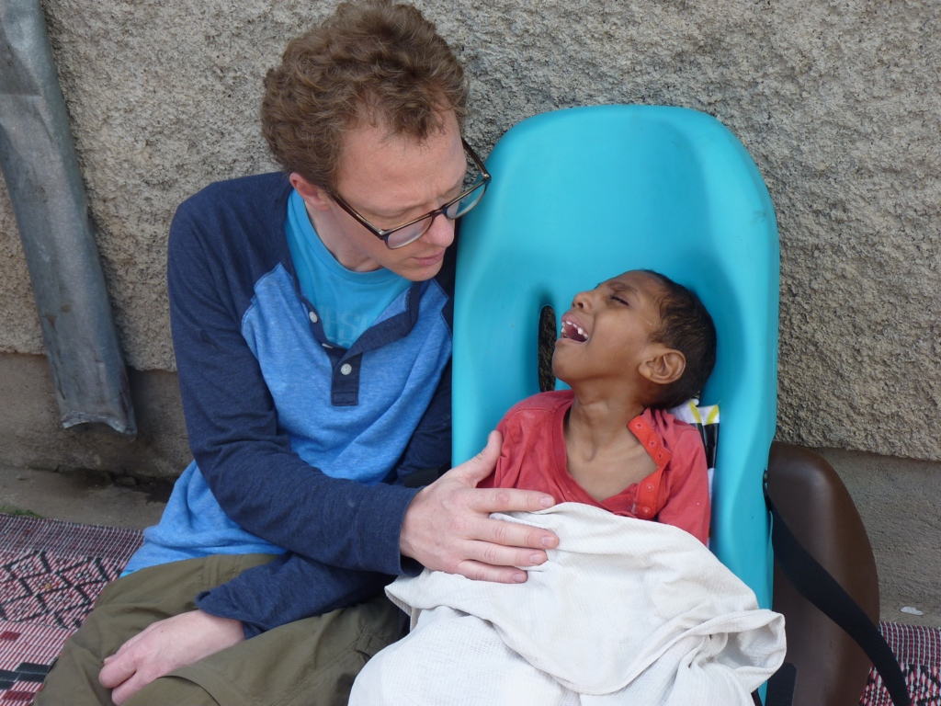

Slide 31
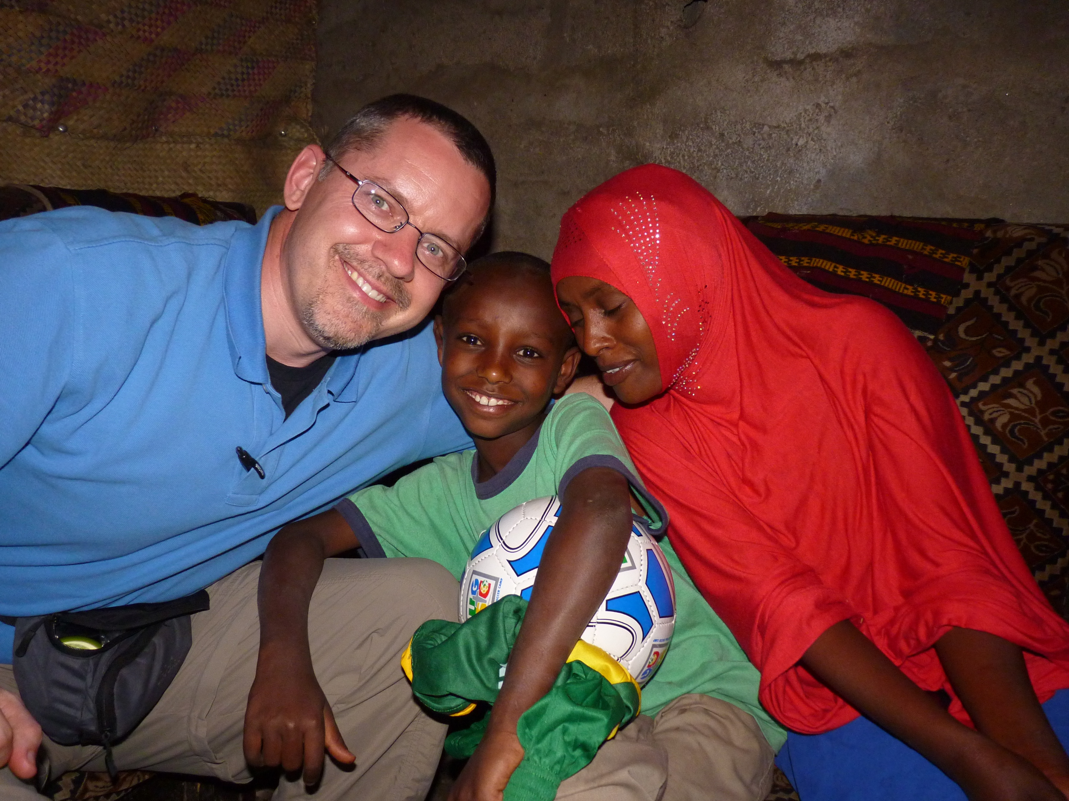

Slide 32
Fact Check
The Global South is at present the location of the church’s greatest growth.
The Global South includes 2.6 billion people who live on less that $2.00 per day.
Per Capita Income in 2012
Congo ($400.00/year) | Uganda ($1,400.00/year)
Somalia ($600.00/year) | Nigeria ($2,700.00/year)
Ethiopia ($1,200.00/year) | Pakistan ($2,900.00/year)
Haiti ($1,300.00/year)

Slide 33
The church of the 21st century will be a church of the poor.
The Great Commission of the 21st century will largely consist of very poor people bringing the gospel to very poor people.

Slide 34
God uses the poor for his purposes.
1Cor 1:26–29. For consider your calling, brothers: not many of you were wise according to worldly standards, not many were powerful, not many were of noble birth. But God chose what is foolish in the world to shame the wise; God chose what is weak in the world to shame the strong; God chose what is low and despised in the world, even things that are not, to bring to nothing things that are, so that no human being might boast in the presence of God.

Slide 35
2 Cor 4:7. But we have this treasure in jars of clay, to show that the surpassing power belongs to God and not to us.
Jas 2:5. Listen, my beloved brothers, has not God chosen those who are poor in the world to be rich in faith and heirs of the kingdom, which he has promised to those who love him?

Slide 36
The Text That Changed Me
Deut 10:12–13, 16–19. And now, Israel, what does the LORD your God require of you, but to fear the LORD your God, to walk in all his ways, to love him, to serve the LORD your God with all your heart and with all your soul, and to keep the commandments and statutes of the LORD, which I am commanding you today for your good? … Circumcise therefore the foreskin of your heart, and be no longer stubborn. For the LORD your God is God of gods and Lord of lords, the great, the mighty, and the awesome God, who is not partial and takes no bribe. He executes justice for the fatherless and the widow, and loves the sojourner, giving him food and clothing. Love the sojourner, therefore, for you were sojourners in the land of Egypt.

Slide 37
Why Must We Engage in Mercy Ministry?
Key Texts:
  Exod 22:21; 23:9; Deut 10:12–13, 18–19; 15:7–8, 24:17–18, 21–22
  Ps 41:1; Prov 14:31; 19:17; Jer 9:23–24; Matt 5:43–48; Luke 6:35–36
  Matt 25:31–46
  2 Cor 8:1–2, 8–14, 24; 9:5–15
  Gal 2:9–10; 1 John 3:16–19, 23–24; Jas 1:22, 27
  Jas 2:1–18

Slide 38
Why Must We Engage in Mercy Ministry?
Carrying out the gospel ministry Christ initiated, God calls us to remember the poor.
  Luke 4:18–19. The Spirit of the Lord is upon me, because he has anointed me to proclaim good news to the poor. He has sent me to proclaim liberty to the captives and recovering of sight to the blind, to set at liberty those who are oppressed, ¹⁹ to proclaim the year of the Lord’s favor.
  Gal 2:9–10. They gave the right hand of fellowship to Barnabas and me, that we should go to the Gentiles and they to the circumcised. ¹⁰ Only, they asked us to remember the poor, the very thing I was eager to do.

Slide 39
  1 John 3:17. But if anyone has the world’s goods and sees his brother in need, yet closes his heart against him, how does God’s love abide in him?

Slide 40
Our care for the poor is a necessary consequence of our personal experience of gospel grace.
  2 Cor. 8:9. For you know the grace of our Lord Jesus Christ, that though he was rich, yet for your sake he became poor, so that you by his poverty might become rich.
  2 Cor. 9:13. By their approval of this service, they will glorify God because of your submission that comes from your confession of the gospel of Christ, and the generosity of your contribution for them and for all others.

Slide 41
Loving and following God necessitates that we delight in what he delights and go where he goes, which includes care for the poor.
  Matt. 5:43–45. You have heard that it was said, ‘You shall love your neighbor and hate your enemy.’ But I say to you, Love your enemies and pray for those who persecute you, so that you may be sons of your Father who is in heaven. For he makes his sun rise on the evil and on the good, and sends rain on the just and on the unjust.
  Luke 6:35–36. But love your enemies, and do good, and lend, expecting nothing in return, and your reward will be great, and you will be sons of the Most High, for he is kind to the ungrateful and the evil. Be merciful, even as your Father is merciful.

Slide 42
In loving the poor, we are manifesting and proving our love for Christ.
  Matt. 25:40. And the King will answer them, ‘Truly, I say to you, as you did it to one of the least of these my brothers, you did it to me.’
  2 Cor. 8:8. I say this not as a command, but to prove by the earnestness of others that your love also is genuine.

Slide 43
Failure to extend mercy to needy believers identifies that we ourselves are not believers and liable for severe judgment.
  Matt 25:41–42, 45. Then he will say to those on his left, “Depart from me, you cursed, into the eternal fire prepared for the devil and his angels. For I was hungry and you gave me no food, I was thirsty and you gave me no drink.” … Then he will answer them, saying, “Truly, I say to you, as you did not do it to one of the least of these, you did not do it to me.”
  2 Cor 8:7–8; 9:13. Excel in this act of grace also … ⁸ to prove … that your love also is genuine…. ^{9:13} By their approval of this service, they will glorify God because of your submission that comes from your confession of the gospel of Christ.

Slide 44
  Jas 2:12–13. So speak and so act as those who are to be judged under the law of liberty. For judgment is without mercy to one who has shown no mercy. Mercy triumphs over judgment.

Slide 45
Care for the poor serves as a pointer to the eternal-saving grace of the gospel and supplies a context from which to evangelize, speaking of relief from eternal suffering.
  Matt 5:16. In the same way, let your light shine before others, so that they may see your good works and give glory to your Father who is in heaven.
  Jesus’ feeding of the 5,000 suppled a context from which he could point to himself as the true manna, the living that we must eat to satisfy our souls (John 6:14, 27, 35).
  Jesus’ healing of the blind man suppled a framework for his reception of spiritual sight and a context for Jesus to castigate spiritual blindedness (John 9:1–7, 35–41).

Slide 46
Through care for the poor we are declaring and demonstrating the already elements of Jesus’s declaring, “I am making all things new.”
  Rev. 21:5. And he who was seated on the throne said, “Behold, I am making all things new.” Also he said, “Write this down, for these words are trustworthy and true.”
  2Cor. 5:17. Therefore, if anyone is in Christ, he is a new creation. The old has passed away; behold, the new has come.
  Col. 1:20. … And through him to reconcile to himself all things, whether on earth or in heaven, making peace by the blood of his cross.

Slide 47
  Rev. 7:15–17. Therefore they are before the throne of God, and serve him day and night in his temple; and he who sits on the throne will shelter them with his presence. They shall hunger no more, neither thirst anymore; the sun shall not strike them, nor any scorching heat. For the Lamb in the midst of the throne will be their shepherd, and he will guide them to springs of living water, and God will wipe away every tear from their eyes.

