Slide 1
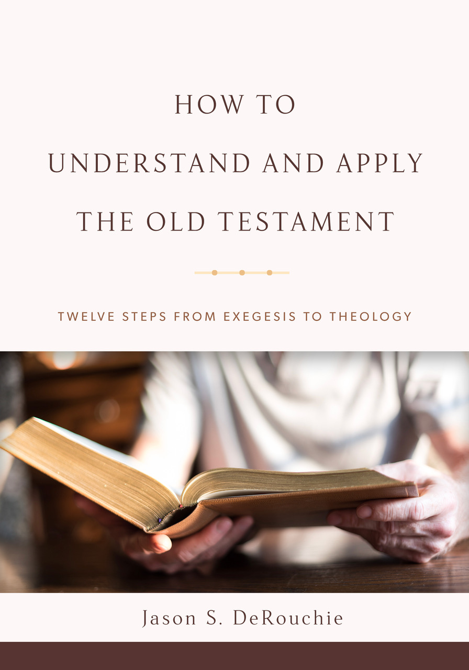
HOW TO
UNDERSTAND AND APPLY
THE OLD TESTAMENT
TWELVE STEPS FROM EXEGESIS TO THEOLOGY
Jason S. DeRouchie, PhD
Professor of Old Testament and Biblical Theology
Bethlehem College & Seminary
Elder, Bethlehem Baptist Church
Spring 2019

Slide 2
STEPS IN THE JOURNEY
Part 1: Text
Part 2: Observation
Part 3: Context – “Where does the passage fit?”
  Historical Context
  Literary Context
Part 4: Meaning
Part 5: Application

Slide 3
9. LITERARY CONTEXT
Goal: Comprehend the role that the passage plays in the whole book.
Grasping Literary Context
A Case Study in Literary Placement: Ps 121
A Case Study in Literary Function: The Twelve

Slide 4
Grasping Literary Context
Literary Placement: A passage’s location.
  Key Questions:
    Is the passage part of a larger literary grouping that has a discernible beginning, middle, or end?
    What leads up to the passage?
    What flows from it?
    How is the book organized, and how does the passage fit within the section of the section, book, canonical division, Testament, and Bible––in that order?

Slide 5
  The Literary Placement of Daniel 3:
    Within the book’s overall structure:
      God’s sovereign control in the present (Dan 1–6): Court stories about the exaltation of Daniel and his three friends, all of which stress that, while not always clear in the present, Israel’s God is sovereign over all things and is working for his own against the world’s rebellion.
      God’s sovereign control in the future (Dan 7–12): Apocalyptic visions about the rise and fall of succeeding empires, all of which emphasize that, while not always clear in the future, Israel’s God is controlling all things according to his purposes and will ultimately establish his kingdom through the Messiah, destroying evil.

Slide 6
    Within the section:
      God’s sovereign control in the present (Dan 1–6):
        Introduction: Preservation of a Remnant (ch. 1)
        Nebuchadnezzar’s statue dream (ch. 2)
        The fiery furnace (ch. 3)
        Nebuchadnezzar’s judgment and restoration (ch. 4)
        Handwriting on the wall (ch. 5)
        Daniel in the lion’s dean (ch. 6)
      God’s sovereign control in the future (Dan 7–12)

Slide 7
    Within Jesus’s Bible:
Law (Established) | Prophets (Enforced) |  | Writings (Enjoyed)
 | Former | Latter | Former | Latter
Genesis | Joshua | Jeremiah | Ruth | Daniel
Exodus | Judges | Ezekiel | Psalms | Esther
Leviticus | 1–2 Samuel | Isaiah | Job | Ezra-Nehemiah
Numbers | 1–2 Kings | The Twelve | Proverbs | 1–2 Chronicles
Deuteronomy |  |  | Ecclesiastes
 |  |  | Song of Songs
 |  |  | Lamentations
Narrative | Narrative | Commentary | Commentary | Narrative

Slide 8
    Within Jesus’s Bible:
      Lam 5:19, 22–23. But you, O LORD, reign forever; your throne endures to all generations…. Renew our days as of old––unless you have utterly rejected us, and you remain exceedingly angry with us.”
      Dan 2:20–21, 44, 47. Daniel answered and said: “Blessed be the name of God forever and ever, to whom belong wisdom and might. He changes times and season; he removes kings and sets up kings; he gives wisdom to the wise and knowledge to those who have understanding…. And in the days of those kings the God of heaven will set up a kingdom that shall never be destroyed, nor shall the kingdom be left to another people. It shall break in pieces all these kingdoms and bring them to an end, and it shall stand forever.” … The king answered and said to Daniel, “Truly, your God is God of gods and Lord of kings, and a revealer of mysteries.”

Slide 9
Literary Function: A passage’s purpose and contribution.
  Key Questions:
    What is the main thrust of the book as a whole, and what role does this particular passage play in the book’s storyline or reasoning?
    Does the passage fill in, add on to, introduce, bring to completion, or counterbalance the portion or book of which it is a part?
    What does it add to the overall picture?
    What does the overall picture add to it?
    If this passage were missing from the book, what would be lost?

Slide 10
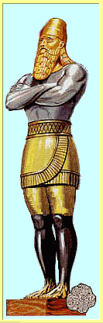
  The Literary Function of Daniel 3:
    In Dan 2, King Nebuchadnezzar dreamed of a statue with four parts, each of which represented an earthly kingdom that would ultimately be overthrown by God’s kingdom that would never perish (Dan 2:44). Babylon, led by Nebuchadnezzar, was the first of these kingdoms (2:37–38).
    In Dan 3, Nebuchadnezzar seeks not only be the head of gold but the whole statue, and he erects a massive image of himself that all peoples, nations, and languages were to worship, lest they be immediately cast into a blazing furnace (3:1–7).

Slide 11
    Daniel’s three friends, Shadrach, Meshach, and Abednego, were unrelentingly committed to Yahweh and refused to bow down (3:16–18), resulting in their punishment. But they were not burned, for one “like a son of the gods” protected them (3:25).
    Therefore, Nebuchadnezzar declared them to be “servants of the Most High God” (3:26), praised their God for this mighty act (3:28), and then decreed that none should speak against their God (3:29).
    Daniel 3 plays a key part in showing how Nebuchadnezzar was growing in his awareness of Yahweh’s sovereign control of the present. And this recognition would only grow until in Dan 4:37 we read, “Now I, Nebuchadnezzar, praise and extol and honor the King of heaven, for all his works are right and his ways are just; and those who walk in pride he is able to humble.”

Slide 12
Literary Details: The particular aspects of a passage that set it apart and that help identify its overall contribution.
  Key Questions:
    How comprehensive or selective is the passage?
    Do any details help you decide whether or not the author wrote it in connection with a specific cultural or historical situation?
    Does the passage relay material from a distinctive perspective? What does this tell you about the author’s intentions?

Slide 13
  The Literary Details of Daniel 3:
    The biblical author clearly wrote Dan 3 to remind the audience of Yahweh’s greatness and worth and of his ability to save either rout of suffering or through suffering.
    Nebuchadnezzar’s initial pride in questioning the three, “Who is the god who will deliver out of my hands?” (3:15), is contrasted with is later declaration, “There is no other god who is able to rescue in this way” (3:29).

Slide 14
    The king’s initial challenge is also countered by Shadrach, Meshach, and Abednego’s relentless commitment to the true God and their confidence that he was able to rescue: “Our God who we serve is able to deliver us from the burning fiery furnace, and he will deliver us out of your hand, O king. But if not, be it known to you, O king, that we will not serve your gods or worship the golden image that you have set up” (Dan 3:17–18). We are thus forced to ask, Will we equally surrender to the supreme Sovereign and Savior in the story?

Slide 15
    When Dan 3 is read in light of the whole book, the emphasis that one “like a son of the gods” protected the three in the furnace (3:25) likely anticipates the “one like a son of man” in 7:13–14––the one who will reign over God’s kingdom.
    Later this figure is probably tagged as the “Messiah,” during whose ministry God intends “to finish the transgression, to put an end to sin, and to atone for iniquity, to bring in everlasting righteousness, to seal both vision and prophet, and to anoint a most holy place” (9:24). So Dan 3 does not merely add general hope in a delivering God; it also fuels anticipation for the Messiah’s reign!

Slide 16
A Case Study in Literary Placement: Psalm 121
Main idea and outline: The psalmist calls others to join him in celebrating Yahweh’s guardianship in their lives.
  The Personal Celebration of Yahweh’s Guardianship (vv. 1–2)
    The posture of the guarded (v. 1)
    The confidence of the guarded (v. 2)
  The Assurance to Others of Yahweh’s Guardianship (vv. 3–6)
    The nature of Yahweh’s guardianship declared (vv. 3–4)
      The ensurer of our perseverance (v. 3a)
      The constant watcher over his own (vv. 3b–4)
    The nature of Yahweh’s guardianship expounded (vv. 5–8)
      His identity: the ever-present defender (vv. 5–6)
      His actions: the life-preserver and lasting protector (vv. 7–8)

Slide 17
The placement of Ps 121 in:
  The Writings (former and latter)
  The Psalter (5 books)
  The 5th book of the Psalter (Pss 107–150)
  The Songs of Ascent (Pss 120–134)

Slide 18
A Case Study in Literary Function: The Twelve
The Function of the “Sin” Prophets
  Hosea: Israel, Yahweh has a case against you: You have played the harlot and been like an unfaithful wife, departing from faithfulness, steadfast love, and knowledge. Please return to Yahweh, your husband!
  Joel: For the Day of Yahweh is at hand, and repentance is your only hope! I will be a refuge to my people, but a roaring, devouring lion against all who fail to heed my voice!
  Amos: How secure you feel, yet how insecure you actually are! I have disciplined you, yet you have not learned from the discipline. You anticipate my coming, but for you this Day will be darkness, not light. Prepare to meet your God, for the fulfillment of my kingdom promises is only for those who truly repent!

Slide 19
  Obadiah: Know this: Pride and hatred have no place in my coming kingdom; this is why your brother Edom will be destroyed.
  Jonah: Yet be warned, for your own pride and hatred of others resembles that of Edom and stands in direct contrast to the mercy Yahweh gives to whomever he wills. Don’t be like Jonah; be like Yahweh and extend compassion rather than gloating in others’ destruction, lest God’s judgment fall on you!
  Micah: Yahweh, from his courtroom, has found you and the nations guilty! Yet your final judgment Day has not come, and in his mercy, he will still forgive your sins, if you but return. Soon God, through his Word and Messiah, will be exalted over all things. Will you be a part of the judgment or the redemption?

Slide 20
The Function of the “Punishment” Prophets
  Nahum: Know this for certain: Yahweh is a stronghold only for those who accept his terms of peace, but he will justly judge all his unrepentant enemies.
  Habakkuk: Yahweh is just, and in his time he will indeed punish all wrongdoers and preserve all who walk by faith, looking to him for help, guidance, and satisfaction.
  Zephaniah: Please be part of the remnant that draws near to God, so that the coming Day may be one of rejoicing! Yet for all who fail to heed God’s voice, the Day of Yahweh the warrior will be sure destruction!

Slide 21
The Function of the “Restoration” Prophets
  Haggai: Drawing near to God necessitates that you take seriously the need for his presence in your midst, that he might bring forth the fulfillment of all he has promised, blessing for you and for the nations who surrender to him.
  Zechariah: You need God’s presence among you, for his kingdom restoration will be brought not by human effort but by the power of his Spirit working through his slain and yet victorious priest-king.
  Malachi: This restoration is for you, if you will but fear and honor God in all areas of your life, awaiting the day when curse will give rise to full restoration blessing!

