Slide 1
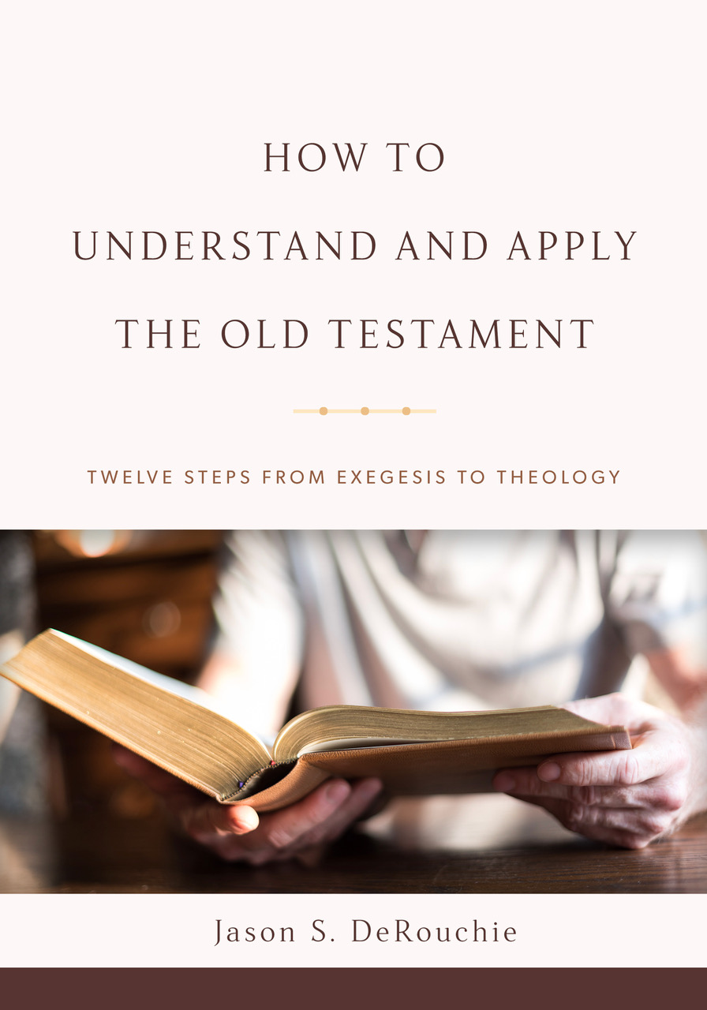
HOW TO
UNDERSTAND AND APPLY
THE OLD TESTAMENT
TWELVE STEPS FROM EXEGESIS TO THEOLOGY
Jason S. DeRouchie, PhD
Professor of Old Testament and Biblical Theology
Bethlehem College & Seminary
Elder, Bethlehem Baptist Church
Spring 2019

Slide 2
STEPS IN THE JOURNEY
Part 1: Text
Part 2: Observation
Part 3: Context – “Where does the passage fit?”
  Historical Context
  Literary Context
Part 4: Meaning
Part 5: Application

Slide 3
8. HISTORICAL CONTEXT
Goal: Understand the historical situation from which the author composed the text and identify any historical details the author mentions or assumes.
Introduction to Assessing Historical Context
Key Spheres for Historical Context
Guidelines for Engaging Historical Context
The Historical Context of 1 Samuel 13:14

Slide 4
Introduction to Assessing Historical Context
The nature of historical context:
  Where does this passage fit in space and time, and how does this information impact my interpretation?
  Historical context often includes shared assumptions between author and audience––knowledge that they took for granted but which we may not be privy.
  Sample historical context questions?

Slide 5
The Key Questions for Assessing Historical Context
  Who? The authorship, audience, major figures and powers
  Where? The physical location and geography
  When? The original date of the message in relation to periods, powers, and events
  Why? The cause and purpose of the message
  How? The genre and thought flow: Why did he say it that way?

Slide 6
  What? What is said and assumed with respect to:
    Linguistic familiarity: Hebrew, Aramaic, Greek
    Worldview: shared values, perspectives, mind-set, outlook
    Societal and economic systems: common history of families or groups, marriage and family patterns, gender roles, social status, ethnicity, trades and vocations, slavery, wealth and poverty
    Behavioral patterns: dress and community or family customs
    Political climate: governmental power centers, structures, loyalties, personnel
    Religious practices: Convictions, rituals, affiliations, personnel and sacred structures associated with Israel or her neighbors worship
    Physical features: climate and weather, topography, architecture, transportation, plants and animals

Slide 7
Shared Assumptions and the Bible’s Clarity
  A Question: How much historical context information is necessary as we approach the biblical text? We must ask, “Are there clues in the literary context that certain historical data are important?”
  An Example: When we read that Ezra journeyed from Babylon to Jerusalem (Ezra 7:9), do we need to have in mind that the journey was about 900 miles (1,448 km) through a desert?
    The rest of Ezra-Nehemiah highlights that the distance between Babylon and Jerusalem was great and that this created a number of obstacles that the reader is expected to feel.
      It was only “because the good hand of his God was on him” that Ezra and his company made it safely to Jerusalem (Ezra 7:9).

Slide 8
      “Then I proclaimed a fast …, that we might humble ourselves before our God, to seek from him a safe journey for ourselves, our children, and all our goods. For I was shamed to ask the king for a band of soldiers and horsemen to protect us against the enemy on our way, since we had told the king, “The hand of our God is for good on all who seek him, and the power of his wrath is against all who forsake him” (Ezra 8:21–22)
    Ezra’s move from Babylon to Jerusalem was less like a journey across town and more akin to moving to a different state but doing so with camels, carts, and at least two thousand people (Ezra 8:1–20).
    Even if we don’t go outside the text to identify the specific 900 mile trek, there is enough in the text to highlight that the great distance is assumed and expected to be appreciated.

Slide 9
  Scripture’s clarity or “perspicuity”:
    The Bible is sufficiently clear, but not everything in it is equally clear. It is sufficiently clear to allow us to grasp the portrait of God’s supremacy and his overarching kingdom purposes climaxing in the saving work of Jesus, but other elements are less clear.

Slide 10
    Wayne Grudem has said, we can understand Scripture, but:
      Not all at once;
      Not without effort;
      Not without ordinary means;
      Not without the reader’s willingness to obey it;
      Not without the help of the Holy Spirit;
      Not without human misunderstanding;
      Never completely.
      *Grudem, “The Perspicuity of Scripture,” Themelios 34.3 (2009): 288–309.

Slide 11
Key Spheres for Historical Context
A proper grasp of linguistic signs
A detailed grasp of the persons, institutions, and events of Scripture
A general awareness of life in this created world (e.g., “ants,” Prov 6:6; “heavens,” Ps 19:1; “birds,” Matt 6:26, 28)
A proper approach to extrabiblical data
  E.g., Creation accounts

Slide 12
  E.g., The vision in Ezekiel 1
    Ezek 1:5–11. And from the midst of [the cloud] came the likeness of four living creatures. And this was their appearance: they had a human likeness, ⁶ but each had four faces, and each of them had four wings. ⁷ Their legs were straight, and the soles of their feet were like the sole of a calf’s foot. And they sparkled like burnished bronze. ⁸ Under their wings on their four sides they had human hands. And the four had their faces and their wings thus: ⁹ their wings touched one another. Each one of them went straight forward, without turning as they went. ¹⁰ As for the likeness of their faces, each had a human face. The four had the face of a lion on the right side, the four had the face of an ox on the left side, and the four had the face of an eagle. ¹¹ Such were their faces. And their wings were spread out above. Each creature had two wings, each of which touched the wing of another, while two covered their bodies….

Slide 13
  E.g., The vision in Ezekiel 1
    ²² Over the heads of the living creatures there was the likeness of an expanse, shining like awe-inspiring crystal, spread out above their heads…. ²⁶ And above the expanse over their heads there was the likeness of a throne, in appearance like sapphire; and seated above the likeness of a throne was a likeness with a human appearance. ²⁷ And upward from what had the appearance of his waist I saw as it were gleaming metal, like the appearance of fire enclosed all around. And downward from what had the appearance of his waist I saw as it were the appearance of fire, and there was brightness around him. ²⁸ Like the appearance of the bow that is in the cloud on the day of rain, so was the appearance of the brightness all around. Such was the appearance of the likeness of the glory of the LORD. And when I saw it, I fell on my face.

Slide 14
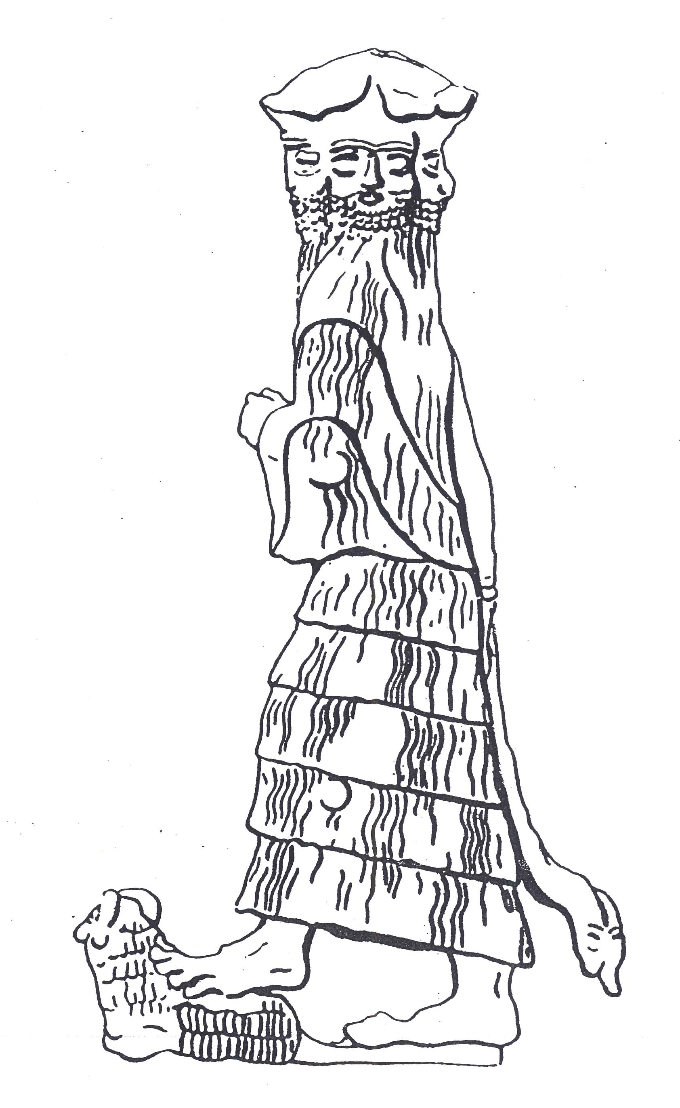
  E.g., The vision in Ezekiel 1
Three-faced divine image

Slide 15
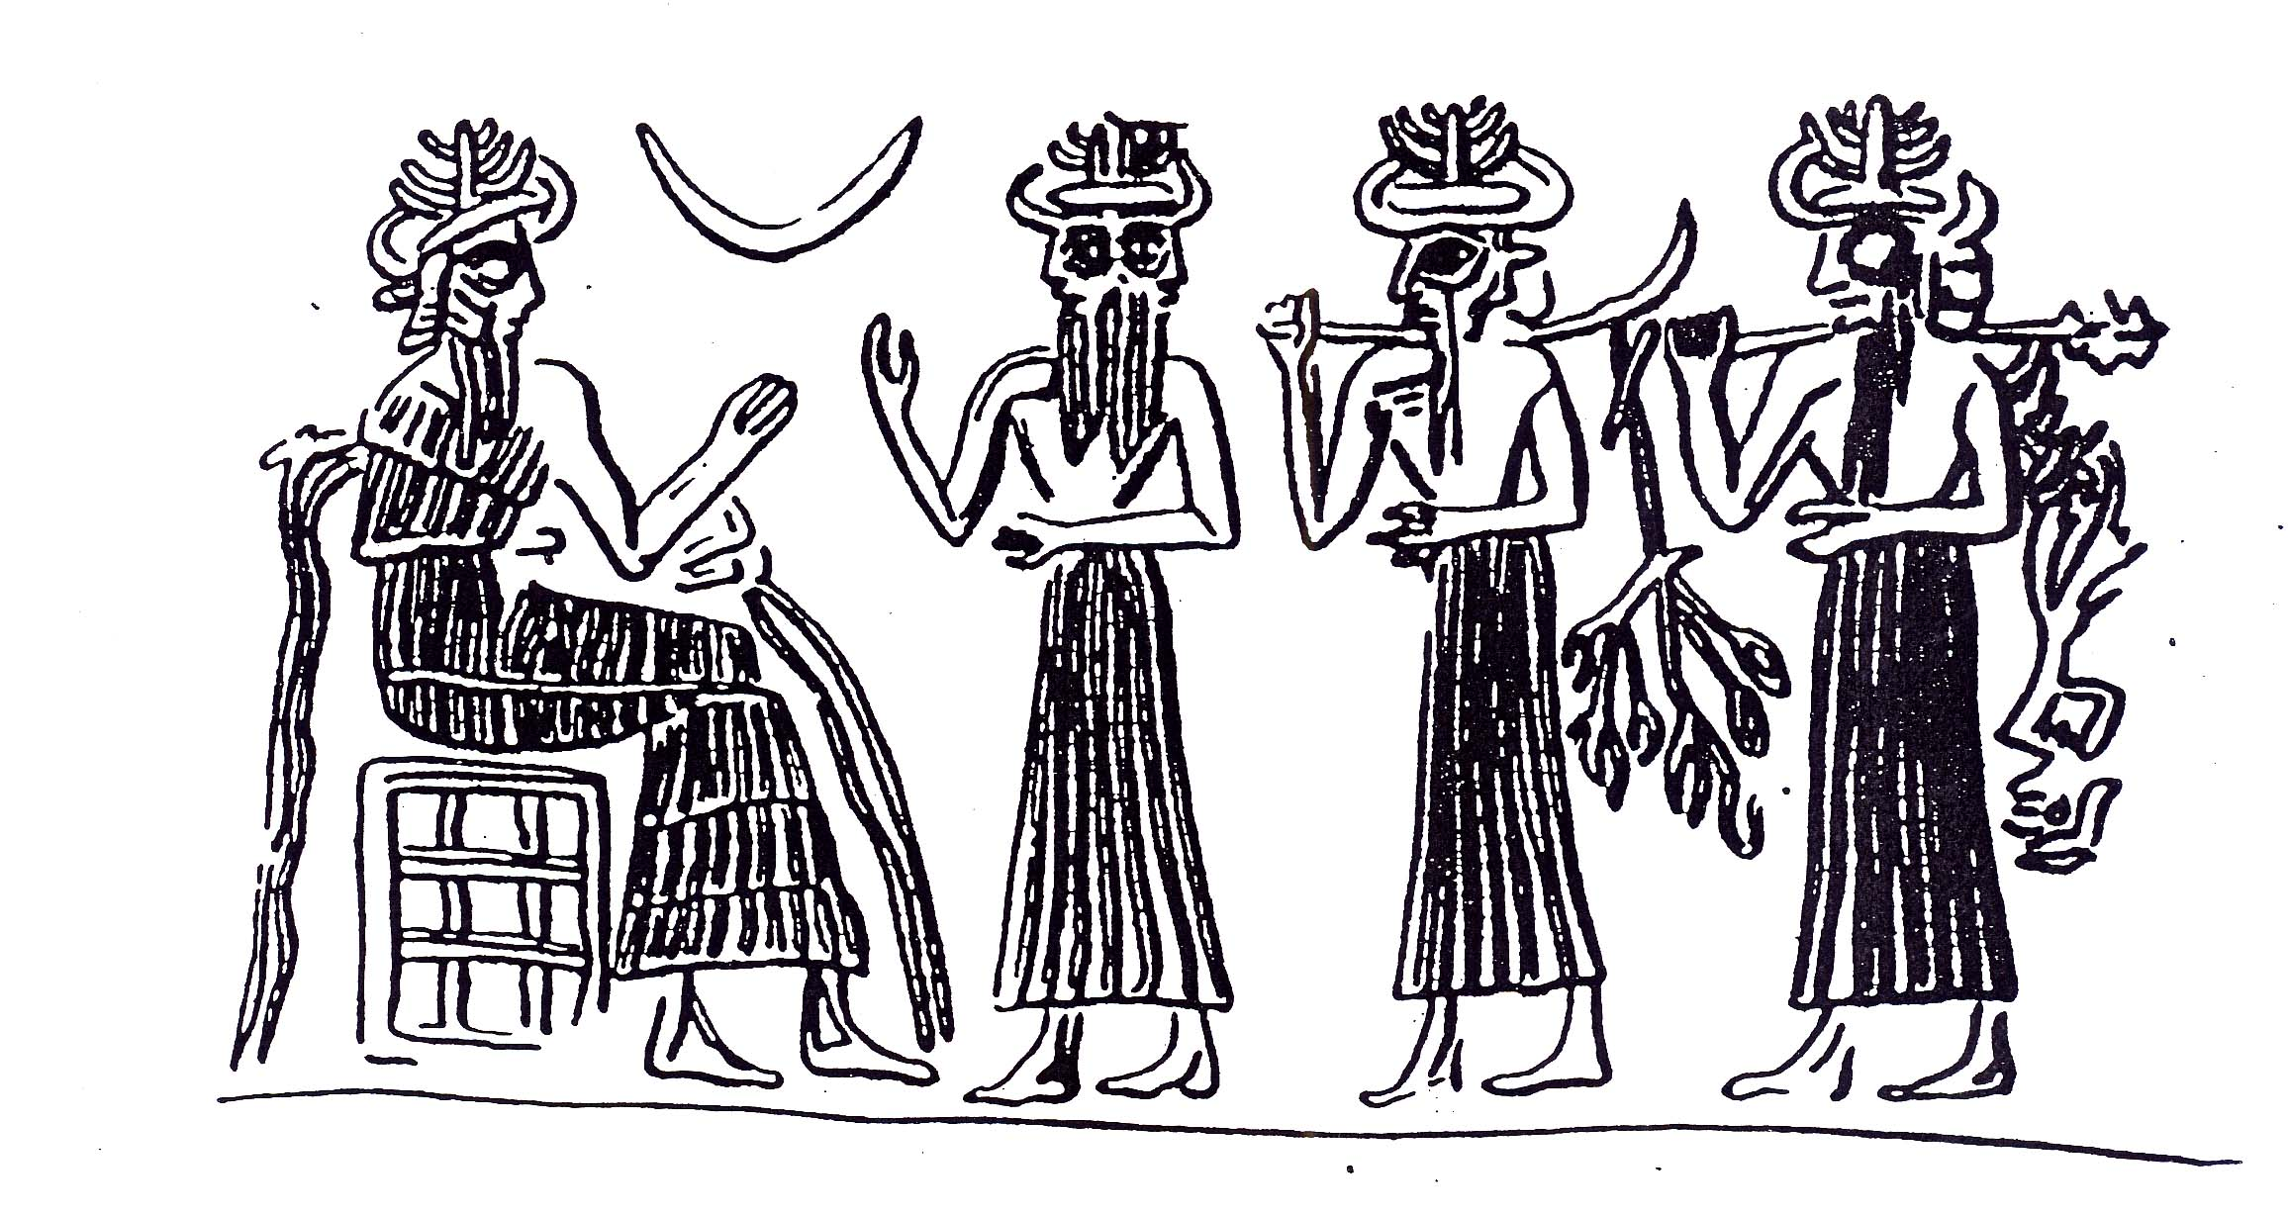
  E.g., The vision in Ezekiel 1
Two-faced divine image

Slide 16
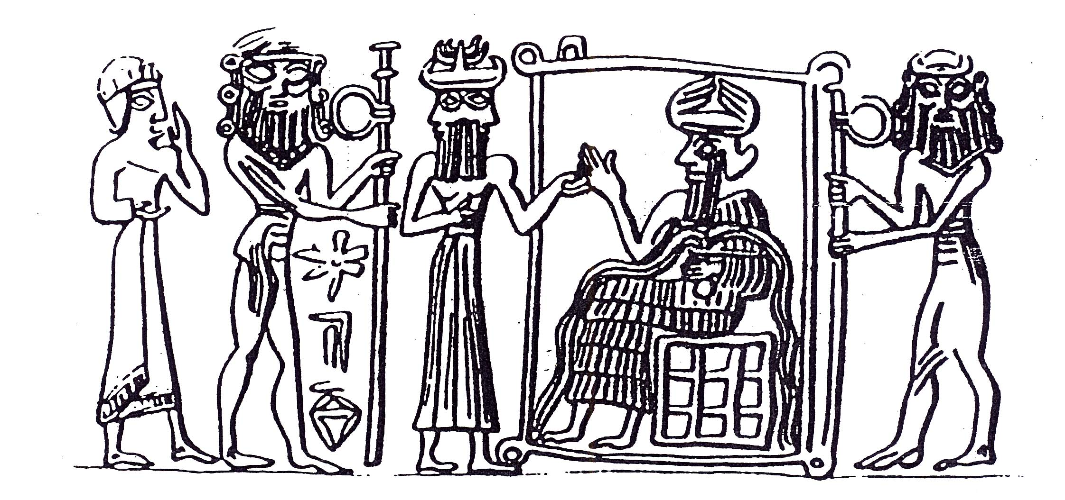
  E.g., The vision in Ezekiel 1
Two-faced divine image

Slide 17
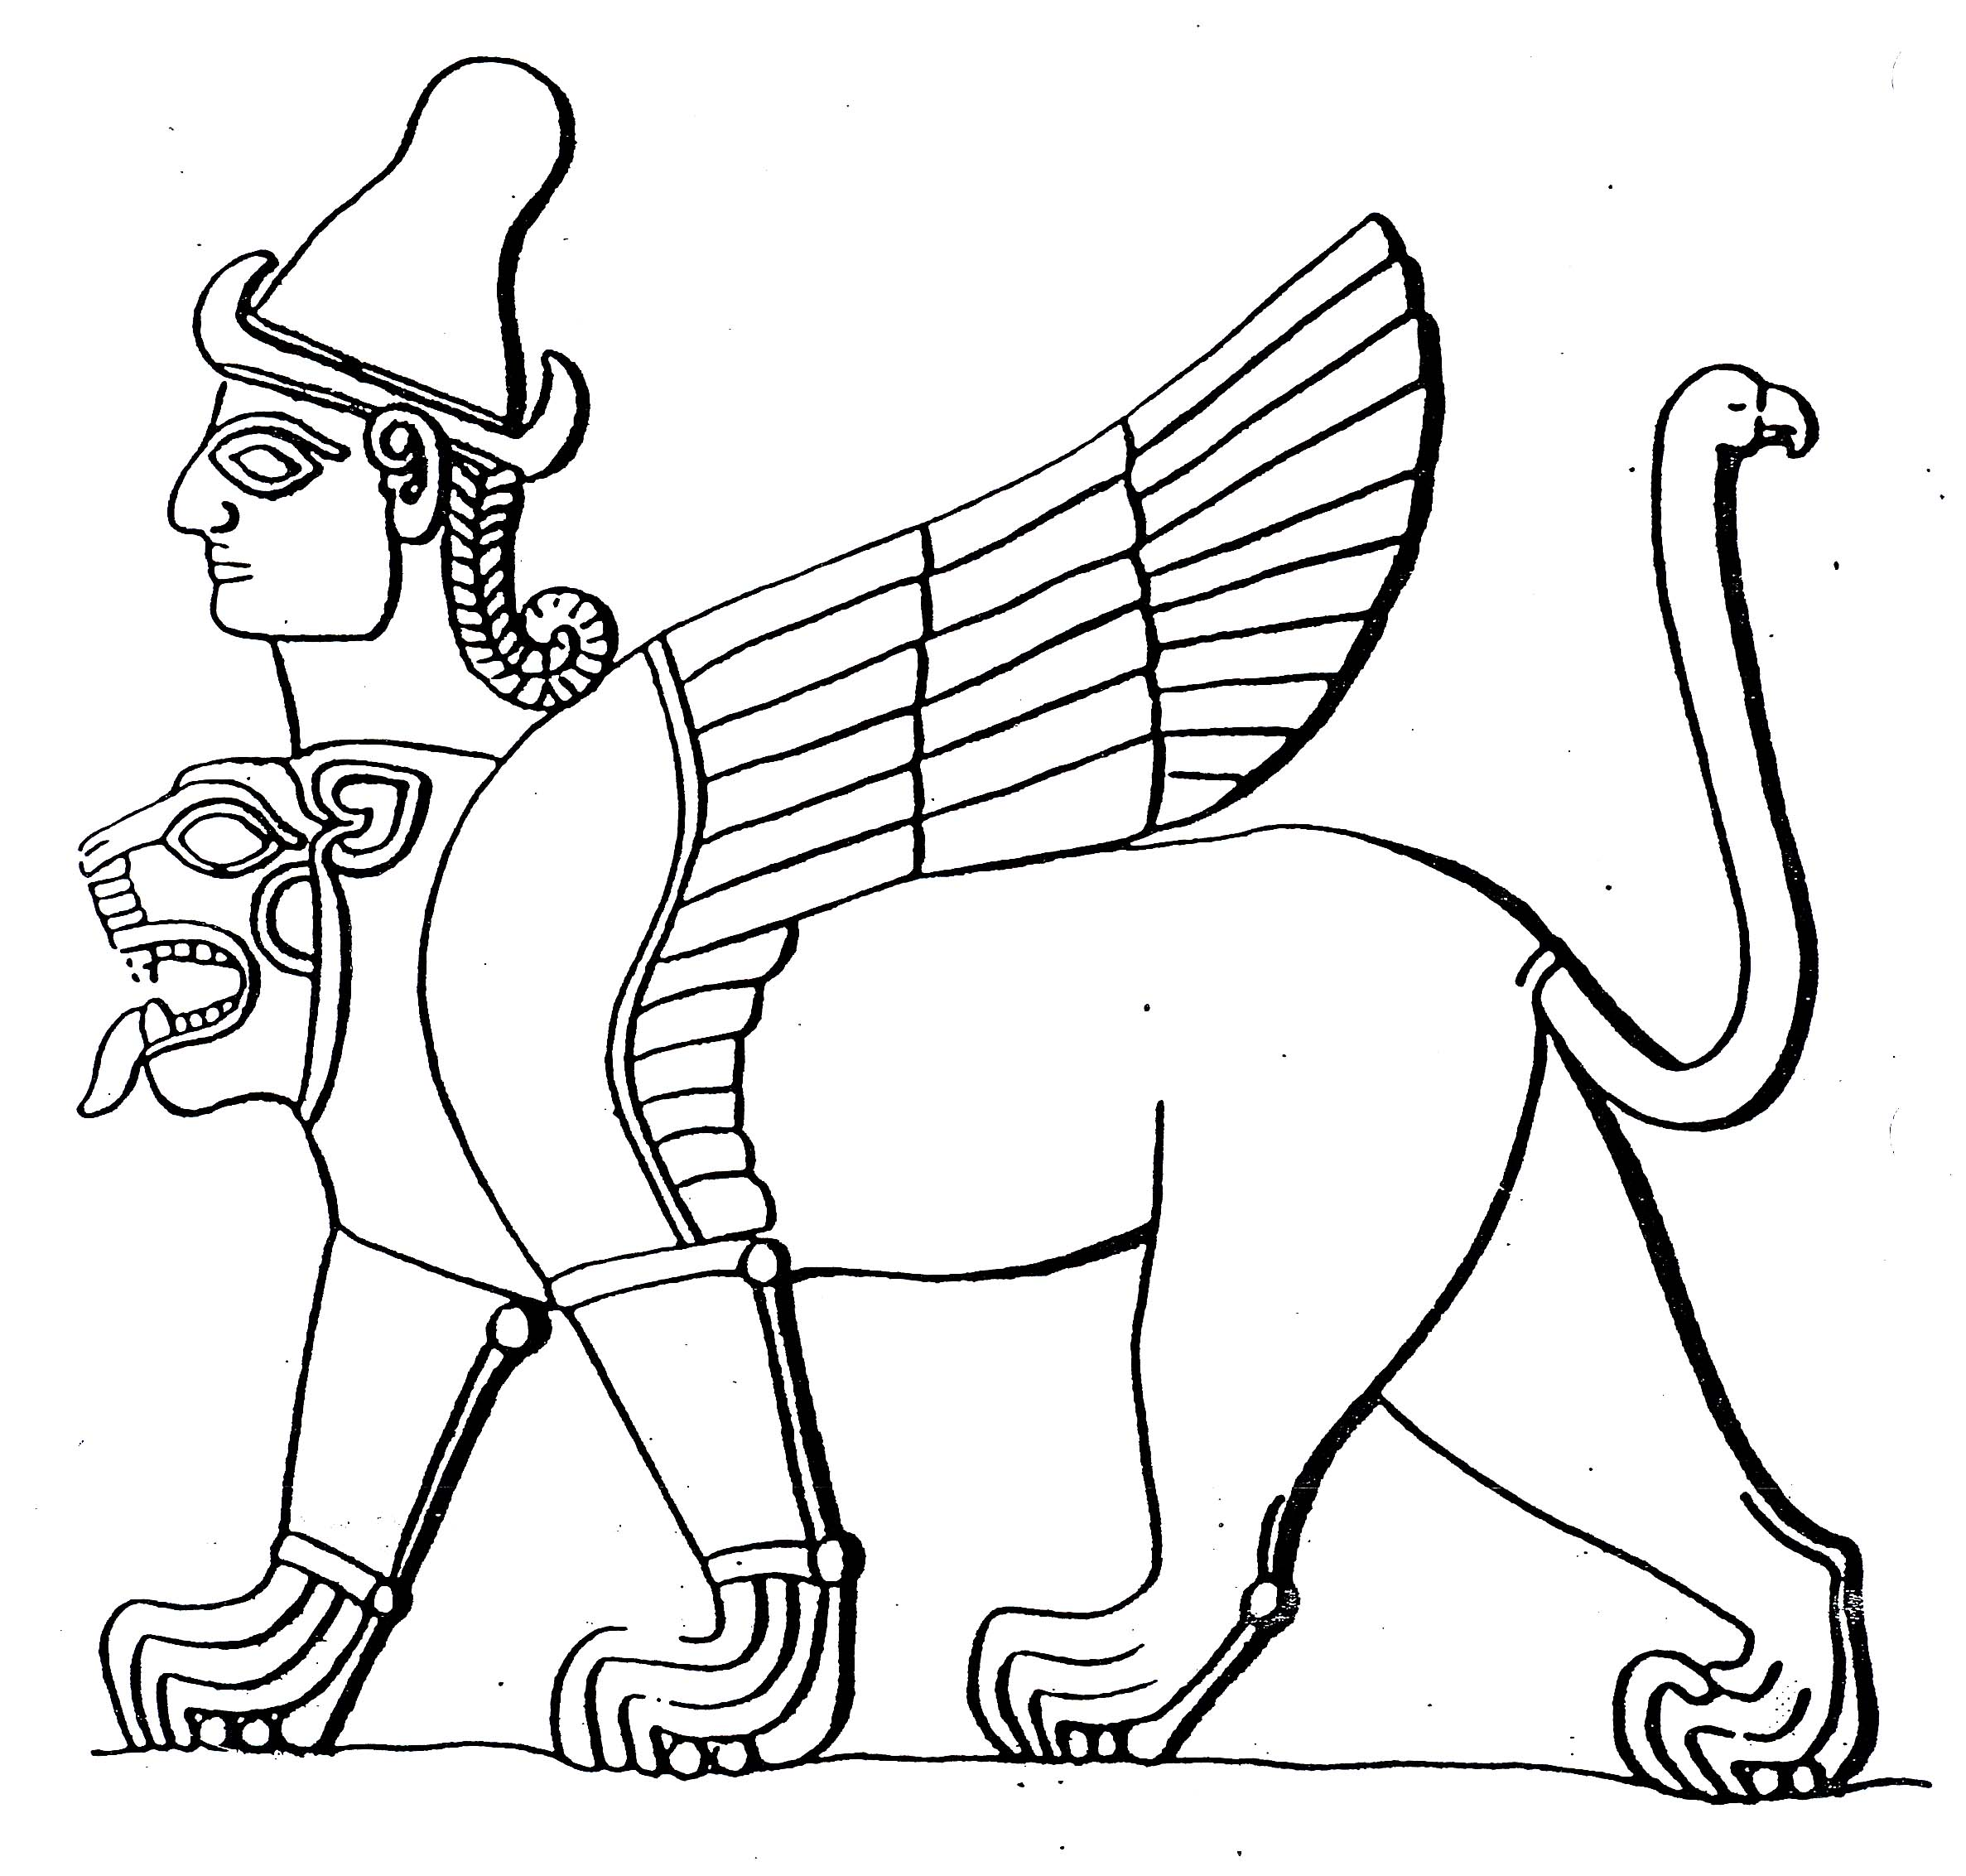
  E.g., The vision in Ezekiel 1
Composite divine image (lion body / human head / eagle wings)

Slide 18
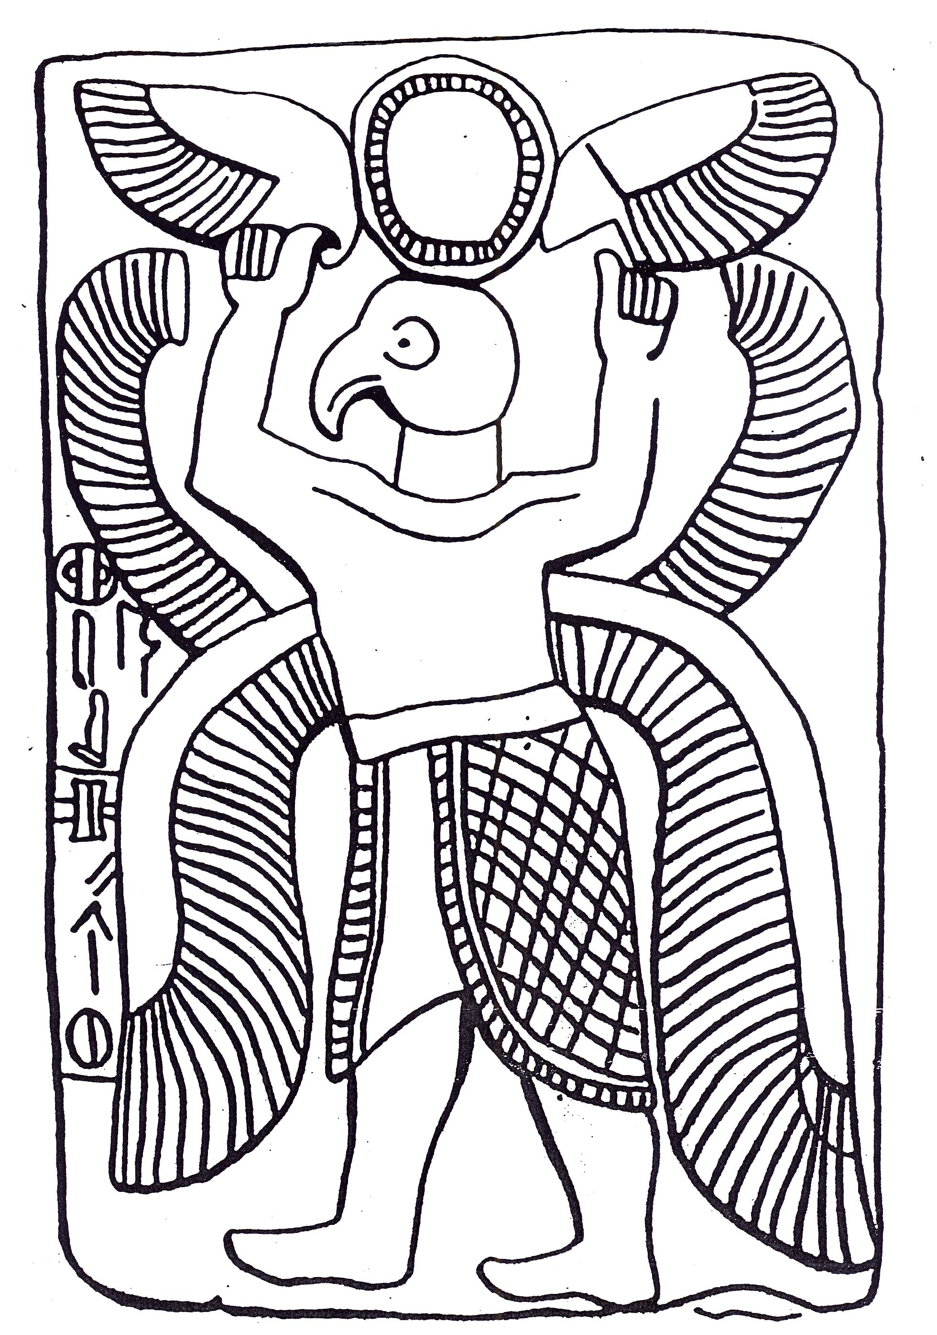
  E.g., The vision in Ezekiel 1
Composite divine image (human body / eagle head / multiple wings)

Slide 19
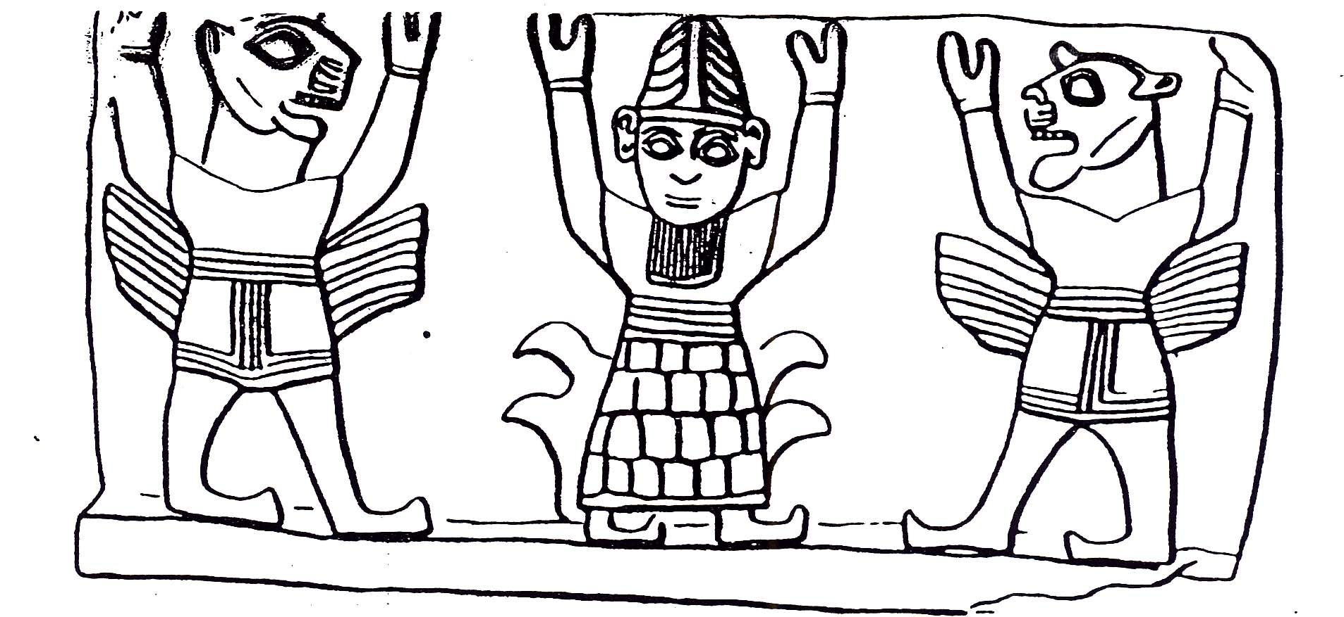
  E.g., The vision in Ezekiel 1
Composite divine images (human body / lion head / wings)

Slide 20
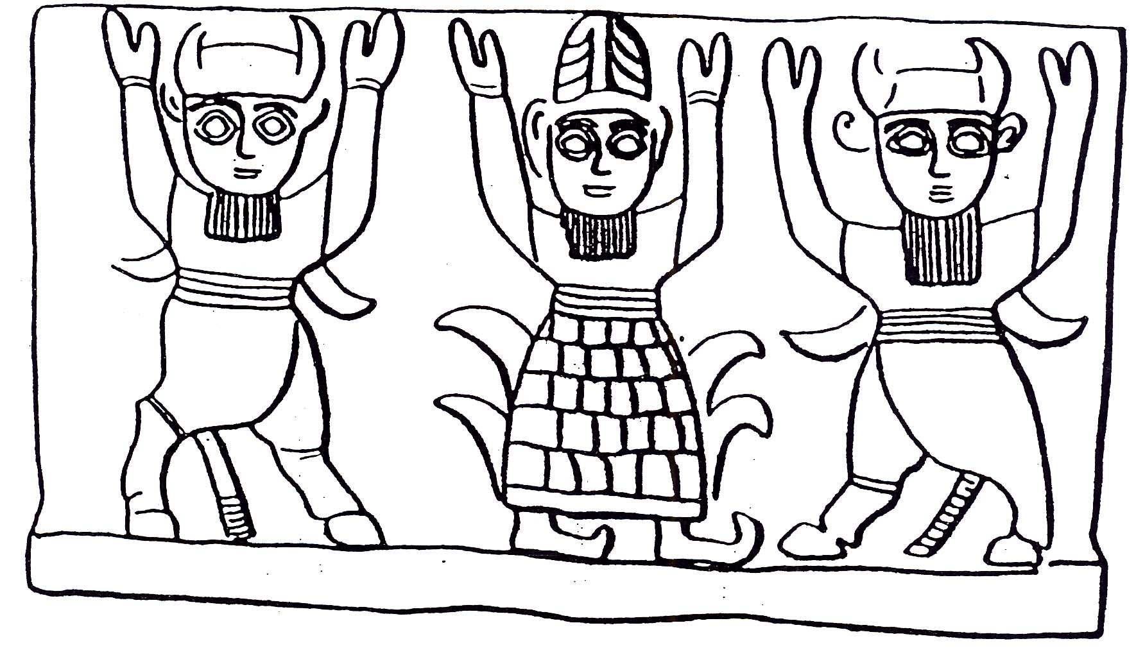
  E.g., The vision in Ezekiel 1
Composite divine images (ox body / ox head / wings)

Slide 21
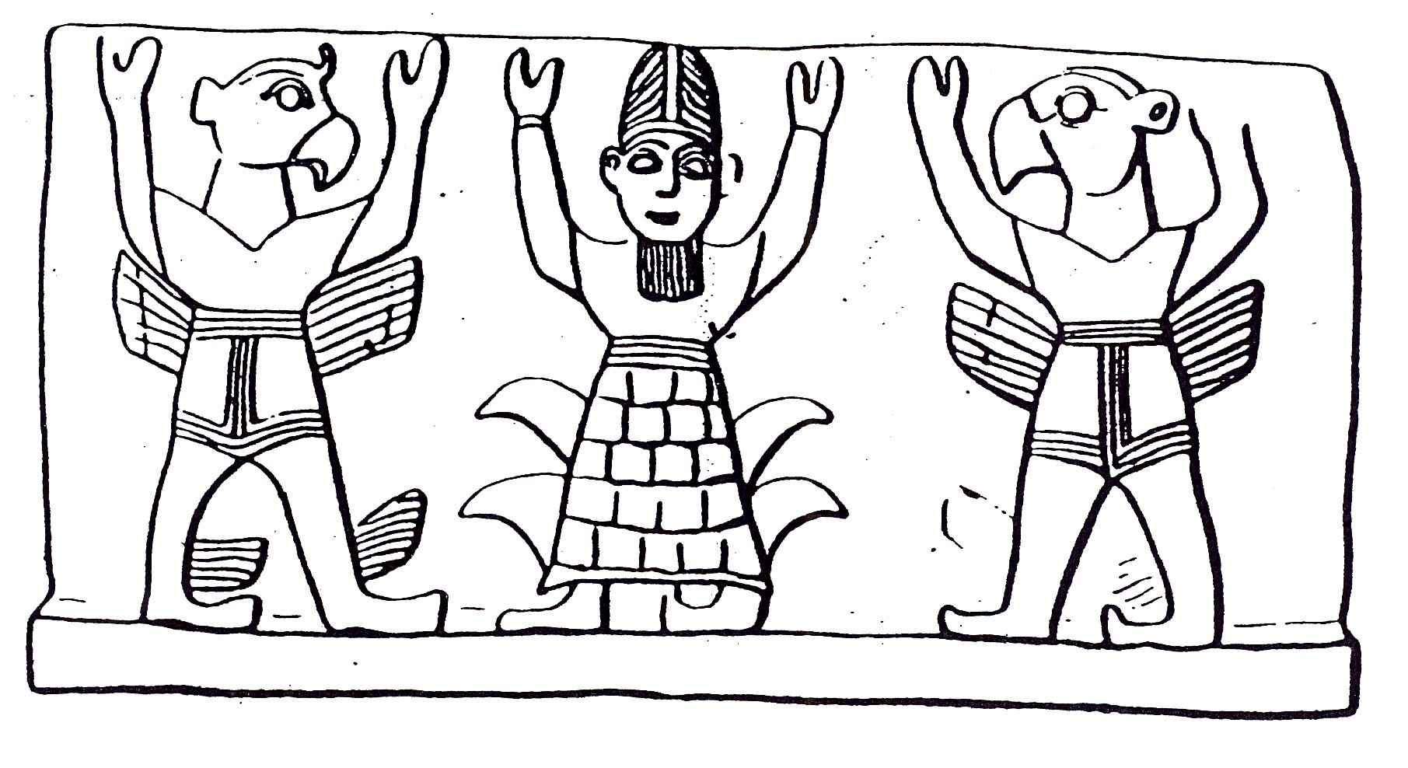
  E.g., The vision in Ezekiel 1
Composite divine images (human body / eagle head / wings)

Slide 22
Guidelines for Engaging Historical Context
Be clear on the type of historical-context information you are assessing (Who? What? Where? When? Why? How?)
Be careful in your assessment of comparative literature, examining both similarities and differences and seeking to discern the rhetorical purpose of the biblical message.
  The Bible often establishes the authentic original historical event that was vulgarized and distorted through polytheism, magic, violence, and paganism.
  The Bible often shows that was myth in the ancient world has real substance and is factual in Israel’s history.

Slide 23
Be restrained in your use of historical-context material, wrestling first within the Scripture itself before going outside the Bible for answers. Material drawn from outside the biblical text must align with and uphold the flow and message of the text.
Be relentless in your commitment to draw your message from the text. Historical context will support, not subvert, the text’s apparent meaning.

Slide 24
The Historical Context of 1 Samuel 13:14
OPTION 1: Adjectival View
בִּקֵשׁ יְהוָה ... אִישׁ ... ↑לוֹ ↑ ↑כִּלְבָבוֹ | sought Yahweh … a man ↑ for himself ↑ ↑ according to his heart
OPTION 2: Adverbial View
בִּקֵשׁ יְהוָה ... אִישׁ ... ↑לוֹ ↑כִּלְבָבוֹ | sought Yahweh … a man ↑ for himself ↑ according to his heart

Slide 25
Texts in Which a Suzerain’s Heart Gives Rise to the Selection of a King
  Hittite New Kingdom treaty (ca. 1250–1225 BC): “Whatever son Kurunta prefers, whether the son of his wife or the son of some other woman, whatever the son is the choice of Kurunta, whatever son Kurunta prefers, (let him place him in kingship in the land of Tarhuntassa).”
  Babylonian Chronicles (ca. 550–400 BC): “The seventh year: In the month of Kislev the king of Akkad [Nebuchadnezzar II] mustered his army and marched to Hattu. He encamped against the city of Judah and on the second day of the month Adar he captured the city (and) seized (its) king. A king of his own choice he appointed in the city [Jerusalem] (and) taking the vassal tribute he brought it into Babylon.

Slide 26
Texts in Which a God’s “Heart” Gives Rise to the Selection of a King
  King Eannatum, Dynasty of Lagash (ca. 2500–2335 BC): “[My] name was called to mind by Enlil; endowed with strength by Ningirsu; envisaged by Nansh in (her) heart; truly and rightly suckled by Ninhursaga; named by Inanna.”
  King Gudea, Dynasty of Akkad (ca. 2335–2112 BC): “Shepherd envisaged by Ningirsu in (his) heart, steadfastly regarded by Nanshe; endowed with strength by Nindar; the man described(?) by Baba.”
  King Gudea, Dynasty of Akkad: “Being the one at whom Nanshe looked with favor, being the man of the heart of Enlil, being the ruler ... (?) of Ningirsu, Gudea, being born in a lofty sanctuary of Gatumdug.”

Slide 27
  King Shu-Sin, Ur III Period (ca. 2112–2004 BC): “Shu-Sin, called by name by the god An, beloved of the god Enlil, king whom the god Enlil chose in his (own) heart as shepherd of the land and of the four quarters, mighty king, king of Ur, king of the four quarters.”
  Neo-Assyrian liver omen (ca. 668–627 BC): “If the Presence is turned upside down: Enlil will install a king of his own choice.”
  Cyrus Cylinder (ca. 539 BC): “[Marduk] surveyed and looked throughout all the lands, searching for a righteous king according to the desire of his heart, so as to grasp his hand. He called his name Cyrus, king of Anshan; he pronounced his name to be king over all (the world).”

