Slide 1
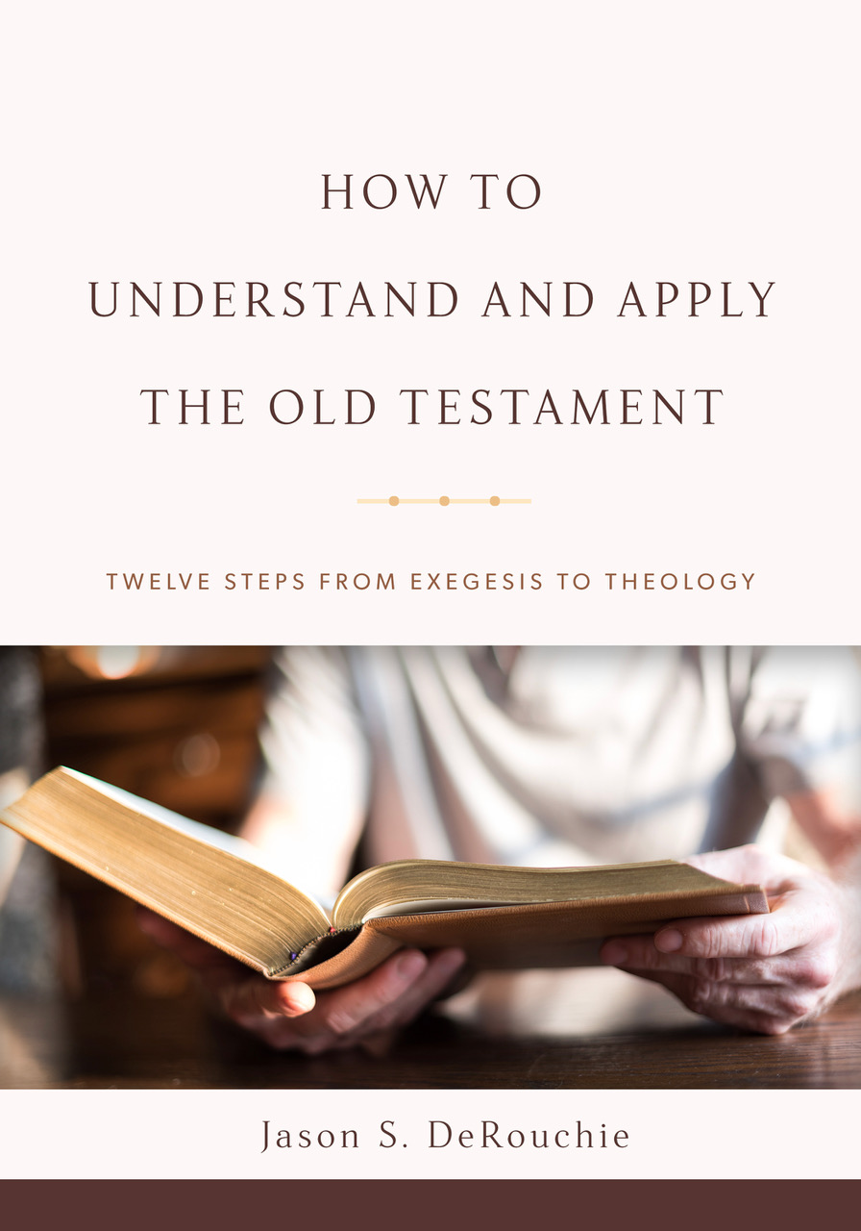
HOW TO
UNDERSTAND AND APPLY
THE OLD TESTAMENT
TWELVE STEPS FROM EXEGESIS TO THEOLOGY
Jason S. DeRouchie, PhD
Professor of Old Testament and Biblical Theology
Bethlehem College & Seminary
Elder, Bethlehem Baptist Church
Spring 2019

Slide 2
STEPS IN THE JOURNEY
Part 1: Text
Part 2: Observation – “How is the passage communicated?”
  Clause and Text Grammar
  Argument Tracing
  Word and Concept Studies
Part 3: Context
Part 4: Meaning
Part 5: Application

Slide 3
7. WORD AND CONCEPT STUDIES
Goal: Clarify the meaning of key words, phrases, and concepts.
The Need for Word and Concept Studies
An Overview of Word Study Tools
Principles for Doing Word and Concept Studies
How to Do a Word or Concept Study

Slide 4
The Need for Word and Concept Studies
Word meaning is context specific:
  Trunk
  Bar
Why study concepts and not just words?
  Because word meanings can overlap, we must consider “concepts” and not just words.
  E.g., “Joy in Isaiah”: “joy,” “rejoice,” “delight,” “exult,” “laugh,” “praise,” “celebrate”

Slide 5
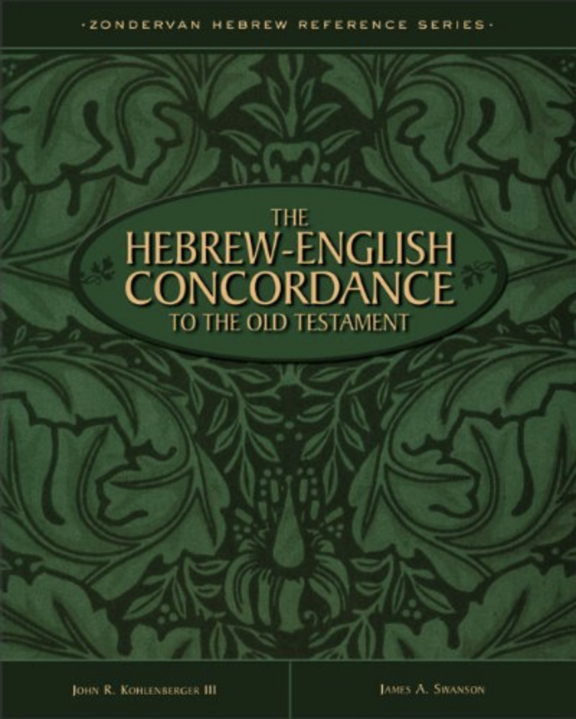
An Overview of Word Study Tools
Concordance: Lists all instances of a word or phrase within a given Testament, usually followed by a sampling of its use in specific contexts.
  Key tool: Kohlenberger, John R., III, and James A Swanson. The Hebrew-English Concordance of the Old Testament. Grand Rapids: Zondervan, 1998. (linked to both
  Strong’s & Goodrick/Kohlenberger
  [G/K] numbers)

Slide 6
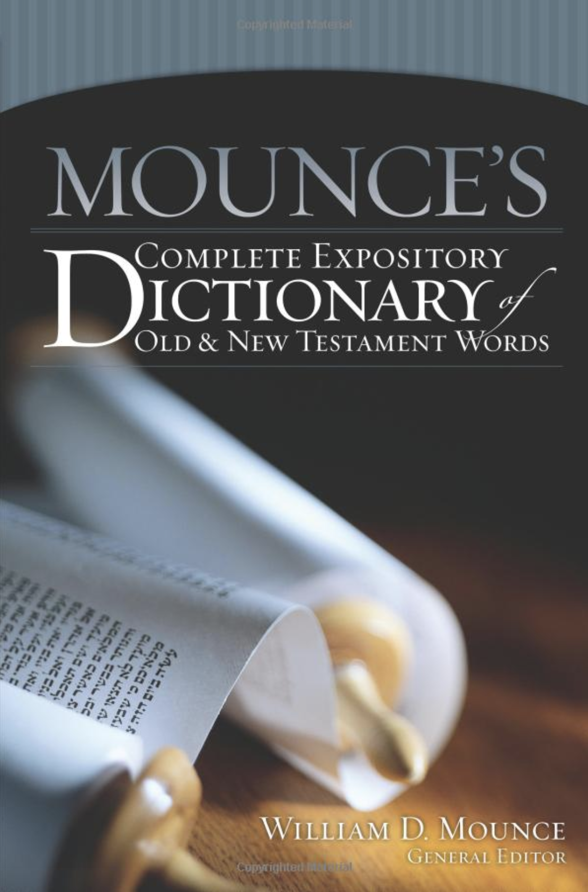
Lexicon: Lists the words of a language and gives their range of meaning through equivalent words in a different language followed by specific biblical references where those meanings occur.
  Key tool: Mounce, William D., ed. Mounce’s Complete Expository Dictionary of Old and New Testament Words. Grand Rapids: Zondervan, 2006. (linked to both
  Strong’s & Goodrick/Kohlenberger
  [G/K] numbers)

Slide 7
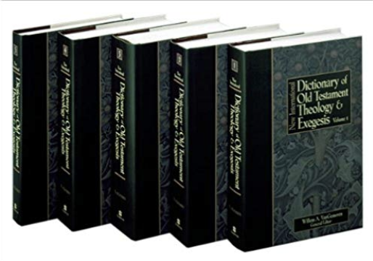
Theological Wordbooks: Multi-volume dictionaries that include articles that survey all major uses of a given term throughout Scripture and also often comment on its use outside the Bible.
  Key tool: VanGemeren, Willem A., ed. New International Dictionary of Old Testament Theology and Exegesis. 5 vols. Grand Rapids: Zondervan, 1997. (linked to both
  Strong’s & Goodrick/Kohlenberger
  [G/K] numbers)

Slide 8
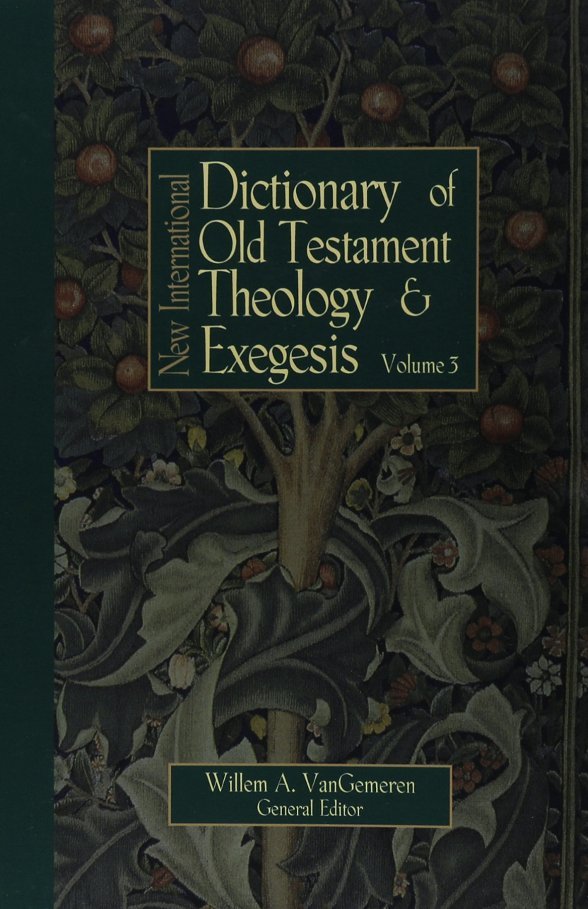
Theological Wordbooks: Multi-volume dictionaries that include articles that survey all major uses of a given term throughout Scripture and also often comment on its use outside the Bible.
  Key tool: VanGemeren, Willem A., ed. New International Dictionary of Old Testament Theology and Exegesis. 5 vols. Grand Rapids: Zondervan, 1997. (linked to both
  Strong’s & Goodrick/Kohlenberger
  [G/K] numbers)

Slide 9
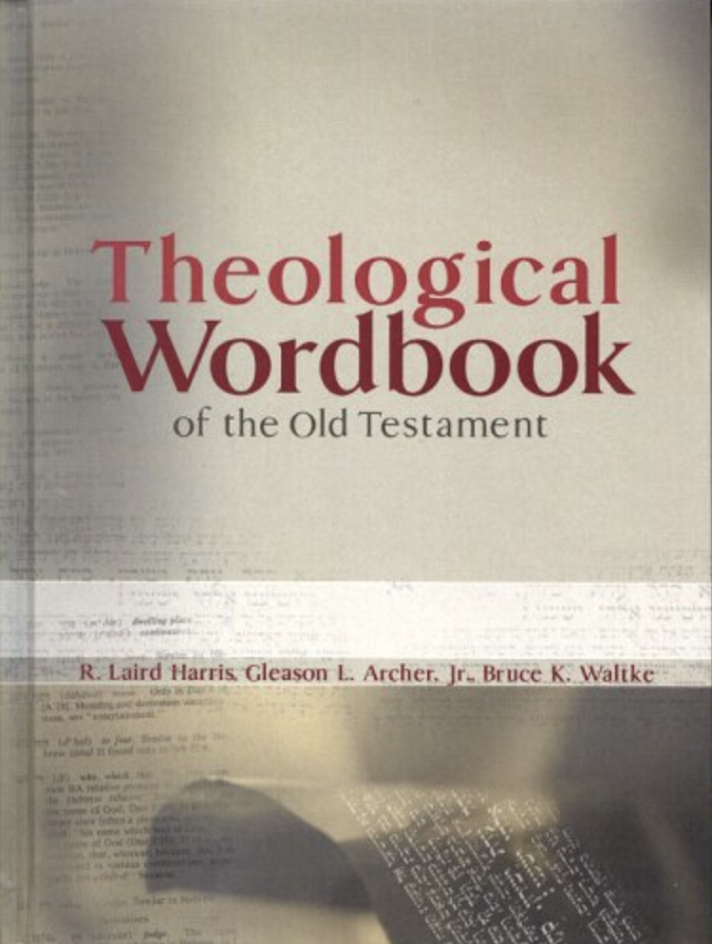
Theological Wordbooks: Multi-volume dictionaries that include articles that survey all major uses of a given term throughout Scripture and also often comment on its use outside the Bible.
  Key tool: Harris, R. Laird, Gleason L. Archer Jr., and Bruce K. Waltke. Theological Wordbook of the Old Testament. Rev. 1 vol. ed. Chicago: Moody, 2003). (linked only to Strong’s numbers)

Slide 10
Principles for Doing Word and Concept Studies
The history and makeup of a word are not reliable guides to meaning.
  Past usage is not necessarily equivalent to current usage.
    In English, awful no longer expresses reverence (“full of awe”).
    In biblical Hebrew, זָקָן ( zāqān“beard”) is no longer directly linked with the idea of being old (cf. the verb זָקֵן [zāqēn “grow old”] or the adjective זָקֵן [zāqēn “old”]).

Slide 11
  Similar roots do not necessarily have similar meaning (though the Hebrew authors can play with words).
    In English, the verb undertake vs. the noun undertaker, the latter of which has a much more limited usage.
    In English, the noun adult has no direct link with the noun adultery.
    In biblical Hebrew, the noun מִדְבָּר (miḏbār “wilderness”) bears no connection in meaning to the verb דִּבֵּר (dibbēr “speak”).

Slide 12
  Comparative languages are unreliable guides.
    In English, we can’s determine the meaning of “dynamite” from the Greek cognate δύναμις (dunamis “power”).

Slide 13
Usage in context determines meaning.
  Context is king.
    In English, minutes can be be parts of an hour or notes from a meeting, depending on context. In biblical Hebrew, the noun רוּחַ (rûaḥ) can mean either “wind” or “S/spirit,” depending on context.
    In English, reformed can be a general adjective (“a reformed man”), but it can also be a technical term for a specific system of Christian doctrine (“Reformed theology”). In biblical Hebrew, שָׂטָן (śāṭān) may refer generally to an “adversary, accuser,” whether human (1 Kgs 11:23) or angelic (Num 22:22), or it may refer to the prince of demons himself––“Satan.”

Slide 14
  Look out for idioms.
    Combinations of verb + preposition can take on special meanings.
    In English, the idiomatic expression “just a minute” refers to an undefined period and could not be applied to the statement, “The Sunday School teaching time will be fifty minutes long.”
    In the biblical Hebrew phrase יוֹם יְהוָה (yôm yhwh “the day of Yahweh”), the term יוֹם (“day”) does not refer to a twenty-four-hour period.

Slide 15
  Assigned meanings must not be too limited.
    In English, we should not define the verb swim by a particular arm stroke, for numerous arm strokes would qualify for “swimming.”
    In biblical Hebrew, the verb בָּרָא (bārā’ “create”) should not be forced to mean “create out of nothing,” for this meaning cannot apply to Gen 5:1, where we are told that God “created” man (cf. Gen 2:7).

Slide 16
Authorial, historical, geographical, and formal correspondence matter when determining meaning.
  Authorial correspondence.
    If you are considering the meaning of the feminine noun צְדָקָה (ṣěḏāqâ “righteousness”) in Gen 15:6, the eight other instances in the Law of Moses should bear a priority in analysis.
  Historical correspondence.
    If you are working through Mic 5:2 and want to grasp the meaning of the substantive participle מוֹשֵׁל (môšēl “ruler”), the eleven occurances of the same verb in his contemporary Isaiah would be helpful.
  Geographical correspondence.
  Generic or formal correspondence.

Slide 17
How to Do a Word or Concept Study
Choose a Hebrew word to study.
  Study words or phrases that are theologically significant or crucial to a passage’s understanding.
    E.g., the meaning סְגֻּלָה (sěgulâ “treasured possession”; S 5459; G/K 6035) in Exod 19:5 or אהב [’hḇ “love”; S 157; G/K 170] in Deut 6:5).
  Study words or phrases that are puzzling or unclear.
    E.g., the meaning of הֶ֫בֶל (heḇel “vanity”; S 1892; G/K 2039) in Eccl 1:2.

Slide 18
  Study words or phrases that have figurative meanings.
    E.g., וּמָל אֶת־לְבָבְךָ (ûmāl’et-lěbābḵā “and he will circumcise your heart”) in Deut 30:6.
  Study words or phrases that are apparent synonyms or antonyms.
    E.g., The verbs כבד (“to honor”; S 3513; G/K 3877) and קלל ( “to curse”; S 7043; G/K 7837) in 1 Sam 2:30.

Slide 19
  Study words or phrases that are repeated and/or clearly central to the meaning of a passage.
    E.g., טוֹב (tôb “good”; S 2896; G/K 3202) in Gen 1:4, 10, 12, 18, 21, 25, 31.
  Study words or phrases that are infrequent.
    אָסֹף אָסֵף (’āsōp ’āsēp “I will utterly sweep away”) in Zeph 1:2.

Slide 20
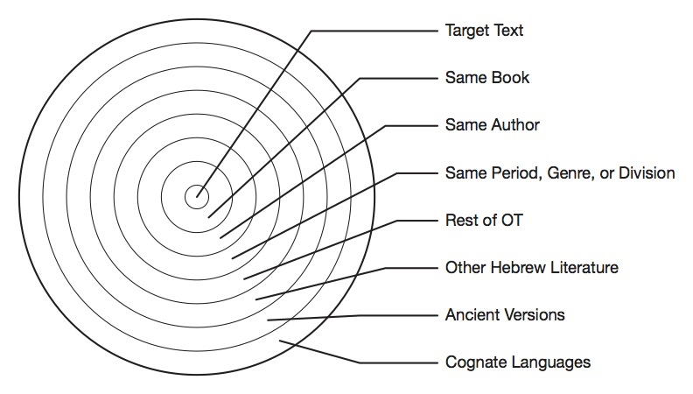
Discover the range of meaning for your Hebrew word (external data).

Slide 21
Discover the range of meaning for your Hebrew word (external data).
  Generate a list of texts (using Kohlenberger and Swanson’s, The Hebrew-English Concordance to the Old Testament).
    E.g., 229 occurrences of זֶ֫רַע (zera‘ “seed”) in the OT.
Gen. 1:11-12, 29; 3:15; 4:25; 7:3; 8:22; 9:9; 12:7; 13:15-16; 15:3, 5, 13, 18; 16:10; 17:7-10, 12, 19; 19:32, 34; 21:12-13; 22:17-18; 24:7, 60; 26:3-4, 24; 28:4, 13-14; 32:13; 35:12; 38:8-9; 46:6-7; 47:19, 23-24; 48:4, 11, 19; Ex. 16:31; 28:43; 30:21; 32:13; 33:1; Lev. 11:37-38; 15:16-18, 32; 18:20-21; 19:20; 20:2-4; 21:15, 17, 21; 22:3-4, 13; 26:5, 16; 27:16, 30; Num. 5:13, 28; 11:7; 14:24; 17:5; 18:19; 20:5; 24:7; 25:13; Deut. 1:8; 4:37; 10:15; 11:9-10; 14:22; 22:9; 28:38, 46, 59; 30:6, 19; 31:21; 34:4; Josh. 24:3; 1 Sam. 1:11; 2:20; 8:15; 20:42; 24:22; 2 Sam. 4:8; 7:12; 22:51; 1 Kings 2:33; 11:14, 39; 18:32; 2 Kings 5:27; 11:1; 17:20; 25:25; Is. 1:4; 5:10; 6:13; 14:20; 17:11; 23:3; 30:23; 41:8; 43:5; 44:3; 45:19, 25; 48:19; 53:10; 54:3; 55:10; 57:3-4; 59:21; 61:9; 65:9, 23; 66:22; Jer. 2:21; 7:15; 22:28, 30; 23:8; 29:32; 30:10; 31:27, 36-37; 33:22, 26; 35:7, 9; 36:31; 41:1; 46:27; 49:10; Ezek. 17:5, 13; 20:5; 43:19; 44:22; Amos 9:13; Hag. 2:19; Zech. 8:12; Mal. 2:3, 15; Psa. 18:51; 21:11; 22:24, 31; 25:13; 37:25-26, 28; 69:37; 89:5, 30, 37; 102:29; 105:6; 106:27; 112:2; 126:6; Job 5:25; 21:8; 39:12; Prov. 11:21; Ruth 4:12; Eccl. 11:6; Esth. 6:13; 9:27-28, 31; 10:3; Dan. 1:3; 9:1; Ezra 2:59; 9:2; Neh. 7:61; 9:2, 8; 1 Chr. 16:13; 17:11; 2 Chr. 20:7; 22:10

Slide 22
  Categorize meanings.
 |  | HUMAN SEED |  |  |  |  |  | PLANT SEED | ANIMAL SEED
 |  | 1. Natural seed | 2. Special natural seed (old covenant nation) | 3. Unique seed | 4. Special natural seed physically restored | 5. Special natural and adopted seed spiritually reconciled | 6. Male semen | 7. Plant seed or seed-time | 8. Natural seed
1 | Gen 1:11–12, 29 |  |  |  |  |  |  | 6
2 | 3:15 |  |  | 1 (sg) woman
3 | 4:25 |  | 1(sg) Eve, contr Cain
4 | 7:3 |  |  |  |  |  |  |  | 1
5 | 8:22 |  |  |  |  |  |  | 1

Slide 23
  Catalogue and assess your data.
 | TOTALS
1. Plant seed or seed time | 43 (18.78%)
2. Animal natural seed | 3 (1.31%)
3. Human seed
a. Male semen | 7 (3.06%)
b. Natural seed, all-inclusive | 87 (37.99%)
c. Special natural seed: pre-exilic old covenant community | 49 (21.40%)
d. Special natural seed: post-exilic old covenant community | 5 (2.18%)
e. Special natural seed: singular, male descendant with key role in redemptive history (type and antitype) | 26 (11.35%)
f. Special regenerated, adopted seed: redeemed new covenant community (includes ethnic Israelites and Gentiles) | 26 (11.35%)
TOTAL | 229

Slide 24
Discover the range of meaning for your Hebrew word (external data).
  Generate a list of texts.
  Categorize meanings.
  Catalogue and assess your data.
  Expand your assessment to include the concept.

Slide 25
Determine the meaning of your Hebrew word in the target text (internal assessment).
  Key Questions:
    What does the immediate literary context clarify about your word’s meaning (what comes before and after)?
    Does your author use the same term elsewhere in the book?
    Do other OT authors appropriate the term in similar settings or when addressing similar issues?

Slide 26
    Does the NT ever quote or allude to your text in a way that clarifies meaning?
    Does your author use the word in a different manner from the way others do?
  Once answered, decide what you believe to be the meaning of your passage in context, argue your case in writing because it will refine your thought, then compare your conclusions to the most important lexicons and theological wordbooks.

