Slide 1
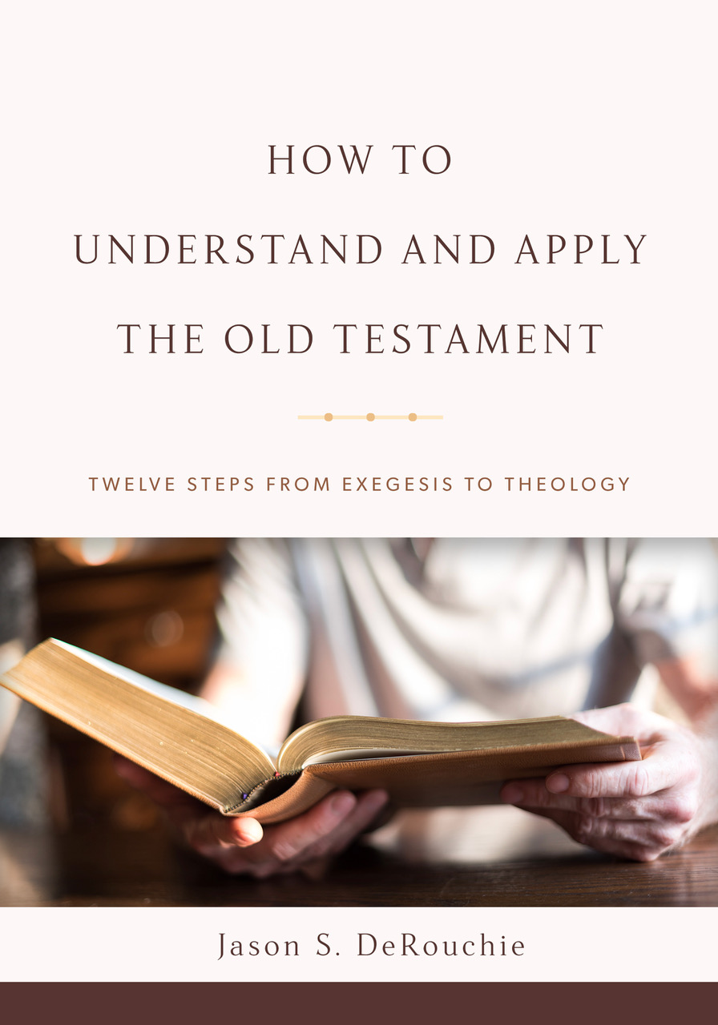
HOW TO
UNDERSTAND AND APPLY
THE OLD TESTAMENT
TWELVE STEPS FROM EXEGESIS TO THEOLOGY
Jason S. DeRouchie, PhD
Professor of Old Testament and Biblical Theology
Bethlehem College & Seminary
Elder, Bethlehem Baptist Church
Spring 2019

Slide 2
STEPS IN THE JOURNEY
Part 1: Text
Part 2: Observation – “How is the passage communicated?”
  Clause and Text Grammar
  Argument Tracing
  Word and Concept Studies
Part 3: Context
Part 4: Meaning
Part 5: Application

Slide 3
6. ARGUMENT TRACING
Goal: Finish tracing the literary argument and create a message-driven outline that is tied to the passage’s main point.
Step 1: Create an Argument Diagram
Step 2: Draft an Exegetical Outline

Slide 4
Step 1: Create an Argument Diagram
Key Tool: www.biblearc.com
Distinguish propositions, whether full clauses or adverbial phrases.
  Clause: A grammatical construction made up of a subject and its predicate with a possible coordinating or subordinating conjunction and various modifiers.
  Adverbial Phrase: A group of words that fills an adverbial slot in a clause.

Slide 5
Identify the semantic relationship between propositions.
  Coordinate relationships: Those that stand side-by-side, whether operating independently in series, in progression pointing to a climax, as alternative possibilities of a given situation, or as both true or both false.
  Subordinate relationships: Always have a main clause or text unit and then another that restates, stands distinct from, or stands contrary to the main clause or text.

Slide 6
Create an Argument Diagram or “Arc”
COORDINATE

Slide 7
Create an Argument Diagram or “Arc”
COORDINATE
Series (S) – “Ezra likes basketball and enjoys soccer.” (signal: “and, likewise”)

Slide 8
Create an Argument Diagram or “Arc”
COORDINATE
Series (S) – “Ezra likes basketball and enjoys soccer.” (signal: “and, likewise”)
Progression (P) – “Ben let go of the branch and then fell to the ground.” (signal: “then, and, furthermore”)

Slide 9
Create an Argument Diagram or “Arc”
COORDINATE
Series (S) – “Ezra likes basketball and enjoys soccer.” (signal: “and, likewise”)
Progression (P) – “Ben let go of the branch and then fell to the ground.” (signal: “then, and, furthermore”)
Alternate (A) – “Emily couldn’t decide whether ‘A’ or ‘B’ was right.” (signal: “or, but, while, on the other hand”)

Slide 10
Create an Argument Diagram or “Arc”
COORDINATE
Series (S) – “Ezra likes basketball and enjoys soccer.” (signal: “and, likewise”)
Progression (P) – “Ben let go of the branch and then fell to the ground.” (signal: “then, and, furthermore”)
Alternate (A) – “Emily couldn’t decide whether ‘A’ or ‘B’ was right.” (signal: “or, but, while, on the other hand”)
Both-And (B&) – “Joey wanted both pizza and popcorn.” (signal: “both … and, neither … nor”)

Slide 11
SUBORDINATE
Restatement

Slide 12
SUBORDINATE
Restatement
Action-Manner or Means (Ac/Mn) – “Grandpa walked with limp” vs. “Grandma walked with a cane” (signal: “in that, by + participles”)

Slide 13
SUBORDINATE
Restatement
Action-Manner or Means (Ac/Mn) – “Grandpa walked with limp” vs. “Grandma walked with a cane” (signal: “in that, by + participles”)
Comparison (Cf) – “Isaac looks a lot like his dad.” (signal: “even as, as … so, like, just as”)

Slide 14
SUBORDINATE
Restatement
Action-Manner or Means (Ac/Mn) – “Grandpa walked with limp” vs. “Grandma walked with a cane” (signal: “in that, by + participles”)
Comparison (Cf) – “Isaac looks a lot like his dad.” (signal: “even as, as … so, like, just as”)
Negative-Positive (–/+) – “For toppings choose not the pepperoni but the green pepper.” (signal: “not … but”)

Slide 15
SUBORDINATE
Restatement
Action-Manner or Means (Ac/Mn) – “Grandpa walked with limp” vs. “Grandma walked with a cane” (signal: “in that, by + participles”)
Comparison (Cf) – “Isaac looks a lot like his dad.” (signal: “even as, as … so, like, just as”)
Negative-Positive (–/+) – “For toppings choose not the pepperoni but the green pepper.” (signal: “not … but”)
Question-Answer (Q/A) – “Do you understand his teaching?” (signal: ?)

Slide 16
SUBORDINATE
Restatement
Action-Manner or Means (Ac/Mn) – “Grandpa walked with limp” vs. “Grandma walked with a cane” (signal: “in that, by + participles”)
Comparison (Cf) – “Isaac looks a lot like his dad.” (signal: “even as, as … so, like, just as”)
Negative-Positive (–/+) – “For toppings choose not the pepperoni but the green pepper.” (signal: “not … but”)
Question-Answer (Q/A) – “Do you understand his teaching?” (signal: ?)
Idea-Explanation (Id/Exp) – “Janie was delighted with her grade. I mean, she was ecstatic!” (signal: “that is, in other words”)

Slide 17
SUBORDINATE
Restatement
Action-Manner or Means (Ac/Mn) – “Grandpa walked with limp” vs. “Grandma walked with a cane” (signal: “in that, by + participles”)
Comparison (Cf) – “Isaac looks a lot like his dad.” (signal: “even as, as … so, like, just as”)
Negative-Positive (–/+) – “For toppings choose not the pepperoni but the green pepper.” (signal: “not … but”)
Question-Answer (Q/A) – “Do you understand his teaching?” (signal: ?)
Idea-Explanation (Id/Exp) – “Janie was delighted with her grade. I mean, she was ecstatic!” (signal: “that is, in other words”)
General-Specific (Gn/Sp) – “He has experienced much suffering in this life. For example….” (signal: “such as, for example”)

Slide 18
SUBORDINATE
Restatement
Action-Manner or Means (Ac/Mn) – “Grandpa walked with limp” vs. “Grandma walked with a cane” (signal: “in that, by + participles”)
Comparison (Cf) – “Isaac looks a lot like his dad.” (signal: “even as, as … so, like, just as”)
Negative-Positive (–/+) – “For toppings choose not the pepperoni but the green pepper.” (signal: “not … but”)
Question-Answer (Q/A) – “Do you understand his teaching?” (signal: ?)
Idea-Explanation (Id/Exp) – “Janie was delighted with her grade. I mean, she was ecstatic!” (signal: “that is, in other words”)
General-Specific (Gn/Sp) – “He has experienced much suffering in this life. For example….” (signal: “such as, for example”)
Fact-Interpretation (Ft/In) – “Jason was head over heels for Teresa, which is another way of saying that he truly loves her.” (signal: “that is, which is, meaning”)

Slide 19
SUBORDINATE
Distinct Statement

Slide 20
SUBORDINATE
Distinct Statement
Ground (G) – “Pete enjoyed his time in Florida because of the warmth.” (signal: “for, because, since”)

Slide 21
SUBORDINATE
Distinct Statement
Ground (G) – “Pete enjoyed his time in Florida because of the warmth.” (signal: “for, because, since”)
Inference (∴) – “Tam hadn’t eaten in twenty-four hours, so she was hungry.” (signal: “therefore, accordingly, so”)

Slide 22
SUBORDINATE
Distinct Statement
Ground (G) – “Pete enjoyed his time in Florida because of the warmth.” (signal: “for, because, since”)
Inference (∴) – “Tam hadn’t eaten in twenty-four hours, so she was hungry.” (signal: “therefore, accordingly, so”)
Bilateral (BL) – “Herb was pale because of his sickness. Therefore, he took medicine.” (signal: “for, because, therefore, so”)

Slide 23
SUBORDINATE
Distinct Statement
Ground (G) – “Pete enjoyed his time in Florida because of the warmth.” (signal: “for, because, since”)
Inference (∴) – “Tam hadn’t eaten in twenty-four hours, so she was hungry.” (signal: “therefore, accordingly, so”)
Bilateral (BL) – “Herb was pale because of his sickness. Therefore, he took medicine.” (signal: “for, because, therefore, so”)
Action-Result (Ac/Res) – “Ruthie climbed very high, so that she got scared.” (signal: “that, so that, in order that, with the result that”)

Slide 24
SUBORDINATE
Distinct Statement
Ground (G) – “Pete enjoyed his time in Florida because of the warmth.” (signal: “for, because, since”)
Inference (∴) – “Tam hadn’t eaten in twenty-four hours, so she was hungry.” (signal: “therefore, accordingly, so”)
Bilateral (BL) – “Herb was pale because of his sickness. Therefore, he took medicine.” (signal: “for, because, therefore, so”)
Action-Result (Ac/Res) – “Ruthie climbed very high, so that she got scared.” (signal: “that, so that, in order that, with the result that”)
Action-Purpose (Ac/Pur) – “Ruthie climbed very high, so that she could see.” (signal: “that, in order that, so that, lest”)

Slide 25
SUBORDINATE
Distinct Statement
Ground (G) – “Pete enjoyed his time in Florida because of the warmth.” (signal: “for, because, since”)
Inference (∴) – “Tam hadn’t eaten in twenty-four hours, so she was hungry.” (signal: “therefore, accordingly, so”)
Bilateral (BL) – “Herb was pale because of his sickness. Therefore, he took medicine.” (signal: “for, because, therefore, so”)
Action-Result (Ac/Res) – “Ruthie climbed very high, so that she got scared.” (signal: “that, so that, in order that, with the result that”)
Action-Purpose (Ac/Pur) – “Ruthie climbed very high, so that she could see.” (signal: “that, in order that, so that, lest”)
Conditional (If/Th) – “If Ruthie climbs high, she will get scared.” (signal: “If … then, provided that, except, unless”)

Slide 26
SUBORDINATE
Distinct Statement Cont.
Temporal (T) – “As soon as they left, Bryan fell asleep.” (signal: “when, whenever, after, before”)
Contrary Statement

Slide 27
SUBORDINATE
Distinct Statement Cont.
Temporal (T) – “As soon as they left, Bryan fell asleep.” (signal: “when, whenever, after, before”)
Locative (L) – “Josiah ate ice cream at the ball game.” (signal: “where, wherever, at”)
Contrary Statement

Slide 28
SUBORDINATE
Distinct Statement Cont.
Temporal (T) – “As soon as they left, Bryan fell asleep.” (signal: “when, whenever, after, before”)
Locative (L) – “Josiah ate ice cream at the ball game.” (signal: “where, wherever, at”)
Anticipation-Fulfillment (Ant/F) – “Janie promised to arrive at 5:00, and she did.” (signal: “and so”)
Contrary Statement

Slide 29
SUBORDINATE
Distinct Statement Cont.
Temporal (T) – “As soon as they left, Bryan fell asleep.” (signal: “when, whenever, after, before”)
Locative (L) – “Josiah ate ice cream at the ball game.” (signal: “where, wherever, at”)
Anticipation-Fulfillment (Ant/F) – “Janie promised to arrive at 5:00, and she did.” (signal: “and so”)
Contrary Statement
Concessive (Csv) – “Even though she was sick, she went to school.” (signal: “although, though, yet, nevertheless, but, however”)

Slide 30
SUBORDINATE
Distinct Statement Cont.
Temporal (T) – “As soon as they left, Bryan fell asleep.” (signal: “when, whenever, after, before”)
Locative (L) – “Josiah ate ice cream at the ball game.” (signal: “where, wherever, at”)
Anticipation-Fulfillment (Ant/F) – “Janie promised to arrive at 5:00, and she did.” (signal: “and so”)
Contrary Statement
Concessive (Csv) – “Even though she was sick, she went to school.” (signal: “although, though, yet, nevertheless, but, however”)
Situation-Response (Sit/R) – “The logs caught fire, and Isaac smiled.” (signal: “and”)

Slide 31
COORDINATE
Series (S) | Alternate (A)
Progression (P) | Both-And (B&)
SUBORDINATE
Restatement | Distinct Statement
Action-Manner (Ac/Mn) | Ground (G)
Comparison (Cf) | Inference (∴)
Negative-Positive (–/+) | Bilateral (BL)
Question-Answer (Q/A) | Action-Result (Ac/Res)
Idea-Explanation (Id/Exp) | Action-Purpose (Ac/Pur)
General-Specific (Gn/Sp) | Conditional (If/Th)
Fact-Interpretation (Ft/In) | Temporal (T)
 | Locative (L)
 | Anticipation-Fulfillment (Ant/F)
Contrary Statement
Concessive (Csv) | Situation-Response (Sit/R)

Slide 32
Argument Tracing in Deut 7:1–4 (NASB)
 |  | Connectors | Relationship
2 | Then you shall utterly destroy them. | “Then” | Temporal
b | You shall make no covenant with them | Ø | Explanation of 2a
c | and show no favor to them. | “and” | Cont. expl. of 2a
3 | Furthermore, you shall not intermarry with them; | “Furthermore” | Cont. expl. of 2a
b | you shall not give your daughters to their sons, | Ø | Explanation of 3a
c | nor shall you take their daughters for your sons. | “nor” | Cont. expl. of 3a
4 | For they will turn your sons away from following Me to serve other gods; | “For” | Reason for 3bc
b | then the anger of the LORD will be kindled against you | “then” | Further reason for 3bc
c | and He will quickly destroy you. | “and” | Further reason for 3bc

Slide 33
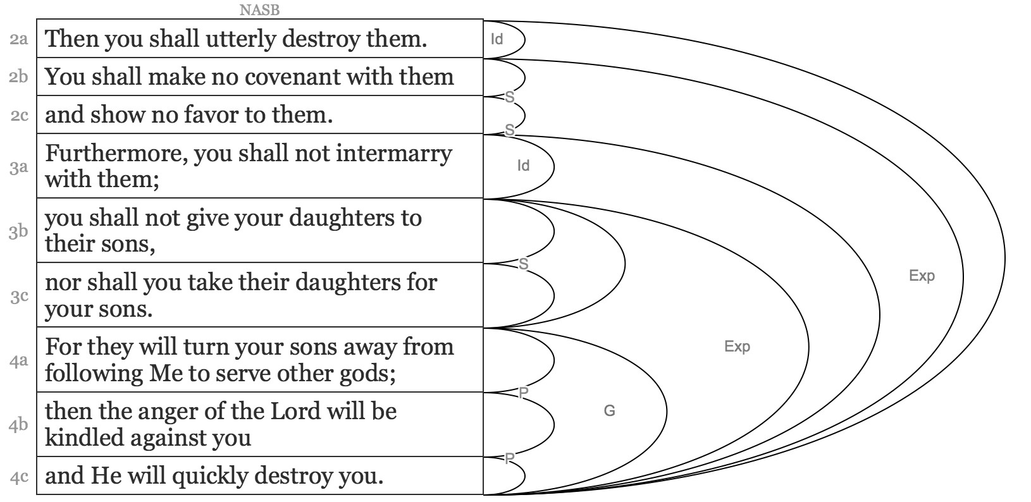
Argument Tracing in Deut 7:1–4 (NASB)

Slide 34
Argument Tracing in Hab 3:17–19 (DeRo)
I. The Temporal Context for Habakkuk’s Joy in God (v. 17)
  Crop devastation (v. 17a–d)
  Livestock devastation (v. 17e–f)
II. The Declaration of Habakkuk’s Joy in God (vv. 18–19)
  The assertion of joy in God (v. 18)
  The basis of joy in God (v. 19)

Slide 35
Argument Tracing in Hab 3:17–19 (DeRo)
 |  | Connectors | Relationship
17 | When the fig tree has not budded | “When” | Temporal marker
b | and there is no fruit at the vines, | “and” | Series with 17a
c | the produce of the olive has failed | Ø | Explanation of 17ab
d | and the fields do not yield food, | “and” | Cont. expl. of 7ab
e | when the fold has not divided sheep, | “when” | Cont. temp. marker
f | and there is no cattle in the stalls, | “and” | Series with 17e
18 | then I will exult in YHWH, | “then” | Inference, temporal
b | I will rejoice in the God of my salvation. | Ø | Explanation of 18a
19 | YHWH my Lord is my strength; | Ø | Explanation of 18b
b | and he has made my feet like the does’, | “and” | Cont. expl. of 18b
c | and on the heights he makes me walk. | “and” | Cont. expl. of 18b

Slide 36
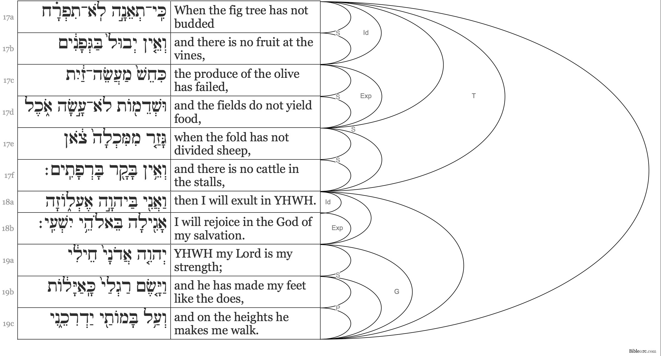
Argument Tracing in Hab 3:17–19 (DeRo)

Slide 37
Argument Tracing in Hab 3:17–19 (DeRo)
I. The Temporal Context for Habakkuk’s Joy in God (v. 17)
  Crop devastation (v. 17a–d)
  Livestock devastation (v. 17e–f)
II. The Declaration of Habakkuk’s Joy in God (vv. 18–19)
  The assertion of joy in God (v. 18)
  The basis of joy in God (v. 19)

Slide 38
Argument Tracing in Exod 19:4–6 (DeRo)
 |  | Connectors | Relationship
4 | You have seen | Ø | New beginning
b | what I did to Egypt | Ø | Direct object
c | and how I lifted you on eagles’ wings, | “and” | Cont. DO
d | and how I brought you to myself. | “and” | Cont. DO
5 | And now, | “And now” | Inference from 4
a | if you will indeed listen at my voice | “if” | Condition to 6
b | and keep my covenant | “and” | Cont. cond. to 6
c | and be my treasured possession from all peoples, | “and” | Cont. cond. to 6
d | for all the earth is mine, | “for” | Reason for 5c
6 | then you will be for me a kingdom of priests and a holy nation. | “then” | Inference from 5a–d

Slide 39
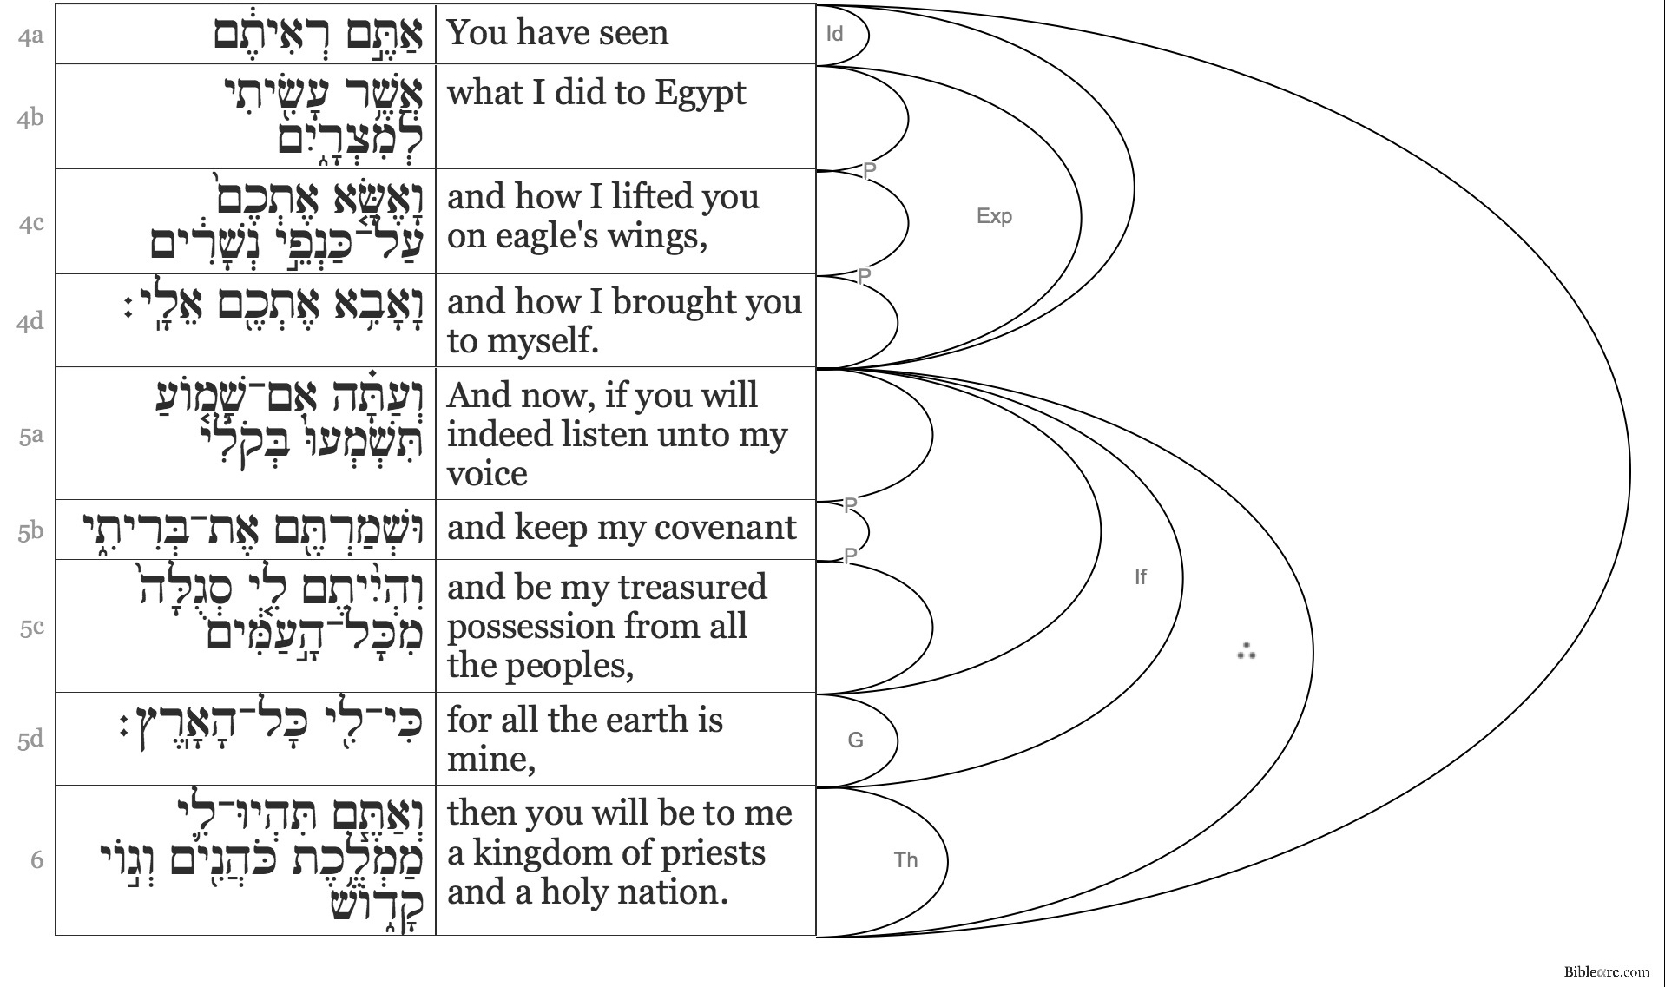
Argument Tracing in Exod 19:4–6 (DeRo)

Slide 40
Argument Tracing in Exod 19:4–6 (DeRo)
The Basis of God’s Calling for His People: God’s Deliverance (v. 4)
The Nature of God’s Calling for His People: To Exalt God in the World (vv. 5–6)
  The means for fulfilling the calling to exalt God in the world: radical God-centered living (v. 5)
    Heed God’s voice
    Keep God’s covenant
    Exist as God’s treasured possession in the context of the world
  The essence of the calling to exalt God in the world (v. 6)
    Serving as a kingdom of priests: mediate God’s greatness and worth
    Serving as a holy nation: display God’s greatness and worth

