Slide 1
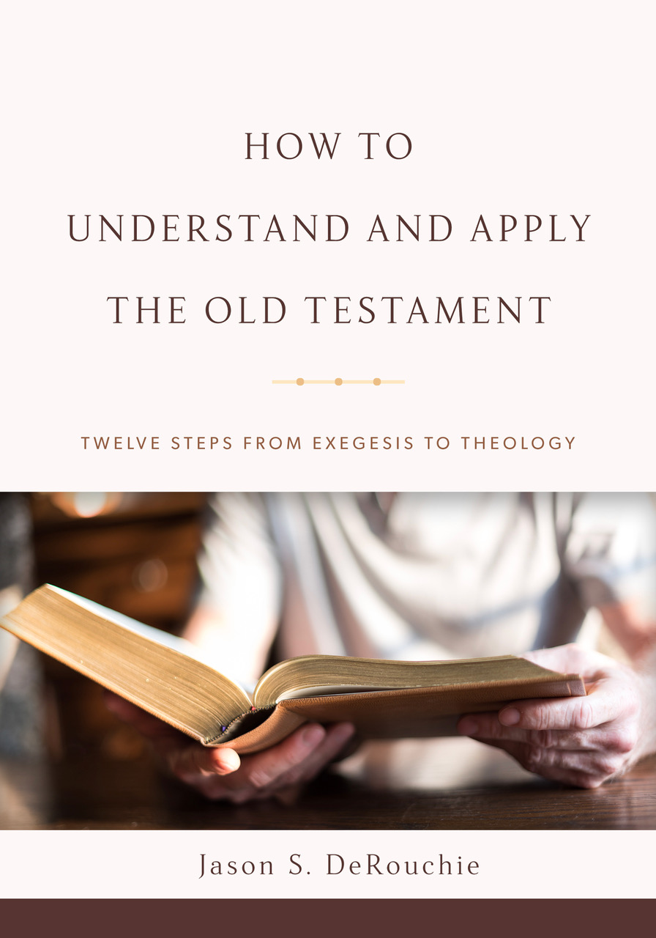
HOW TO
UNDERSTAND AND APPLY
THE OLD TESTAMENT
TWELVE STEPS FROM EXEGESIS TO THEOLOGY
Jason S. DeRouchie, PhD
Professor of Old Testament and Biblical Theology
Bethlehem College & Seminary
Elder, Bethlehem Baptist Church
Spring 2019

Slide 2
STEPS IN THE JOURNEY
Part 1: Text
Part 2: Observation – “How is the passage communicated?”
  Clause and Text Grammar
  Argument Tracing
  Word and Concept Studies
Part 3: Context
Part 4: Meaning
Part 5: Application

Slide 3
5. CLAUSE AND TEXT GRAMMAR
Goal: Assess the makeup and relationship of words, phrases, clauses, and larger text units.
It’s All Hebrew to Me
A Man after God’s Heart? The Importance of Grammar in 1 Sam 13:14
What Is Grammar?
Clauses and Sentences

Slide 4
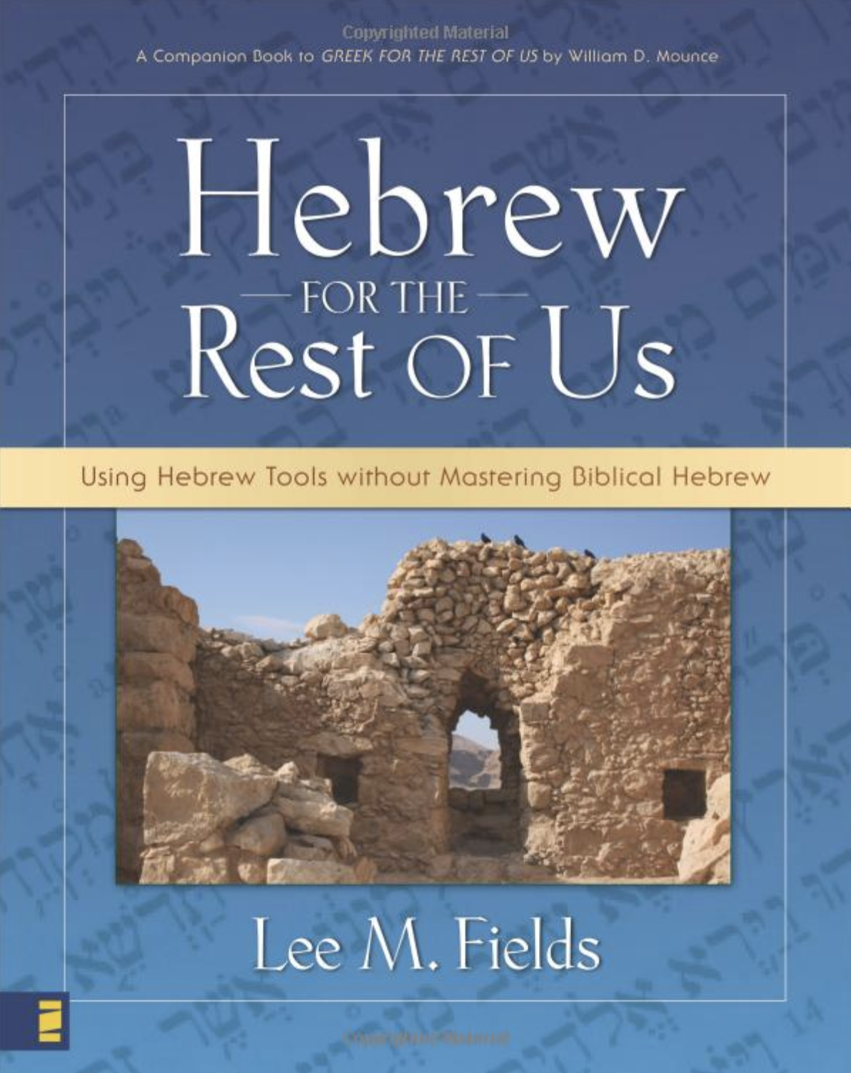
It’s All Hebrew to Me
Pleasing Pain
An aid:
Consonants and the History of Hebrew
Vowels and How We Got the OT
Roots, Clauses, and Function Words
Nominals
Verbals
A Method to Our Madness
  Hebrew Words Studies
  Electronic Resources
  Hebrew Prose
  Hebrew Poetry

Slide 5
A Man after God’s Heart?
The Importance of Grammar in 1 Samuel 13:14
1 Sam 13:14 (NASB). The LORD has sought out for himself a man after his own heart.
בִּקֵשׁ יְהוָה לוֹ אִישׁ כִּלְבָבוֹ M DO M S V after/like/according-to- a-man for-himself Yahweh sought his-heart

Slide 6
OPTION 1a: Adjectival View (View 1)
בִּקֵשׁ יְהוָה ... אִישׁ ... ↑לוֹ ↑ ↑כִּלְבָבוֹ | sought Yahweh … a man ↑ for himself ↑ ↑ according to his heart
Interpretation: If “his heart” refers to God’s character or loyalty, then the clause would mean:
  “Yahweh has sought a man whose character or loyalty in some way corresponds to God’s character or loyalty.”

Slide 7
Option 1 (Adjectival View 1) in Translations:
  BBE: “The Lord, searching for a man who is pleasing to him in every way.”
  NET: “The LORD has sought out for himself a man who is loyal to him.”
  HCSB: “The LORD has found a man loyal to him.”
  CEB: “The LORD will search for a man following the Lord’s own heart.”

Slide 8
OPTION 1b: Adjectival View (View 2)
בִּקֵשׁ יְהוָה ... אִישׁ ... ↑לוֹ ↑ ↑כִּלְבָבוֹ | sought Yahweh … a man ↑ for himself ↑ ↑ according to his heart
Interpretation: If “his heart” refers to Yahweh’s will or desire, then the clause would mean:
  “Yahweh sought for himself a man who was in according with his own choosing.”

Slide 9
Option 2 (Adjectival View 2) in Translations:
  MSG: “GOD is out looking for your replacement right now. This time he’ll do the choosing.”
  CEB A: “The LORD will search for a man of his own choosing.”

Slide 10
OPTION 2: Adverbial View
בִּקֵשׁ יְהוָה ... אִישׁ ... ↑לוֹ ↑כִּלְבָבוֹ | sought Yahweh … a man ↑ for himself ↑ according to his heart
Interpretation: If “his heart” serves as the standard or norm by which God sought a new king:
  “Yahweh sought for himself according to his own will a man.”

Slide 11
What Is Grammar?
Grammar: The whole system and structure that language uses for communicating effectively.
  Orthography: the study of the alphabet and how its letters combine to form sounds.
  Phonology: the study of a language’s system of sounds (phonemes).
  Morphology: the study of the formation of words.
  Syntax: how words combine to form phrases, clauses, sentences (micro-syntax), and even larger structures (macro-syntax).

Slide 12
Some Key Questions:
  Could any clause or groups of clauses be understood differently if the grammar were construed differently?
  Have I identified the antecedent referent of every pronoun and the subject of every verb?
  Do I understand the function of every subordinate conjunction?
  Do I know how every clause relates to its context?
  Have I grasped the role of every discourse marker?

Slide 13
Clauses and Sentences
Clause: The basic building block of all text analysis; a grammatical construction that is made up of a subject and its predicate.
  Example: “John prayed.”
    Subject = “John”
    Predicate = “prayed”
  Predicate: the part of the clause that refers to the state, process, or action associated with the subject.

Slide 14
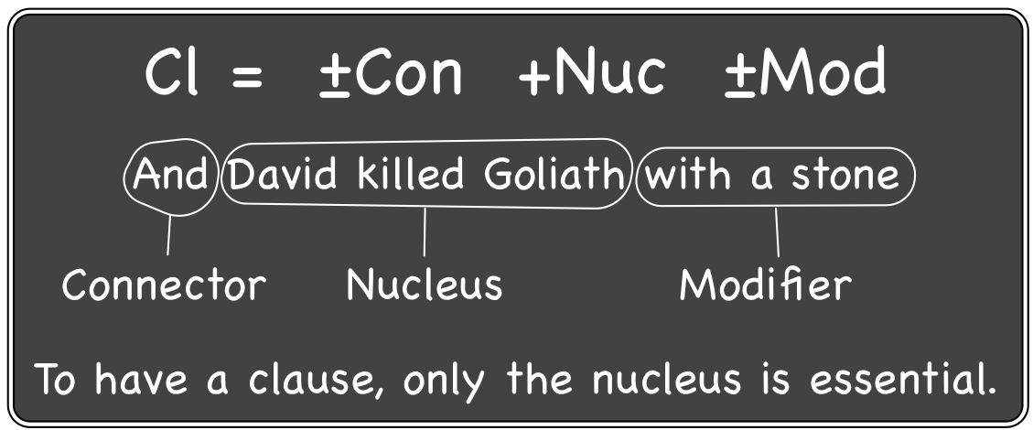
  Clause (Cl) makeup:
    Optional connector (Con)
    Mandatory nucleus (Nuc) = subject + predicate
    Optional modifiers (Mod), whether a word (e.g., adverb), a phrase (e.g., prep. phrase), or a whole clause (e.g., relative clause).

Slide 15
  Clause (Cl) makeup:
    Optional connector (Con)
    Mandatory nucleus (Nuc) = subject + predicate
    Optional modifiers (Mod), whether a word (e.g., adverb), a phrase (e.g., prep. phrase), or a whole clause (e.g., relative clause).
Word | “Yesterday David slew Goliath.”
Phrase
Clause

Slide 16
  Clause (Cl) makeup:
    Optional connector (Con)
    Mandatory nucleus (Nuc) = subject + predicate
    Optional modifiers (Mod), whether a word (e.g., adverb), a phrase (e.g., prep. phrase), or a whole clause (e.g., relative clause).
Word | “Yesterday David slew Goliath.”
Phrase | “David slew Goliath in the afternoon.”
Clause

Slide 17
  Clause (Cl) makeup:
    Optional connector (Con)
    Mandatory nucleus (Nuc) = subject + predicate
    Optional modifiers (Mod), whether a word (e.g., adverb), a phrase (e.g., prep. phrase), or a whole clause (e.g., relative clause).
Word | “Yesterday David slew Goliath.”
Phrase | “David slew Goliath in the afternoon.”
Clause | “David, who is but a youth, slew Goliath.”

Slide 18
Clause: A grammatical construction made up of a subject and its predicate.
Phrase: A group of words that fills a single slot in a clause.
Subordinate clause: A clause that serves as a modifier and is embedded in a higher level clause, as in “who is but a youth.”
Main clause: One that is not grammatically subordinate to any other higher level clause. “David, who is but a youth, slew Goliath.”
Sentence: A main clause with all its subordinate clauses.

Slide 19
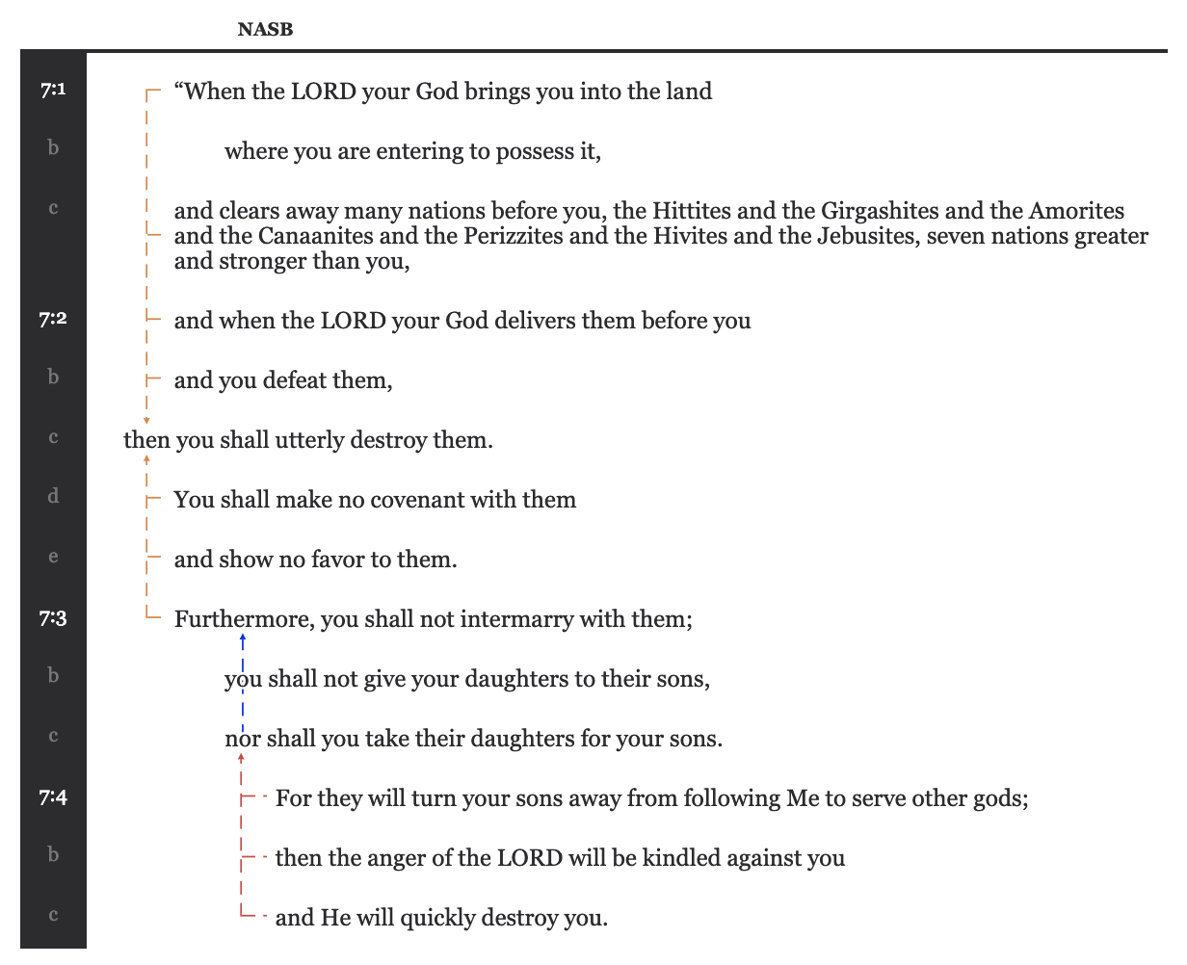
An Exercise in Text Grammar: Deut 7:1–4

