Slide 1
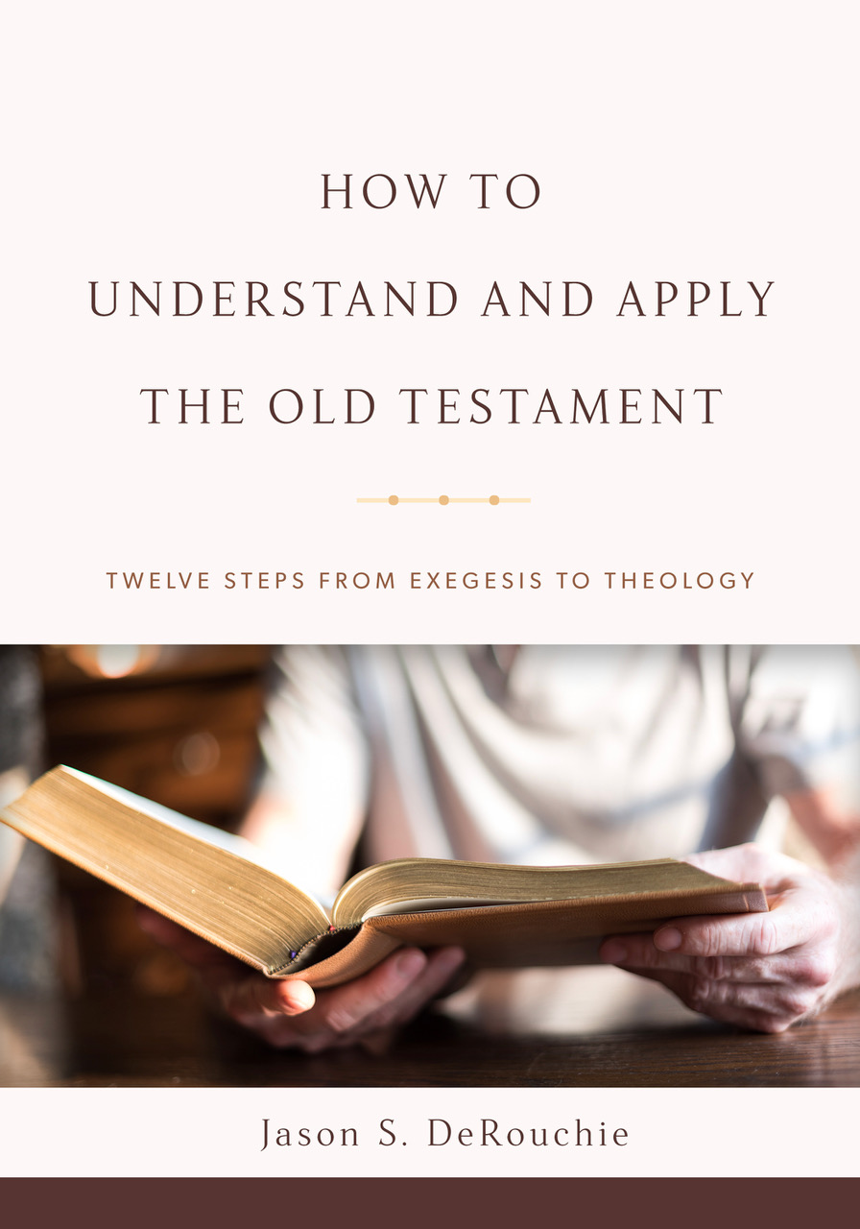
HOW TO
UNDERSTAND AND APPLY
THE OLD TESTAMENT
TWELVE STEPS FROM EXEGESIS TO THEOLOGY
Jason S. DeRouchie, PhD
Professor of Old Testament and Biblical Theology
Bethlehem College & Seminary
Elder, Bethlehem Baptist Church
Spring 2019

Slide 2
STEPS IN THE JOURNEY
Part 1: Text – “What is the makeup of the passage?”
  Genre
  Literary Units and Text Hierarchy
  Text Criticism
  Translation
Part 2: Observation
Part 3: Context
Part 4: Meaning
Part 5: Application

Slide 3
4. TRANSLATIONS
Goal: Translate the text and compare other translations.
A Missional Vision for Bible Translation
The Benefit of Multiple English Translations in Bible Study
Engaging Different Translations and Translation Theories

Slide 4
A Missional Vision for Bible Translation
Facts:
  Only 2,932 of the approximately 7,000 language have at least some of the Bible; this leaves 3,955 languages without any access to Scripture (Wycliffe Global Alliance).
  Because “faith comes from hearing, and hearing from the word of Christ” (Rom. 10:17), the translated word of God is essential!

Slide 5
A Biblical Foundation for Bible Translation
  While the OT was originally drafted (mostly) in Hebrew, the NT apostle do not hesitate to preach from the Septuagint for their Greek-speaking audience, convinced that “whatever was written in former days was written for our instruction” (Rom 15:4, citing the LXX of Ps 69:9[10]).
  Ezra and the Levites helped their non-Hebrew-speaking audience “understand the Law,” likely by translating it (Neh 8:7–8; cf. 13:24).
  At Pentecost God allowed Jews “from every nation under heaven” to hear “the mighty works of God” in their “own language” (Acts 2:5–6, 11).

Slide 6
The Biblical Hope for Bible Translation
  In response to the Tower of Babel incident, Yahweh both “dispersed” across the globe the seventy “families/clans” deriving from Noah and “confused the language of all the earth” (Gen 10:32; 11:9).
  It is to these “families” that God promised “blessing” to come through Abraham and his seed (12:3; 22:18).
  It is to the “daughter” community of these “dispersed” ones that God promised to one day change their “speech/tongue …. To a pure speech that all of them may call upon the name of the LORD and serve him with one according” (Zeph 3:9–10).

Slide 7
  The portrait of heaven in Revelation displays a multilingual community from every nation on earth declaring with one voice, “Salvation belongs to our God who sits on the throne, and to the Lamb!” (Rev 7:9–10).
Pray that the ministry of Bible translation would flourish in the 21st century!

Slide 8
The Benefit of Multiple English Translations in Bible Study
Facts:
  In light of the global need, English speakers should stand in awe of the plethora of solid Bible translations that we have.
  If you can’t read the original languages, the more you can familiarize yourself with the various translations, the more confident you’ll be that you have made the best exegetical choices.

Slide 9
The Shema: Different Translations of Deuteronomy 6:4
1 2 3 4 שְׁמַע יִשְׂרָאֵל יְהוָה אֱלֹהֵינוּ יְהוָה אֶחָד |  | 1 2 3 4 “Hear, Israel: Yahweh our-God Yahweh one”
A | B |  | Version | Distinct Significance

Slide 10
The Shema: Different Translations of Deuteronomy 6:4
1 2 3 4 שְׁמַע יִשְׂרָאֵל יְהוָה אֱלֹהֵינוּ יְהוָה אֶחָד |  | 1 2 3 4 “Hear, Israel: Yahweh our-God Yahweh one”
A | B |  | Version | Distinct Significance
1. God our God, | God the one and only! |  | MSG | Slogan: Stresses sole allegiance to Yahweh

Slide 11
The Shema: Different Translations of Deuteronomy 6:4
1 2 3 4 שְׁמַע יִשְׂרָאֵל יְהוָה אֱלֹהֵינוּ יְהוָה אֶחָד |  | 1 2 3 4 “Hear, Israel: Yahweh our-God Yahweh one”
A | B |  | Version | Distinct Significance
1. God our God, | God the one and only! |  | MSG | Slogan: Stresses sole allegiance to Yahweh
2. The LORD our God | is one LORD. |  | ASV, KJV, BBE | Confront poly-Yahwism

Slide 12
The Shema: Different Translations of Deuteronomy 6:4
1 2 3 4 שְׁמַע יִשְׂרָאֵל יְהוָה אֱלֹהֵינוּ יְהוָה אֶחָד |  | 1 2 3 4 “Hear, Israel: Yahweh our-God Yahweh one”
A | B |  | Version | Distinct Significance
1. God our God, | God the one and only! |  | MSG | Slogan: Stresses sole allegiance to Yahweh
2. The LORD our God | is one LORD. |  | ASV, KJV, BBE | Confront poly-Yahwism
3. The LORD our God, | the LORD is one. |  | NKJV, ESV, NIV, CSB | Stresses Yahweh’s supremacy and uniqueness

Slide 13
The Shema: Different Translations of Deuteronomy 6:4
1 2 3 4 שְׁמַע יִשְׂרָאֵל יְהוָה אֱלֹהֵינוּ יְהוָה אֶחָד |  | 1 2 3 4 “Hear, Israel: Yahweh our-God Yahweh one”
A | B |  | Version | Distinct Significance
1. God our God, | God the one and only! |  | MSG | Slogan: Stresses sole allegiance to Yahweh
2. The LORD our God | is one LORD. |  | ASV, KJV, BBE | Confront poly-Yahwism
3. The LORD our God, | the LORD is one. |  | NKJV, ESV, NIV, CSB | Stresses Yahweh’s supremacy and uniqueness
4a. The LORD is our God, | the LORD alone! |  | NRSV | Identifies Yahweh as our only God

Slide 14
The Shema: Different Translations of Deuteronomy 6:4
1 2 3 4 שְׁמַע יִשְׂרָאֵל יְהוָה אֱלֹהֵינוּ יְהוָה אֶחָד |  | 1 2 3 4 “Hear, Israel: Yahweh our-God Yahweh one”
A | B |  | Version | Distinct Significance
1. God our God, | God the one and only! |  | MSG | Slogan: Stresses sole allegiance to Yahweh
2. The LORD our God | is one LORD. |  | ASV, KJV, BBE | Confront poly-Yahwism
3. The LORD our God, | the LORD is one. |  | NKJV, ESV, NIV, CSB | Stresses Yahweh’s supremacy and uniqueness
4a. The LORD is our God, | the LORD alone! |  | NRSV | Identifies Yahweh as our only God
4b. Our God is the LORD, | only the LORD! |  | CEB | Asserts that our only God is Yahweh

Slide 15
The Shema: Different Translations of Deuteronomy 6:4
1 2 3 4 שְׁמַע יִשְׂרָאֵל יְהוָה אֱלֹהֵינוּ יְהוָה אֶחָד |  | 1 2 3 4 “Hear, Israel: Yahweh our-God Yahweh one”
A | B |  | Version | Distinct Significance
1. God our God, | God the one and only! |  | MSG | Slogan: Stresses sole allegiance to Yahweh
2. The LORD our God | is one LORD. |  | ASV, KJV, BBE | Confront poly-Yahwism
3. The LORD our God, | the LORD is one. |  | NKJV, ESV, NIV, CSB | Stresses Yahweh’s supremacy and uniqueness
4a. The LORD is our God, | the LORD alone! |  | NRSV | Identifies Yahweh as our only God
4b. Our God is the LORD, | only the LORD! |  | CEB | Asserts that our only God is Yahweh
5. The LORD is our God; | the LORD is one. |  | NASB, WEB, NET | Combines 3 and 4

Slide 16
The Shema: Different Translations of Deuteronomy 6:4
1 2 3 4 שְׁמַע יִשְׂרָאֵל יְהוָה אֱלֹהֵינוּ יְהוָה אֶחָד |  | 1 2 3 4 “Hear, Israel: Yahweh our-God Yahweh one”
A | B |  | Version | Distinct Significance
1. God our God, | God the one and only! |  | MSG | Slogan: Stresses sole allegiance to Yahweh
2. The LORD our God | is one LORD. |  | ASV, KJV, BBE | Confront poly-Yahwism
3. The LORD our God, | the LORD is one. |  | NKJV, ESV, NIV, CSB | Stresses Yahweh’s supremacy and uniqueness
4a. The LORD is our God, | the LORD alone! |  | NRSV | Identifies Yahweh as our only God
4b. Our God is the LORD, | only the LORD! |  | CEB | Asserts that our only God is Yahweh
5. The LORD is our God; | the LORD is one. |  | NASB, WEB, NET | Combines 3 and 4

Slide 17
Engaging Different Translations and Translation Theories
Introduction:
  Bible translations differ on whether they are form-, sense-, or idea-driven and to what degree they are gender-inclusive.
  Different translation theories or principles stand behind the various versions, creating a continuum of equivalence, based on how they handle lexical, grammatical, and historical correspondence.

Slide 18
  Three types of correspondences:
    Lexical correspondence: how closely translators attempt to render single words in the source text into individual words in the target language.
    Grammatical correspondence: how closely word order and syntax in the original language is aligned with word order and syntax in translation.
    Historical correspondence: how closely the translators retain the factual and cultural elements connected with the biblical times.
  There are strengths and weakness with each approach.

Slide 19
Form-Equivalence |  |  | Sense-Equivalence |  |  | Idea-Equivalence
YLT | KJV/NKJV NASB/NASU | RSV/NRSV ESV | CSB NET NIV | NAB NJB | JB GNB REB NLT | NEB CEB | TLB MSG
+ Lexical, Grammatical, Historical |  |  | + Historical – Lexical and Grammatical |  |  | – Lexical, Grammatical, Historical
Form-Equivalence: Trying to retain correspondence of words, grammar, and history (NASB, ESV).
  Strengths:
    Useful when tracking the flow of thought, as they retain more conjunctions and other connections words.
    The least interpretive translation.

Slide 20
Form-Equivalence |  |  | Sense-Equivalence |  |  | Idea-Equivalence
YLT | KJV/NKJV NASB/NASU | RSV/NRSV ESV | CSB NET NIV | NAB NJB | JB GNB REB NLT | NEB CEB | TLB MSG
+ Lexical, Grammatical, Historical |  |  | + Historical – Lexical and Grammatical |  |  | – Lexical, Grammatical, Historical
Form-Equivalence: Trying to retain correspondence of words, grammar, and history (NASB, ESV).
  Weaknesses:
    Sometimes cumbersome rather than contemporary English.
    Requires the teacher to clarify more often.

Slide 21
Form-Equivalence |  |  | Sense-Equivalence |  |  | Idea-Equivalence
YLT | KJV/NKJV NASB/NASU | RSV/NRSV ESV | CSB NET NIV | NAB NJB | JB GNB REB NLT | NEB CEB | TLB MSG
+ Lexical, Grammatical, Historical |  |  | + Historical – Lexical and Grammatical |  |  | – Lexical, Grammatical, Historical
Sense-Equivalence: Seeking dynamic correspondence that retains historical features and captures meaning but not hesitate to translate words, grammar, and style into common English (NIV, NLT).
  Strength:
    Beautiful, meaningful contemporary English that can be clear and faithful to God’s word.

Slide 22
Form-Equivalence |  |  | Sense-Equivalence |  |  | Idea-Equivalence
YLT | KJV/NKJV NASB/NASU | RSV/NRSV ESV | CSB NET NIV | NAB NJB | JB GNB REB NLT | NEB CEB | TLB MSG
+ Lexical, Grammatical, Historical |  |  | + Historical – Lexical and Grammatical |  |  | – Lexical, Grammatical, Historical
Sense-Equivalence: Seeking dynamic correspondence that retains historical features and captures meaning but not hesitate to translate words, grammar, and style into common English (NIV, NLT).
  Weaknesses:
    Where there is greater interpretation in translation, there is more opportunity for teachers to disagree with a translator’s choice.
    They often fail to represent text features like connectors and discourse markers, making it more difficult to track an author’s flow of thought.

Slide 23
Form-Equivalence |  |  | Sense-Equivalence |  |  | Idea-Equivalence
YLT | KJV/NKJV NASB/NASU | RSV/NRSV ESV | CSB NET NIV | NAB NJB | JB GNB REB NLT | NEB CEB | TLB MSG
+ Lexical, Grammatical, Historical |  |  | + Historical – Lexical and Grammatical |  |  | – Lexical, Grammatical, Historical
Idea-Equivalence: Paraphrases that strive only to convey Scripture’s concepts with little attempt to retain lexical, grammatical, and historical correspondence (TLB, MSG).
  Strength: Highly contemporary.
  Weakness: Less helpful for study or teaching because they have distanced themselves too far from the original.

Slide 24
Psalm 119:105 in Various Translations
 |  |  |  | L | G | H
 | 5 4 3 2 1 נֵר־לְרַגְלִי דְבָרֶ֫ךָ וְאוֹר לִנְתִיבָתִי |  | 1 2 3 4 5 A-lamp to-my-feet your-word and-light to-my-path.
Form
Sence
Idea

Slide 25
Psalm 119:105 in Various Translations
 |  |  |  | L | G | H
 | 5 4 3 2 1 נֵר־לְרַגְלִי דְבָרֶ֫ךָ וְאוֹר לִנְתִיבָתִי |  | 1 2 3 4 5 A-lamp to-my-feet your-word and-light to-my-path.
Form | YLT | [Nun] A lamp to my foot [is] Thy Word, And a light to my path. |  | 5 | 5 | 5
Sence
Idea

Slide 26
Psalm 119:105 in Various Translations
 |  |  |  | L | G | H
 | 5 4 3 2 1 נֵר־לְרַגְלִי דְבָרֶ֫ךָ וְאוֹר לִנְתִיבָתִי |  | 1 2 3 4 5 A-lamp to-my-feet your-word and-light to-my-path.
Form | YLT | [Nun] A lamp to my foot [is] Thy Word, And a light to my path. |  | 5 | 5 | 5
 | NASB | Your word is a lamp to my feet and a light to my path. |  | 4 | 4 | 5
Sence
Idea

Slide 27
Psalm 119:105 in Various Translations
 |  |  |  | L | G | H
 | 5 4 3 2 1 נֵר־לְרַגְלִי דְבָרֶ֫ךָ וְאוֹר לִנְתִיבָתִי |  | 1 2 3 4 5 A-lamp to-my-feet your-word and-light to-my-path.
Form | YLT | [Nun] A lamp to my foot [is] Thy Word, And a light to my path. |  | 5 | 5 | 5
 | NASB | Your word is a lamp to my feet and a light to my path. |  | 4 | 4 | 5
 | ESV | Your word is a lamp to my feet and a light to my path. |  | 4 | 4 | 5
Sence
Idea

Slide 28
Psalm 119:105 in Various Translations
 |  |  |  | L | G | H
 | 5 4 3 2 1 נֵר־לְרַגְלִי דְבָרֶ֫ךָ וְאוֹר לִנְתִיבָתִי |  | 1 2 3 4 5 A-lamp to-my-feet your-word and-light to-my-path.
Form | YLT | [Nun] A lamp to my foot [is] Thy Word, And a light to my path. |  | 5 | 5 | 5
 | NASB | Your word is a lamp to my feet and a light to my path. |  | 4 | 4 | 5
 | ESV | Your word is a lamp to my feet and a light to my path. |  | 4 | 4 | 5
Sence | NIV | Your word is a lamp for my feet, a light on my path. |  | 3 | 3 | 5
Idea

Slide 29
Psalm 119:105 in Various Translations
 |  |  |  | L | G | H
 | 5 4 3 2 1 נֵר־לְרַגְלִי דְבָרֶ֫ךָ וְאוֹר לִנְתִיבָתִי |  | 1 2 3 4 5 A-lamp to-my-feet your-word and-light to-my-path.
Form | YLT | [Nun] A lamp to my foot [is] Thy Word, And a light to my path. |  | 5 | 5 | 5
 | NASB | Your word is a lamp to my feet and a light to my path. |  | 4 | 4 | 5
 | ESV | Your word is a lamp to my feet and a light to my path. |  | 4 | 4 | 5
Sence | NIV | Your word is a lamp for my feet, a light on my path. |  | 3 | 3 | 5
 | NLT | Your word is a lamp to guide my feet and a light for my path. |  | 2 | 3 | 5
Idea

Slide 30
Psalm 119:105 in Various Translations
 |  |  |  | L | G | H
 | 5 4 3 2 1 נֵר־לְרַגְלִי דְבָרֶ֫ךָ וְאוֹר לִנְתִיבָתִי |  | 1 2 3 4 5 A-lamp to-my-feet your-word and-light to-my-path.
Form | YLT | [Nun] A lamp to my foot [is] Thy Word, And a light to my path. |  | 5 | 5 | 5
 | NASB | Your word is a lamp to my feet and a light to my path. |  | 4 | 4 | 5
 | ESV | Your word is a lamp to my feet and a light to my path. |  | 4 | 4 | 5
Sence | NIV | Your word is a lamp for my feet, a light on my path. |  | 3 | 3 | 5
 | NLT | Your word is a lamp to guide my feet and a light for my path. |  | 2 | 3 | 5
Idea | TLB | Your words are a flashlight to light the path ahead of me and keep me from stumbling. |  | 1 | 1 | 2

Slide 31
Psalm 119:105 in Various Translations
 |  |  |  | L | G | H
 | 5 4 3 2 1 נֵר־לְרַגְלִי דְבָרֶ֫ךָ וְאוֹר לִנְתִיבָתִי |  | 1 2 3 4 5 A-lamp to-my-feet your-word and-light to-my-path.
Form | YLT | [Nun] A lamp to my foot [is] Thy Word, And a light to my path. |  | 5 | 5 | 5
 | NASB | Your word is a lamp to my feet and a light to my path. |  | 4 | 4 | 5
 | ESV | Your word is a lamp to my feet and a light to my path. |  | 4 | 4 | 5
Sence | NIV | Your word is a lamp for my feet, a light on my path. |  | 3 | 3 | 5
 | NLT | Your word is a lamp to guide my feet and a light for my path. |  | 2 | 3 | 5
Idea | TLB | Your words are a flashlight to light the path ahead of me and keep me from stumbling. |  | 1 | 1 | 2
 | MSG | By your words I can see where I am going; they throw a beam of light on my dark path. |  | 1 | 1 | 3

Slide 32
Psalm 119:105 in Various Translations
 |  |  |  | L | G | H
 | 5 4 3 2 1 נֵר־לְרַגְלִי דְבָרֶ֫ךָ וְאוֹר לִנְתִיבָתִי |  | 1 2 3 4 5 A-lamp to-my-feet your-word and-light to-my-path.
Form | YLT | [Nun] A lamp to my foot [is] Thy Word, And a light to my path. |  | 5 | 5 | 5
 | NASB | Your word is a lamp to my feet and a light to my path. |  | 4 | 4 | 5
 | ESV | Your word is a lamp to my feet and a light to my path. |  | 4 | 4 | 5
Sence | NIV | Your word is a lamp for my feet, a light on my path. |  | 3 | 3 | 5
 | NLT | Your word is a lamp to guide my feet and a light for my path. |  | 2 | 3 | 5
Idea | TLB | Your words are a flashlight to light the path ahead of me and keep me from stumbling. |  | 1 | 1 | 2
 | MSG | By your words I can see where I am going; they throw a beam of light on my dark path. |  | 1 | 1 | 3

