Slide 1

HOW TO
UNDERSTAND AND APPLY
THE OLD TESTAMENT
TWELVE STEPS FROM EXEGESIS TO THEOLOGY
Jason S. DeRouchie, PhD
Professor of Old Testament and Biblical Theology
Bethlehem College & Seminary
Elder, Bethlehem Baptist Church
Spring 2019

Slide 2
STEPS IN THE JOURNEY
Part 1: Text – “What is the makeup of the passage?”
  Genre
  Literary Units and Text Hierarchy
  Text Criticism
  Translation
Part 2: Observation
Part 3: Context
Part 4: Meaning
Part 5: Application
Notes:
"

Slide 3
3. TEXT CRITICISM
Goal: Establish the passage’s original wording.
The Nature of Text Criticism
A Simplified Journey into Text Criticism––Psalm 22:16[H17] as a Case Study

Slide 4
The Nature of Text Criticism
Some Facts:
  For all their care and detail, the scribes who copied and recopied the Hebrew Bible were not perfect, so errors of copying did occur.
    The causes: poor memory, impaired judgment, mishearing, and errors of sight of misunderstanding.
    The result: omitting, substituting, or repeating letters or entire words.
  Interpreters must sometimes engage in text criticism, identifying a scribal error and arguing for a more accurate, original reading.

Slide 5
Definition: Text Criticism is the discipline of restoring the biblical authors’ original words by comparing and contrasting the various copies and translations of the Bible.

Slide 6
More facts:
  While textual errors do exist, the do not destroy the Bible’s credibility or message (cf. a book or article with minor typographical errors in it).
  Most of the biblical text is certain, and where variations do occur among existing copies, we can usually determine the original wording with a good degree of certainty.
  Most modern translations use footnotes to let readers know where the text is difficult or where scribal errors may exist.

Slide 7
A Simplified Journey into Text Criticism––Psalm 22:16[H17] as a Case Study
The English translations of Ps 22:16[H17]:
  Textual comparison:
    ESV: “They have pierced my hands and feet¹” (cf. NKJV, NRSV, NASB, NIV, CSB)
    NET: “Like a lion, they pin my hands and feet.”
  Footnote:
    ESV: “¹Some Hebrew manuscripts, Septuagint, Vulgate, Syriac; most Hebrew manuscripts like a lion [they are at] my hands and feet.”

Slide 8
The Question:
  The NT refers to this psalm numerous times in relation to Christ’s suffering, death, and resurrection:
Ps 22:1[H2], “My God, my God why?” | Matt 27:46; Mark 15:34
Ps 22:7[H8], “they wag their heads” | Matt 27:39
Ps 22:8[H9], “let him deliver him” | Matt 27:43
Ps 22:15[H16], “my tongue sticks to my mouth” | John 19:28
Ps 22:18[H19], “divide my garments ... [by] lots" | John 19:24 and Matt 27:35
Ps 22:22[H23], “I will tell … to my brothers” | Heb 2:12 and Matt 28:10; 20:17; Rom 8:29
Ps 22:24[H25], “[He] has heard, when he cried” | Heb 5:7

Slide 9
The Question:
  The NT refers to this psalm numerous times in relation to Christ’s suffering, death, and resurrection.
  Does Ps 22:16[H17] contain a direct Messianic prediction of Christ’s crucifixion?
    John 19:23, 37. The soldiers had crucified Jesus…. For these things took place that the Scripture might be fulfilled … “They will look on him whom they have pierced” (citing Zech. 12:10).
    John 20:25. So the other disciples told him, “We have seen the Lord.” But he said to them, “Unless I see in his hands the mark of the nails, and place my finger into the mark of the nails, and place my hand into his side, I will never believe.”
    Luke 24:40. And when he had said this, he showed them his hands and his feet.

Slide 10
The Most Important Texts and Versions
  The Facts:
    Not one of the original biblical manuscripts still exist, but through the years faithful scribes, translators, and expositors preserved the Scriptures.
    We have ancient manuscripts in Hebrew, Greek, Aramaic, Syriac, and Latin plus thousands of leather and papyrus scroll fragments, some more than 2,000 years old.
    “Texts” = Hebrew witness; “Versions” = Translations

Slide 11
  The Hebrew Texts:
    Masoretic Text (MT): The standard Hebrew text received from the Jewish scholars known as the Masoretes (AD 500–1000); the earliest complete Masoretic manuscript, the Leningrad Codex (AD 1008), supplied the text for the standard Hebrew Old Testament.

Slide 12
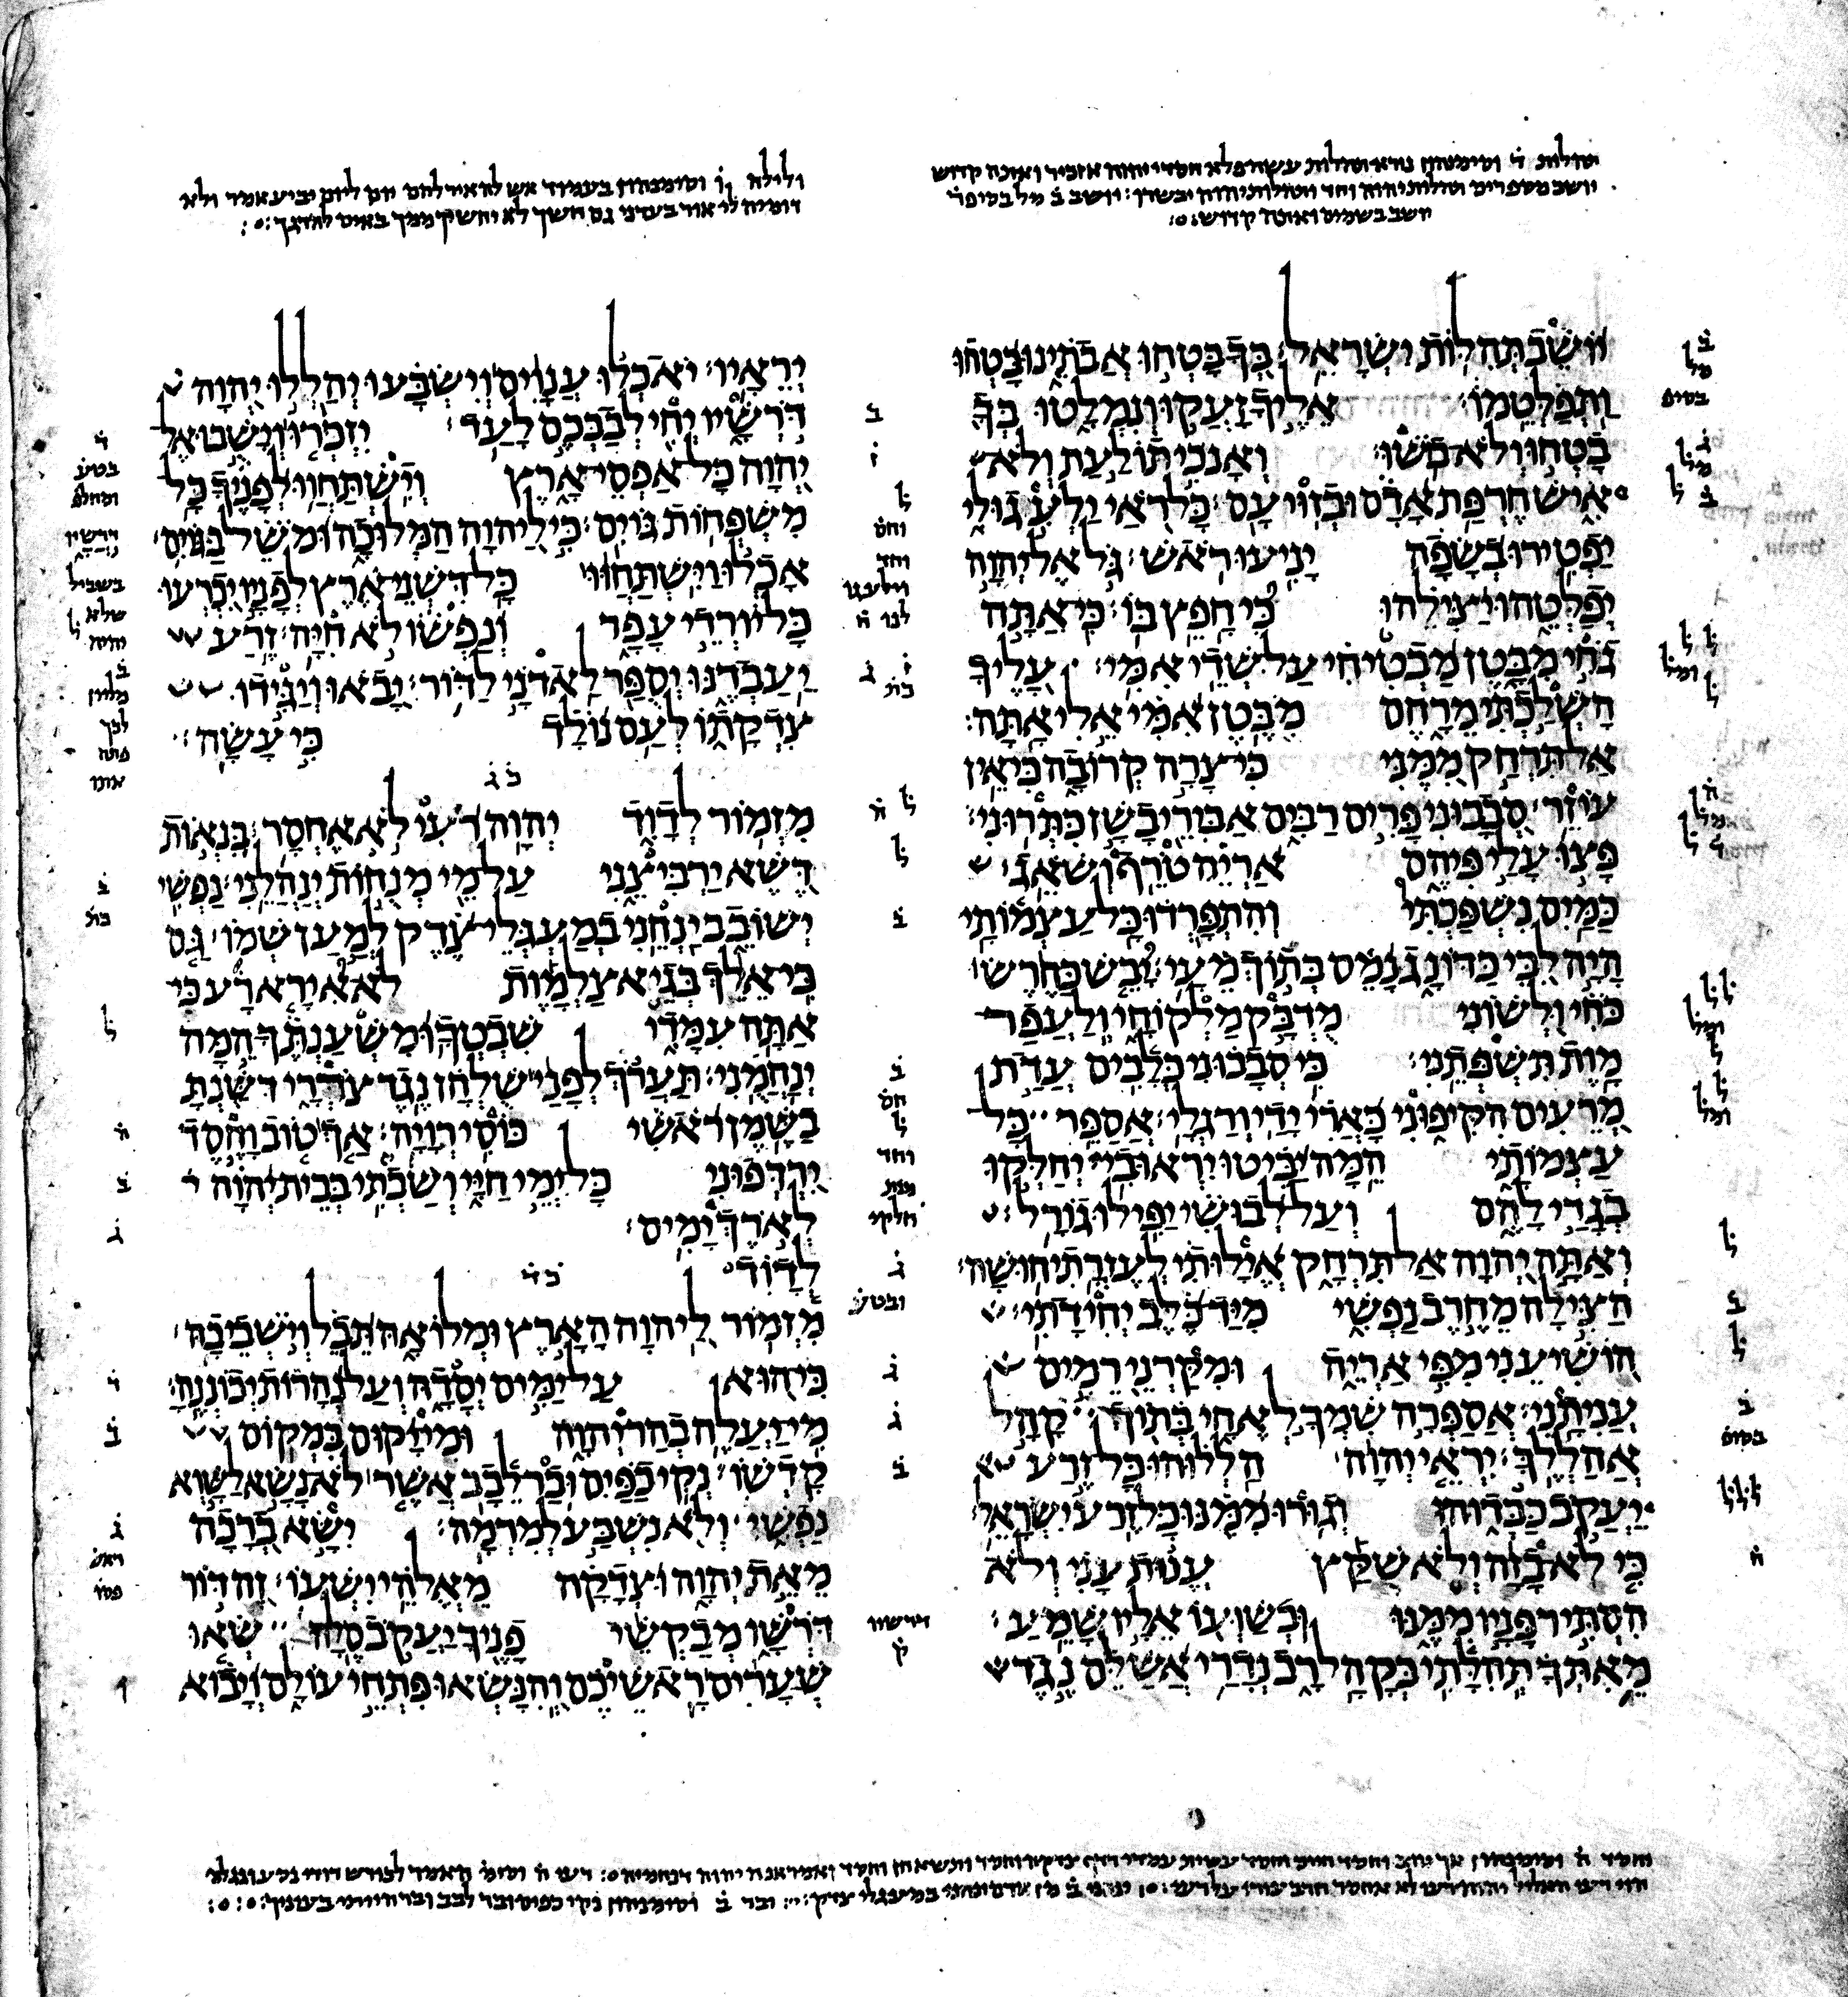

Slide 13
  The Hebrew Texts:
    Masoretic Text [MT]: The standard Hebrew text received from the Jewish scholars known as the Masoretes (AD 500–1000); the earliest complete Masoretic manuscript, the Leningrad Codex (AD 1008), supplied the text for the standard Hebrew Old Testament.
    The Dead Sea Scrolls [DSS]: More than 800 scrolls found since 1947 in the Judean Dessert (ca. 250 BC–135 AD); the manuscripts and fragments are in Hebrew, Greek, and Aramaic, and many are biblical, including every OT book except Esther. A great number reflect essentially the same Hebrew text of the Masoretes.

Slide 14
    The Samaritan Pentateuch [Smr]: The Bible of the Samaritan community, which contains only the five books of Moses.

Slide 15
  The Versions/Translations
    The Septuagint [LXX]: The translation of the OT into Greek by numerous translators of varied skill and accuracy; it became the Bible of the early church. It is the most useful version for establishing the OT text because (1) it’s the earliest translation; (2) it is well attested in numerous manuscripts; and (3) it contains more significant variant readings than any other version.
    The Targums [T] (Aramaic for “translation, interpretation”): An Aramaic translation or paraphrase of the Hebrew Scriptures made for postexilic Jews whose mother tongue was Aramaic.

Slide 16
    The Peshitta [S] (Syriac for “simple, straightforward”): A Syriac translation of the Hebrew Scriptures and the authorized Bible of the Syrian church.
    The Vulgate [V] ( Latin for “common, popular”): The Latin standard Bible of the Western church; the OT portion includes Jerome’s translation from the Hebrew with help from the Septuagint.

Slide 17
Assessing the Text Problem in Ps 22:16[H17]:
  The Guiding Principle: The more original reading is the one that best explains the rise of all the others.
  The ESV translation and note:
    Ps 22:16[H17]. “They have pierced my hands and feet¹”
    “¹Some Hebrew manuscripts, Septuagint, Vulgate, Syriac; most Hebrew manuscripts like a lion [they are at] my hands and feet.”

Slide 18
  External evidence:
    The Texts:
      MT: כָּאֲרִי יָדַי וְרַגְלָי (“like a lion my hands and feet”)
      DSS: כרי[ו] ידי ורגלי (4QPs^{f}; followed by LXX ,V, S)
    The Difference:
      MT: כְּ (“like”) + אֲרִי (“lion”)
      DSS: כָּרוּ (“they burrowed, gouged, pierced”)

Slide 19
    Assessment:
      The MT is more than “grammatically awkward” (NET notes); it is nonsensical (“like a lion my hands and feet”).
      כרה (krh) = “to borrow, hollow, dig,” whether of a well (Gen 26:25), a cistern (Ps 7:15[H16]), a pit (Ps 57:6[H7]), a pond (Ps 94:13), or a grave (2 Chr 16:14); even of an “open” ear for hearing God (Ps 40:6[H7]). It is a fine choice for expressing “gouging” or “piercing” of Christ’s hands and feet.
      The other natural option was דקר (“pierce”), which occurs in Zech 12:10 with the same predictive effect: “when they look on me, on him whom they have pierced, they shall mourn for him” (cf. John 19:37).

Slide 20
  Internal evidence:
    We already have numerous references in Psalm 22 that are applied by the NT to Christ’s passion.
    We have a number of examples in the OT where the bias of later Jewish scribes against Christianity appears to have moved them (consciously or unconsciously) to vocalize the Hebrew text is a less messianic way.
    Including “lion” in 22:16[H17] would break what appears to be an intentional inversion within the text:
      Vv. 12–18[H13–19], the enemies are “bulls,” a “lion,” “dogs,” and armed “evil doers” (vv. 12, 13, 16[H13, 14, 17])
      Vv. 20–21[H21–22], the enemies are “the sword,” “the dog,” “the lion,” and the horned “wild oxen.”

Slide 21
  Conclusion:
    Ps 22:16[H17] stands alongside Zech 12:10 (which uses a different verb for “pierced”) in supplying a direct prediction of the Messiah’s death (Matt 27:35; Mark 15:24; Luke 23:33), which included the piercing of his hands and feet (John 19:37; cf. 20:25; Luke 24:40).
    No major doctrines are at stake. Jesus’s feet and hands were pierced for our transgressions regardless of whether Ps 22:16[H17] predicted or not (Isa 53:5; Zech 12:10). But there are sound reasons to affirm the decision of our ESV translators.

