Slide 1
An Invitation to the
OLD TESTAMENT
An Overview of Jesus’ Bible
Jason S. DeRouchie, PhD
Professor of Old Testament and Biblical Theology
Bethlehem College & Seminary
www.jasonderouchie.com

Slide 2
Jesus’ KINGDOM Mission
Jesus and his early followers were convinced that Moses and the rest of the prophets wrote about Christ and should be believed.
  John 5:39, 46. You search the Scriptures because you think that in them you have eternal life; and ^{w}it is they that bear witness about me…. ⁴⁶For if you believed Moses, you would believe me, for he wrote of me. ⁴⁷But if you do not believe his writings, how will you believe my words?
  Luke 24:25–26. O foolish ones, and slow of heart to believe all that the prophets have spoken! ²⁶ Was it not necessary that the Christ should suffer these things and enter into his glory?

Slide 3
  John 1:45. We have found him of whom Moses in the Law and also the prophets wrote, Jesus of Nazareth.

Slide 4
Jesus was fulfilling all that the Old Testament anticipated.
  Matthew 5:17. Do not think that I have come to abolish the Law or the Prophets; I have not come to abolish but to fulfill.
  Luke 24:44. These are my words that I spoke to you while I was still with you, that everything written about me in the Law of Moses and the Prophets and the Psalms must be fulfilled.
  Acts 3:18. What God foretold by the mouth of all the prophets, that his Christ would suffer, he thus fulfilled.
  2 Cor 1:20. For all the promises of God find their Yes in him. That is why we utter our Amen to God for his glory.

Slide 5
Jesus’ mission of fulfillment was about God’s kingdom.
  Luke 4:43. I must preach the good news of the kingdom of God to the other towns as well, for I was sent for this purpose.
  Acts 1:3. He presented himself alive to them after his suffering by many proofs, appearing to them during forty days and speaking about the kingdom of God.
  God’s kingdom: God’s reign over God’s people in God’s land. God rules, saves, and satisfies through Jesus.

Slide 6
Jesus’ kingdom message focused on his work as Messiah and the global mission springing from it.
  Luke 24:44–47. the he said to them, “these are my words that I spoke to you while I was still with you, that everything written about me in the Law of Moses and the Prophets and the Psalms must be fulfilled.” ⁴⁵ Then he opened their minds to understand the Scriptures, ⁴⁶ and he said to them, “Thus it is written, that the Christ should suffer and on the third day rise from the dead, ⁴⁷ and that repentance and forgiveness of sins should be proclaimed in his name to all nations, beginning from Jerusalem.

Slide 7
Like Jesus, Paul’s preaching was about the kingdom of God climaxing in Christ.
  Acts 20:25, 31. And now behold, I know that none of you among whom I have gone about proclaiming the kingdom will see my face again. . . . ³¹ Be alert, remembering that for three years I did not cease night or day to admonish everyone with tears.
  Acts 28:23. From morning till evening he expounded to them, testifying to the kingdom of God and trying to convince them about Jesus both from the Law of Moses and from the Prophets.

Slide 8
Like Jesus, Paul’s kingdom message focused on the Messiah’s death and resurrection and the global mission that would grow from it.
  Acts 26:22–23. I stand here testifying both to small and great, saying nothing but what the prophets and Moses said would come to pass: ²³ that the Christ must suffer and that, by being the first to rise from the dead, he would proclaim light both to our people and to the Gentiles.

Slide 9
POP QUIZ

Slide 10
POP QUIZ
From your reading, what does the acronym KINGDOM stand for?
From your reading, what single statement captures the Bible’s frame, form, focus, and fulcrum?

Slide 11
God’s KINGDOM Plan in Scripture
OLD TESTAMENT FOUNDATION | K
 | I
 | N
 | G
 | D
NEW TESTAMENT FULFILLMENT | O
 | M

Slide 12
God’s KINGDOM Plan in Scripture
OLD TESTAMENT FOUNDATION | K | Kickoff & rebellion
 | I
 | N
 | G
 | D
NEW TESTAMENT FULFILLMENT | O
 | M

Slide 13
God’s KINGDOM Plan in Scripture
OLD TESTAMENT FOUNDATION | K | Kickoff & rebellion
 | I | Instrument of blessing
 | N
 | G
 | D
NEW TESTAMENT FULFILLMENT | O
 | M

Slide 14
God’s KINGDOM Plan in Scripture
OLD TESTAMENT FOUNDATION | K | Kickoff & rebellion
 | I | Instrument of blessing
 | N | Nation redeemed & commissioned
 | G
 | D
NEW TESTAMENT FULFILLMENT | O
 | M

Slide 15
God’s KINGDOM Plan in Scripture
OLD TESTAMENT FOUNDATION | K | Kickoff & rebellion
 | I | Instrument of blessing
 | N | Nation redeemed & commissioned
 | G | Government in the land
 | D
NEW TESTAMENT FULFILLMENT | O
 | M

Slide 16
God’s KINGDOM Plan in Scripture
OLD TESTAMENT FOUNDATION | K | Kickoff & rebellion
 | I | Instrument of blessing
 | N | Nation redeemed & commissioned
 | G | Government in the land
 | D | Dispersion & return
NEW TESTAMENT FULFILLMENT | O
 | M

Slide 17
God’s KINGDOM Plan in Scripture
OLD TESTAMENT FOUNDATION | K | Kickoff & rebellion
 | I | Instrument of blessing
 | N | Nation redeemed & commissioned
 | G | Government in the land
 | D | Dispersion & return
NEW TESTAMENT FULFILLMENT | O | Overlap of the ages
 | M

Slide 18
God’s KINGDOM Plan in Scripture
OLD TESTAMENT FOUNDATION | K | Kickoff & rebellion
 | I | Instrument of blessing
 | N | Nation redeemed & commissioned
 | G | Government in the land
 | D | Dispersion & return
NEW TESTAMENT FULFILLMENT | O | Overlap of the ages
 | M | Mission accomplished

Slide 19
God’s KINGDOM Plan in Scripture
OLD TESTAMENT FOUNDATION | K | Kickoff & rebellion
 | I | Instrument of blessing
 | N | Nation redeemed & commissioned
 | G | Government in the land
 | D | Dispersion & return
NEW TESTAMENT FULFILLMENT | O | Overlap of the ages
 | M | Mission accomplished

Slide 20
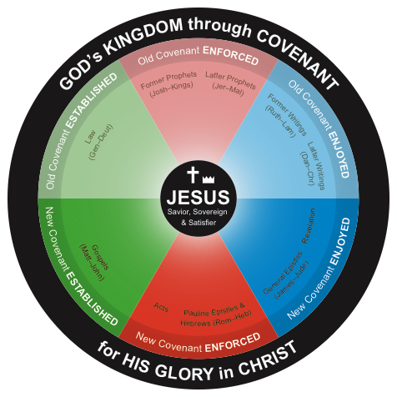
The Bible’s Frame, Form,
Focus, & Fulcrum

Slide 21
Rapid-Fire Q&A
(15 min)

Slide 22
God’s KINGDOM Plan in Scripture

Slide 23
God’s KINGDOM Plan in Scripture

Slide 24
God’s KINGDOM Plan in Scripture

Slide 25
God’s KINGDOM Plan in Scripture

Slide 26
God’s KINGDOM Plan in Scripture

Slide 27
God’s KINGDOM Plan in Scripture

Slide 28
God’s KINGDOM Plan in Scripture

Slide 29
The Overlap of the Ages in Salvation History

Slide 30
God’s KINGDOM Plan in Scripture

Slide 31
The OT is foundation; the NT fulfillment
  The OT anticipated Christ
    Rom 1:1–4
    John 5:39
    1 Pet 1:10–12
    Matt 13:17
    John 8:56
  Jesus fulfills all OT anticipations
    Matt 5:17–18
    Matt 11:13–14
    Acts 13:32–33

Slide 32
Old Covenant Structure
Law (Established) | Prophets (Enforced) |  | Writings (Enjoyed)
 | Former | Latter | Former | Latter
Genesis | Joshua | Jeremiah | Ruth | Daniel
Exodus | Judges | Ezekiel | Psalms | Esther
Leviticus | 1–2 Samuel | Isaiah | Job | Ezra-Nehemiah
Numbers | 1–2 Kings | The Twelve | Proverbs | 1–2 Chronicles
Deuteronomy |  |  | Ecclesiastes
 |  |  | Song of Songs
 |  |  | Lamentations
Narrative | Narrative | Commentary | Commentary | Narrative
K-I-N | G |  |  | D

Slide 33
Why Do We Call It the
Old Testament?
The Bible’s nature as covenantal revelation
  Covenant?

Slide 34
Why Do We Call It the
Old Testament?
The Bible’s nature as covenantal revelation
  Covenant? An elected relationship of obligation established under oath.
  5 key covenants that shape Scripture’s plot line?
    Adamic/Noahic
    Abrahamic
    Mosaic
    Davidic
    New

Slide 35
The covenant triangle in salvation history
God
People
Land

Slide 36
The covenant triangle in salvation history
  Adamic/Noahic covenant
Yahweh God
Humanity
Expanding Eden/Earth

Slide 37
The covenant triangle in salvation history
  Abrahamic covenant
Yahweh God
Offspring of Promise
Promised Land
All Nations
Whole Earth

Slide 38
The covenant triangle in salvation history
  Mosaic covenant
Yahweh God
National Israel
Promised Land
All Nations
Whole Earth

Slide 39
The covenant triangle in salvation history
  New (creation) covenant
Triune God
Believing Jew & Gentile
New Earth

Slide 40
Why Do We Call It the
Old Testament?
10 Reasons Why Old Does Not Mean Unimportant:
  The OT was Jesus’ only Scripture and makes us three-fourths (75%) of our Bible.
  The OT substantially influences our understanding of key biblical teachings.
  We meet the same God in both Testaments.
  The OT announces the very “good news/gospel” we enjoy.
  Both the old and new covenants call for love, and we can learn much about love from the OT.

Slide 41
  Jesus came not to destroy the Law and the Prophets but to fulfill them.
  Jesus said that all the OT points to him.
  Failing to declare “the whole counsel of God” can put us in danger before the Lord.
  The NT authors stressed that God gave the OT for Christians.
  Paul commands church leaders to preach the OT.

Slide 42
Rapid-Fire Q&A
(15 min)

Slide 43
The Bible’s historical grounding
  God has spoken through human authors (2 Tim 3:16; 2 Pet 1:21)
  Special revelation within a specific historical-geographical context
    Ethnicity
    Language
    Culture and worldview

Slide 44
    Historical scope
      Egypt (3000–1200 BC)
      Israel (1010–930 BC)
      Assyria (870–626 BC)
      Babylon (626–539 BC)
      Persia (539–323 BC)

Slide 45
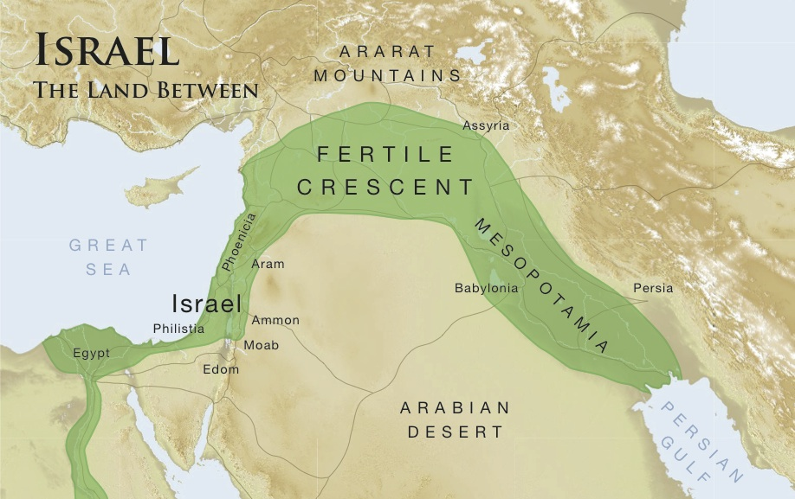

Slide 46
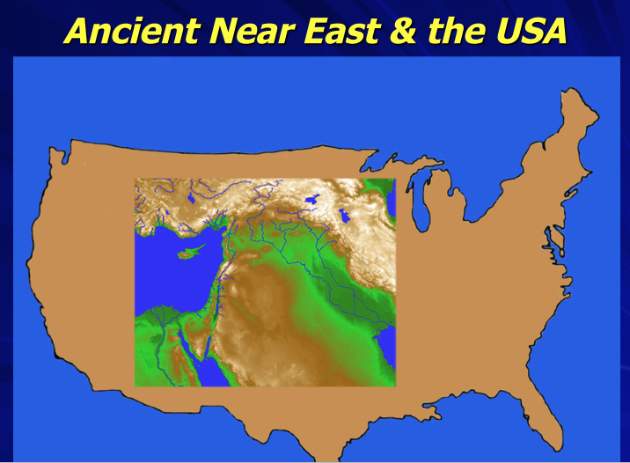

Slide 48
    Israel as the “Land Between”
      Ezek 5:5–6
      Gen 12:3
      Exod 19:5–6
      Deut 4:5–8
      Ezek 36:23

