Slide 1
JESUS’ BIBLE AS CHRISTIAN SCRIPTURE
FOR OUR INSTRUCTION
Rev. Dr. Jason S. DeRouchie, PhD
Professor Professor of Old Testament and Biblical Theology
Bethlehem College & Seminary
www.jasonderouchie.com

Slide 2
Ten Reasons the Old Testament Is Important for Christians
The OT was Jesus’ only Scripture and makes up three-fourths (75.55%) of our Bible.
The OT substantially influences our understanding of key biblical teachings.
We meet the same God in both Testaments.
The OT announces the very “good news/gospel” we enjoy.

Slide 3
Both the old and new covenants call for love, and we can learn much about love from the OT.
Jesus came not to destroy the Law and the Prophets but to fulfill them.
Jesus said that all the OT points to him.
Failing to declare “the whole counsel of God” can put us in danger before the Lord.
The NT authors stressed that God gave the OT for Christians.
Paul commands church leaders to preach the OT.

Slide 4
Both the old and new covenants call for love, and we can learn much about love from the OT.
Jesus came not to destroy the Law and the Prophets but to fulfill them.
Jesus said that all the OT points to him.
Failing to declare “the whole counsel of God” can put us in danger before the Lord.
The NT authors stressed that God gave the OT for Christians.
Paul commands church leaders to preach the OT.

Slide 5
My Main Thesis
The Old Testament is Christian Scripture.
God originally gave the Old Testament to instruct Christians.
The Old Testament authors had some sense that their words would be more meaningful for those living this side of the cross than for those living before it.
Jesus is the one who enlivens us to read the Old Testament and to receive what is there and who guides us to know how to read it in a way that ultimately points to him.

Slide 6
1. New Testament Reflections on the Main Audience of Old Testament Instruction
Paul believed God gave the Old Testament for new covenant believers.
  Rom 4:23–24. But the words “it was counted to him” were not written for his sake alone, but for ours also. (Cf. Gen 15:6)
  Rom 15:4. For whatever was written in former days was written for our instruction, that through endurance and through the encouragement of the Scriptures we might have hope. (Cf. Ps 69:9)

Slide 7
  1 Cor 10:11. Now these things happened to them as an example, but they were written down for our instruction, on whom the end of the ages has come.
  2 Tim 3:15–17, 4:2. From childhood you have been acquainted with the sacred writings, which are able to make you wise for salvation through faith in Christ Jesus. ¹⁶ All Scripture is breathed out by God and profitable for teaching, for reproof, for correction, and for training in righteousness, ¹⁷ that the man of God may be complete, equipped for every good work…. ^{4:2} Preach the word; be ready in season and out of season; reprove, rebuke, and exhort, with complete patience and teaching.

Slide 8
New Testament authors used the OT as the basis for Christian exhortation.
  Eph 6:2–3. “Honor your father and mother” (this is the first commandment with a promise), that it may go well with you and that you may live long in the land. (Cf. Exod 20:12)
  1 Tim 5:17–18. Let the elders who rule well be considered worthy of double honor, especially those who labor in preaching and teaching. For the Scripture says, “You shall not muzzle an ox when it treads out the grain.” (Cf. Deut 25:4)

Slide 9
  1 Pet 1:15–16. Be holy in all your conduct, since it is written, “You shall be holy, for I am holy.” (Cf. Lev 11:44–45)

Slide 10
Peter stressed that the Old Testament authors themselves knew that they were writing for us.
  1 Pet 1:10–12. Concerning this salvation, the prophets who prophesied about the grace that was to be yours searched and inquired carefully, inquiring what person or time the Spirit of Christ in them was indicating when he predicted the sufferings of Christ and the subsequent glories. It was revealed to them that they were serving not themselves but you, in the things that have now been announced to you through those who preached the good news to you by the Holy Spirit sent from heaven, things into which angels long to look.

Slide 11
2. Old Testament Reflections on the Main Audience of Old Testament Instruction
Moses
  Deut 29:2, 4[H1, 3]. You have seen all that the LORD did before your eyes in the land of Egypt…. ⁴ But to this day the LORD has not given you a heart to understand or eyes to see or ears to hear.
  Deut 30:6, 8. The LORD your God will circumcise your heart ... so that you will love the LORD your God with all…. ⁸ And you will turn and you will hear the voice of the LORD and do all his commandments that I am commanding you today.

Slide 12
Isaiah
  Isa 29:9–11. Astonish yourselves and be astonished; blind yourselves and be blind! ... ¹⁰ For the LORD has poured out upon you a spirit of deep sleep, and has closed your eyes (the prophets), and covered your heads (the seers). ¹¹ And the vision of all this has become to you like the words of a book that is sealed. When men give it to one who can read, saying, “Read this,” he says, “I cannot, for it is sealed.”
  Rom 11:7–8. Israel failed to obtain what it was seeking. The elect obtained it, but the rest were hardened, ⁸ as it is written, “God gave them a spirit of stupor, eyes that would not see and ears that would not hear, down to this very day.”

Slide 13
  Isa 29:18. In that day the deaf shall hear the words of a book, and out of their gloom and darkness the eyes of the blind shall see. (Cf. Isa 42:6–7).
  Isa 30:8. And now, go, write it before them on a tablet and inscribe it in a book, that it may be for the time to come as a witness forever.

Slide 14
Jeremiah
  Jer 30:2–3. Thus says the LORD, the God of Israel: Write in a book all the words that I have spoken to you. ³ For behold, days are coming, declares the LORD, when I will restore the fortunes of my people, Israel and Judah, says the LORD, and I will bring them back to the land that I gave to their fathers, and they shall take possession of it.
  Jer 30:24–31:1. The fierce anger of the LORD will not turn back until he has executed and accomplished the intentions of his mind. In the latter days you will understand this. ^{31:1} At that time, declares the LORD, I will be the God of all the clans of Israel, and they shall be my people.

Slide 15
Daniel
  Dan 12:2–4, 6–10, 13. And many of those who sleep in the dust of the earth shall awake, some to everlasting life, and some to shame and everlasting contempt. ³ And those who are wise shall shine like the brightness of the sky above; and those who turn many to righteousness, like the stars forever and ever. ⁴ But you, Daniel, shut up the words and seal the book, until the time of the end. Many shall run to and fro, and knowledge shall increase.”... ⁶ And someone said …, “How long shall it be till the end of these wonders?” ⁷ And I heard the man … [say] that it would be for a time, times, and a half a time, and that when the shattering of

Slide 16
  the power of the holy people comes to an end all these things would be finished. ⁸ I heard, but I did not understand. Then I said, “O my lord, what shall be the outcome of these things?” ⁹ He said, “Go your way, Daniel, for the words are shut up and sealed until the time of the end. ¹⁰ Many shall purify themselves and make themselves white and be refined, but the wicked shall act wickedly. And none of the wicked shall understand, but those who are wise shall understand…. But go your way till the end. And you shall rest and shall stand in your allotted place at the end of the days.

Slide 17
Synthesis: “they were serving not
themselves” (1 Pet 1:12)
  Yahweh’s prophets did not fully grasp the meaning of all their predictions and declarations, but a remnant of faithful would understand in the latter days.
    Dan 12:8, 10. I heard, but I did not understand…. He said, “Go your way, Daniel, for the words are shut up and sealed until the time of the end…. And none of the wicked shall understand, but those who are wise shall understand.”
    Jer 30:24. In the latter days you will understand this.

Slide 18
  God’s prophets were convinced that the rebel majority among their contemporaries would neither hear nor heed their messages due to God’s hardening judgment, but they also envisioned a day when the Lord would overcome such spiritual disability.
    Deut 29:4[H3]; 30:8. But to this day the LORD has not given you a heart to understand or eyes to see or ears to hear…. ^{30:8} And you shall turn and heed the voice of the LORD your God and keep all his commandments that I command you today.
    Isa 29:11, 18. And the vision of all this has become to you like the words of a book that is sealed. When men give it to one who can read, saying, “Read this,” he says, “I cannot, for it is sealed.”… ¹⁸ In that day the deaf shall hear the words of a book, and out of their gloom and darkness the eyes of the blind shall see.

Slide 19
3. New Testament Reflections on the Rebels’ Inability to Understand the Old Testament
The blindness of the Jewish leaders
  “Have you not read?” (Matt 12:3, 5; 19:4; 21:16, 42; 22:31)
The blindness of the crowds
  John 12:37–41. Though [Jesus] had done so many signs before them, they still did not believe in him, so that the word spoken by the prophet might be fulfilled: “Lord, who has believed what he heard from us, and to whom has the arm of the Lord been revealed?” Therefore they could not believe. For again Isaiah said, “He has blinded their eyes, and hardened their heart, lest they see with their eyes, and understand with their heart, and turn, and I will heal them.” Isaiah said these things because he saw his glory and spoke of him. (Cf. Isa 53:1; 6:10)

Slide 20
Paul’s commentary
  Rom 11:7–8. Israel failed to obtain what it was seeking. The elect obtained it, but the rest were hardened, as it is written, ‘God gave them a spirit of stupor, eyes that would not see and ears that would not hear, down to this very day. (Cf. Deut 29:4[H3]; Isa 29:10)

Slide 21
  2 Cor 3:14. The [Jews’] minds were hardened. For to this day, when they read the old covenant, that same veil remains unlifted, because only through Christ is it taken away.
  2 Cor 4:4, 6. The god of this world has blinded the minds of the unbelievers, to keep them from seeing the light of the gospel of the glory of Christ, who is the image of God…. ⁶ God, who said, ‘Let light shine out of darkness,’ has shone in our hearts to give the light of the knowledge of the glory of God in the face of Jesus Christ.

Slide 22
4. New Testament Reflections on the Remnant’s Inability to Fully Understand the Old Testament
Jesus’ engagement with his disciples before his death
  Mark 4:11–13. And he said to them, “To you has been given the secret of the kingdom of God, but for those outside everything is in parables, ¹² so that “‘they may indeed see but not perceive, and may indeed hear but not understand, lest they should turn and be forgiven.’” ¹³ And he said to them, “Do you not understand this parable? How then will you understand all the parables? (Cf. Isa 6:9–10)

Slide 23
  Luke 24:25–26. O foolish ones, and slow of heart to believe all that the prophets have spoken! Was it not necessary that the Christ should suffer these things and enter into his glory?
  Luke 24:32. Did not our hearts burn within us while he talked to us on the road, while he opened to us the Scriptures?
  Isa 29:18. The deaf shall hear the words of a book, and out of their gloom and darkness the eyes of the blind shall see.
  Dan 12:10. Those who are wise shall understand.

Slide 24
  Luke 24:44–45. Then he said to them, ‘These are my words that I spoke to you while I was still with you, that everything written about me in the Law of Moses and the Prophets and the Psalms must be fulfilled.’ Then he opened their minds to understand the Scriptures.
  Note: Jesus is revealing a “mystery” that is not totally new revelation, but its full disclosure was to a significant extent hidden.

Slide 25
5. New Testament Reflections on the
Old Testament’s Mystery Revealed
The Old Testament prophets understood in part but only in part what they were testifying.
  The prophets knew something:
    Dan 10:1. He understood the word and had understanding of the vision.
    John 8:56. Your father Abraham rejoiced that he would see my day. He saw it and was glad.

Slide 26
    Acts 2:30–31. Knowing that God had sworn with an oath to him that he would set one of his descendants on his throne, [David] foresaw and spoke about the resurrection of the Christ. (Cf. Ps 16:8–11)
    Heb 11:13. These all died in faith, not having received the things promised, but having seen them and greeted them from afar.

Slide 27
  The prophets didn’t know all.
    Dan 12:8–9. I heard, but I did not understand…. [Then the messenger of the Lord said,] ⁹ “Go your way, Daniel, for the words are shut up and sealed until the time of the end.”
    Luke 10:24. I tell you that many prophets and kings desired to see what you see, and did not not see it, and to hear what you hear, and did not hear it.

Slide 28
The prophets were serving us.
  1 Pet 1:10–11. Concerning this salvation, the prophets who prophesied about the grace that was to be yours searched and inquired carefully, inquiring what person or time the Spirit of Christ in them was indicating when he predicted the sufferings of Christ and the subsequent glories. It was revealed to them that they were serving not themselves but you, in the things that have now been announced to you through those who preached the good news to you by the Holy Spirit sent from heaven, things into which angels long to look.

Slide 29
The prophets were serving us.
  1 Pet 1:10–12. Concerning this salvation, the prophets who prophesied about the grace that was to be yours searched and inquired carefully, ¹¹ inquiring what person or time the Spirit of Christ in them was indicating when he predicted the sufferings of Christ and the subsequent glories. ¹² It was revealed to them that they were serving not themselves but you, in the things that have now been announced to you through those who preached the good news to you by the Holy Spirit sent from heaven, things into which angels long to look.
  Note 1: They understood something.

Slide 30
The prophets were serving us.
  1 Pet 1:10–11. Concerning this salvation, the prophets who prophesied about the grace that was to be yours searched and inquired carefully, ¹¹ inquiring what person or time the Spirit of Christ in them was indicating when he predicted the sufferings of Christ and the subsequent glories. ¹² It was revealed to them that they were serving not themselves but you, in the things that have now been announced to you through those who preached the good news to you by the Holy Spirit sent from heaven, things into which angels long to look.
  Note 2: They also grasped that their messages were principally for those living in the days of fulfillment.

Slide 31
The significance of Jesus’ resurrection and glorification for our understanding of the Old Testament.
  John 2:20–22. The Jews then said, “It has taken forty-six years to build this temple, and will you raise it up in three days?” But [Jesus] was speaking about the temple of his body. When therefore he was raised from the dead, his disciples remembered that he had said this, and they believed the Scripture and the word that Jesus had spoken.

Slide 32
  John 12:13–16. So they took branches of palm trees and went out to meet him, crying out, “Hosanna! Blessed is he who comes in the name of the Lord, even the King of Israel!” And Jesus found a young donkey and sat on it, just as it is written, “Fear not, daughter of Zion; behold, your king is coming, sitting on a donkey’s colt!” His disciples did not understand these things at first, but when Jesus was glorified, then they remembered that these things had been written about him and had been done to him.

Slide 33
Paul’s celebration of the mystery revealed.
  Rom 16:25–26. Now to him who is able to strengthen you according to my gospel and the preaching of Jesus Christ, according to the revelation of the mystery that was kept secret for long ages but has now been disclosed and through the prophetic writings has been made known to all nations, according to the command of the eternal God, to bring about the obedience of faith.

Slide 34
Paul’s celebration of the mystery revealed.
  Rom 16:25–26. Now to him who is able to strengthen you according to my gospel and the preaching of Jesus Christ, according to the revelation of the mystery that was kept secret for long ages but has now been disclosed and through the prophetic writings has been made known to all nations, according to the command of the eternal God, to bring about the obedience of faith.
  Note 1: The revelation of the mystery is bound up in the gospel and Paul’s preaching about Jesus Christ.

Slide 35
Paul’s celebration of the mystery revealed.
  Rom 16:25–26. Now to him who is able to strengthen you according to my gospel and the preaching of Jesus Christ, according to the revelation of the mystery that was kept secret for long ages but has now been disclosed and through the prophetic writings has been made known to all nations, according to the command of the eternal God, to bring about the obedience of faith.
  Note 2: The message of the gospel was in some senses “kept secret for long ages,” out of the grasp of rebel and remnant alike.

Slide 36
Paul’s celebration of the mystery revealed.
  Rom 16:25–26. Now to him who is able to strengthen you according to my gospel and the preaching of Jesus Christ, according to the revelation of the mystery that was kept secret for long ages but has now been disclosed and through the prophetic writings has been made known to all nations, according to the command of the eternal God, to bring about the obedience of faith.
  Note 3: Yet the revelation of the mystery itself is, by means of Christ, made known through the Old Testament prophets.

Slide 37
6. The Centrality of Christ for
Interpreting the Old Testament
Synthesis:
  What we are seeing is both organic unity and progressive development.
  Christ’s appearing supplies believers with the necessary light to see what has been in the OT all along.
  Yet his coming also supplies a lens that influences and guides our reading.

Slide 38
6. The Centrality of Christ for
Interpreting the Old Testament
Synthesis:
  What we are seeing is both organic unity and progressive development.
  Christ’s appearing supplies believers with the necessary light to see what has been in the OT all along. (The Lifting of a Veil)
  Yet his coming also supplies a lens that influences and guides our reading. (An Answer Key)

Slide 39
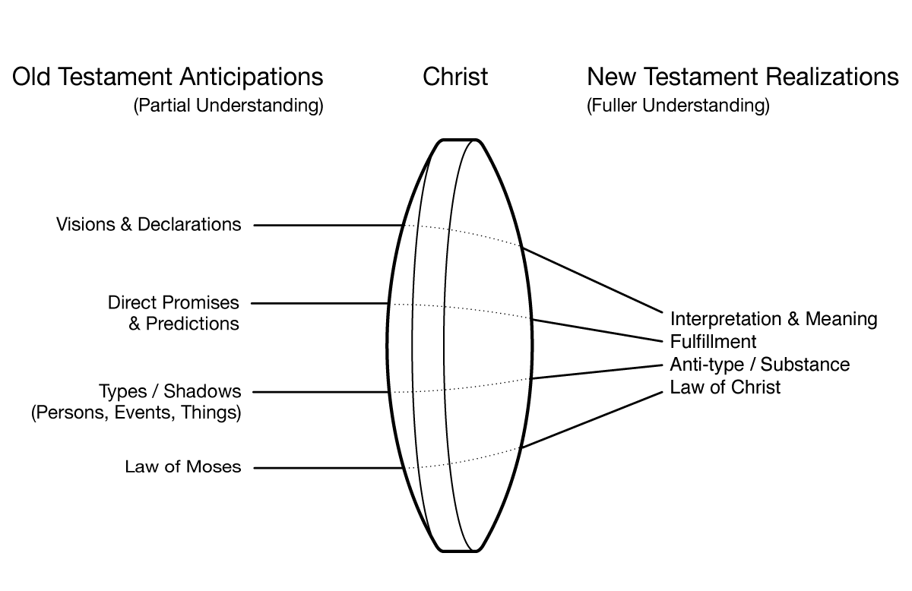
6. The Centrality of Christ for
Interpreting the Old Testament

