Slide 1
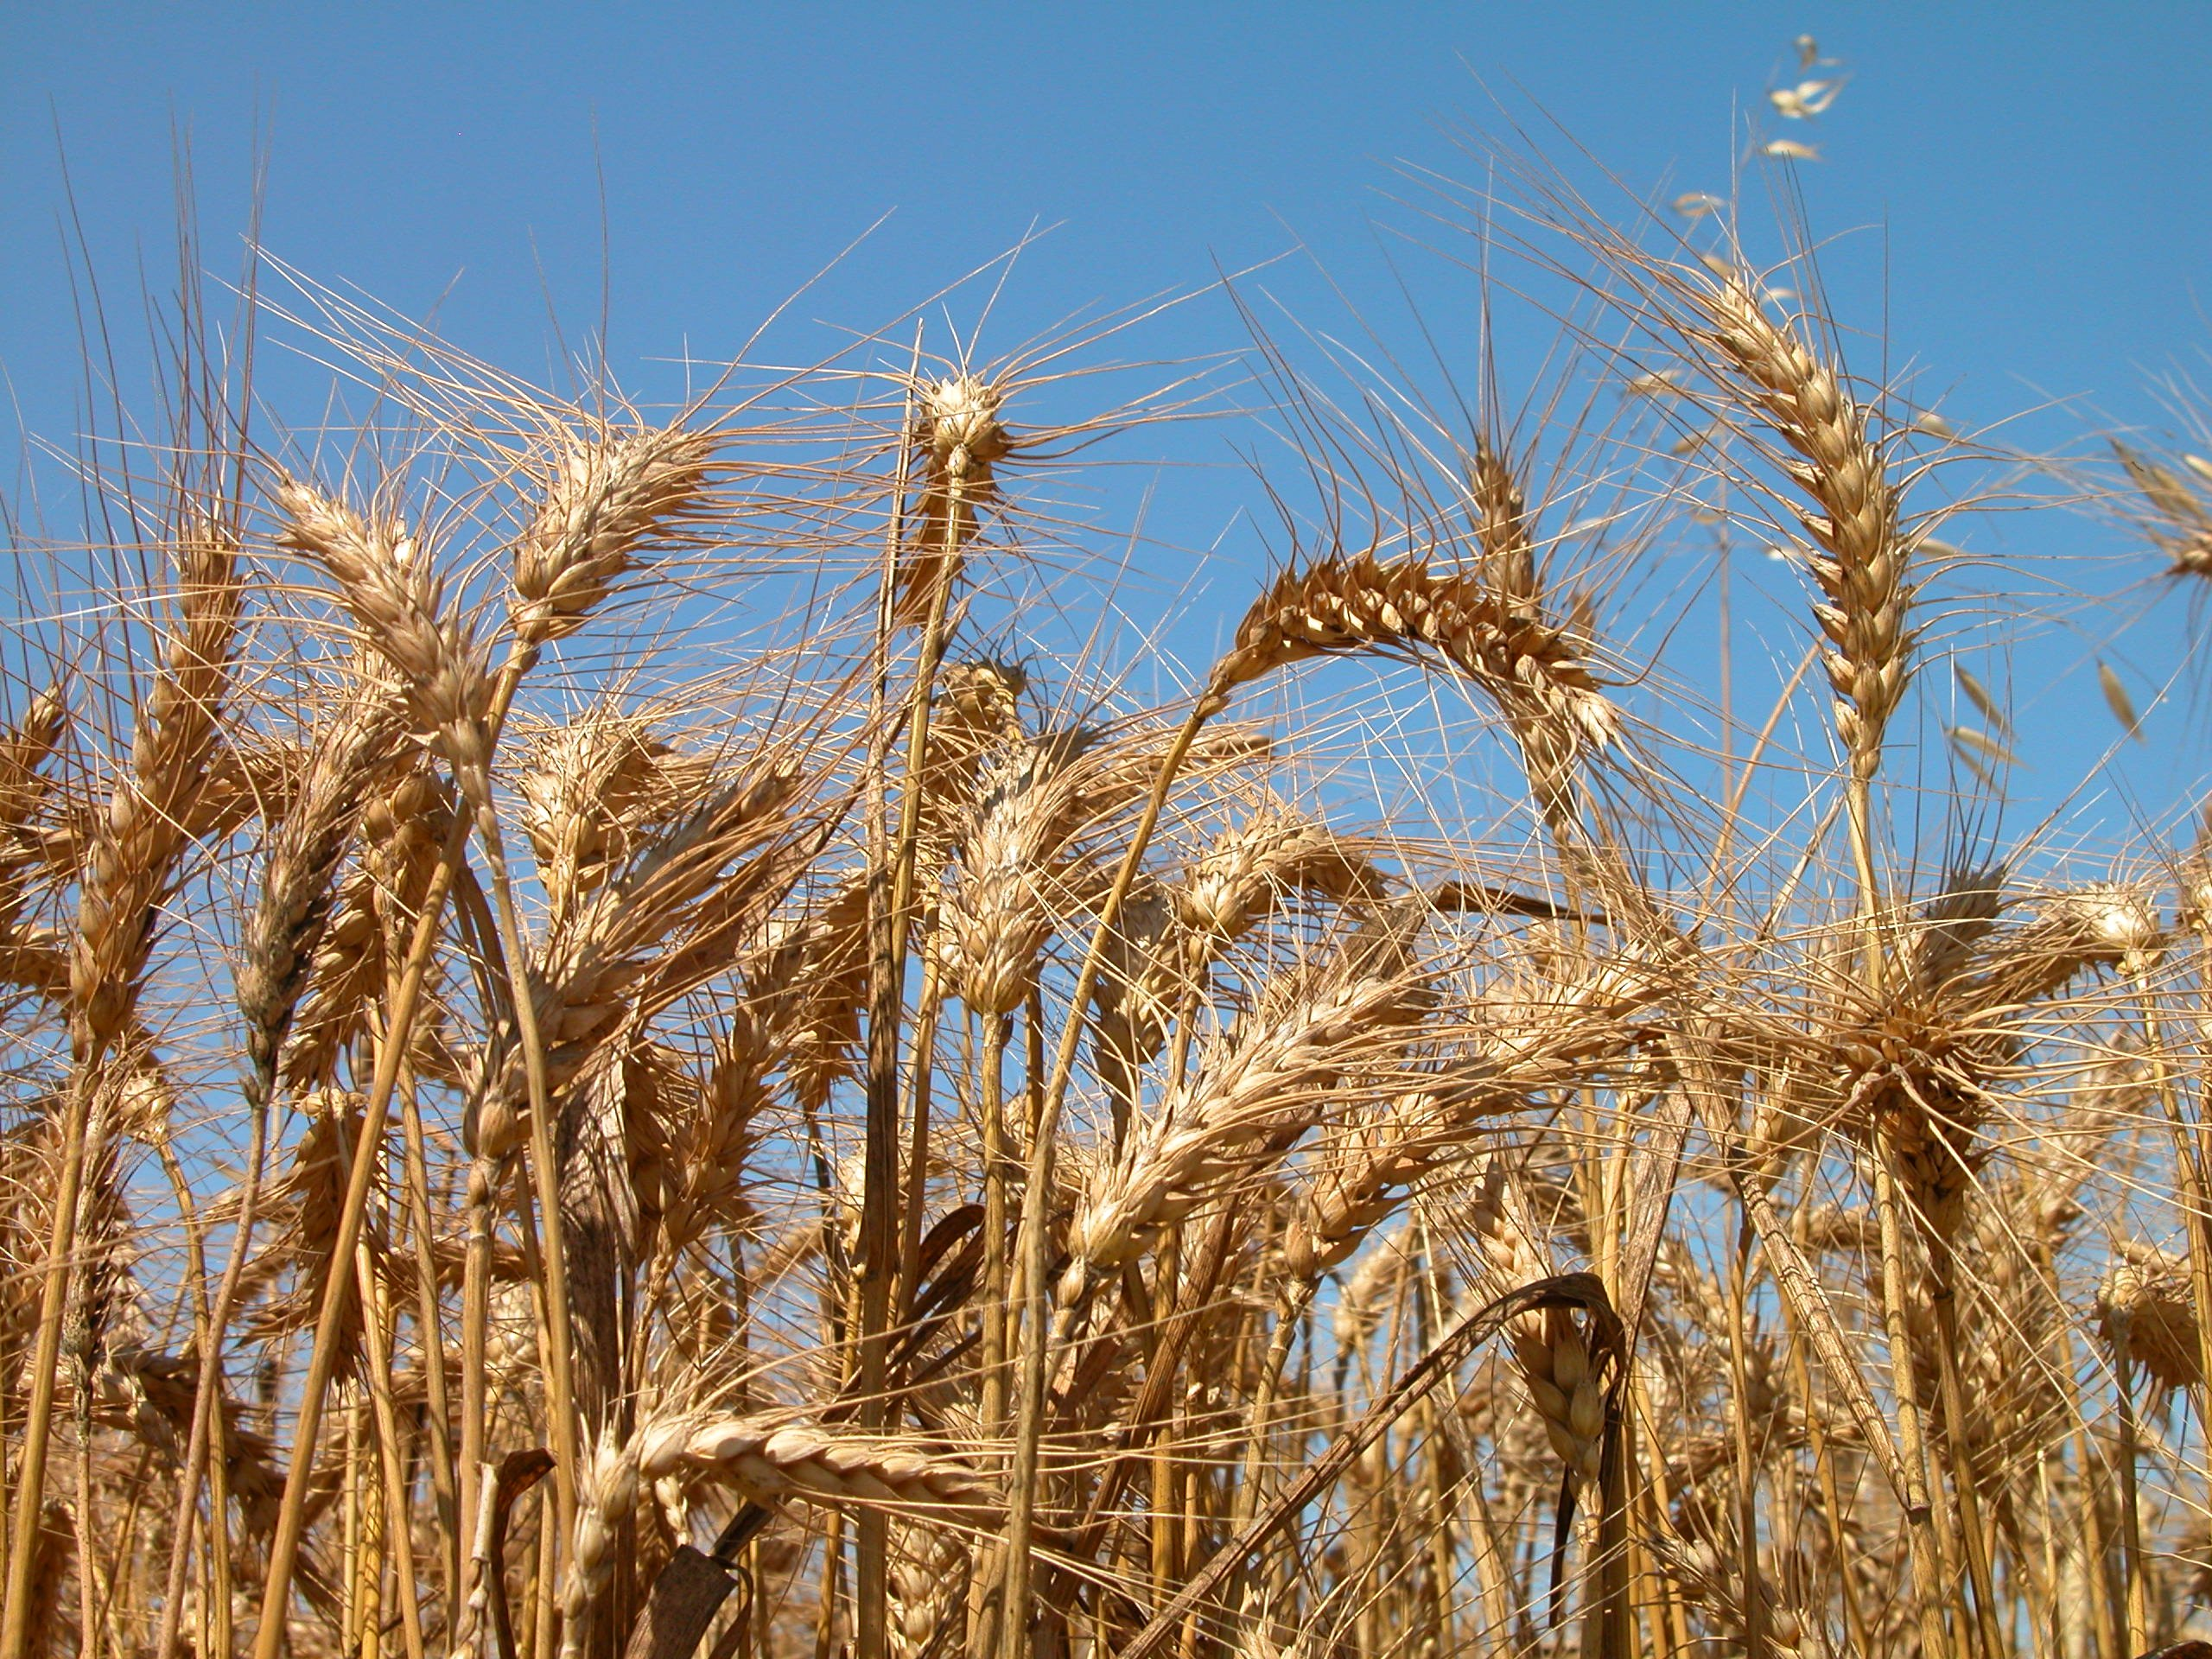
An Invitation to RUTH
Rev. Dr. Jason DeRouchie
Bethlehem’s Women’s Bible Study
Summer 2018

Slide 3
1. Ruth’s setting in time
“The days that the judges ruled” (Ruth 1:1):
  Days of Israel’s tribal confederation
  Days of Israel’s Canaanization (Judg 2:2–3)
  Days of cycles of disobedience and divine curse (2:11–19)

Slide 4
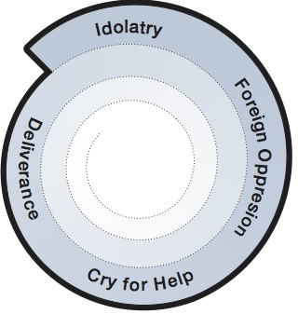
Downward Spiraling Cycles of Disobedience in Judges

Slide 5
1. Ruth’s setting in time
“The days that the judges ruled” (Ruth 1:1):
  Days of Israel’s tribal confederation
  Days of Israel’s Canaanization (Judg 2:2–3)
  Days of cycles of disobedience and divine curse (2:11–19)
  Days of increasingly degenerate thinking, relationships, and rule
  Days of self-rule (Judg 21:25)

Slide 6
1. Ruth’s setting in time
“There was a famine in the land” (Ruth 1:1):
  Highlights the curse-context (Deut 28:15, 23–24)
  Forces a departure from “the house of bread” in Moab (Ruth 1:1)
  Draws attention to Bethlehem
The significance?

Slide 7
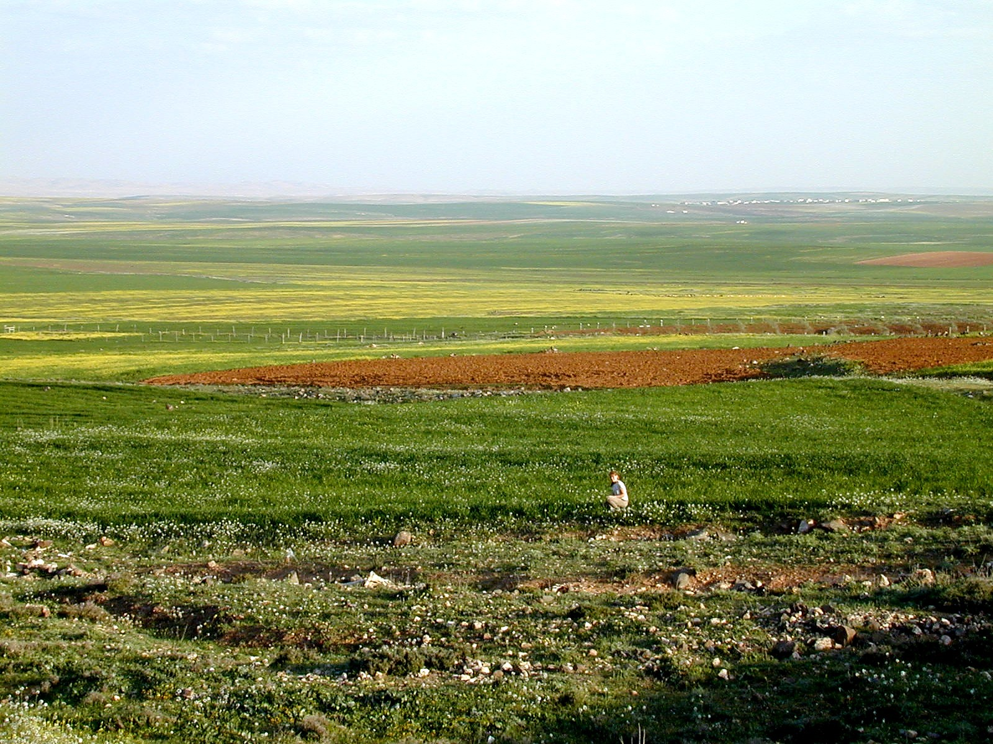
“Then she arose with her daughters-in-law to return from the country of Moab, for she heard in the fields of Moab that the LORD had visited his people and given them food” (Ruth 1:6).

Slide 8
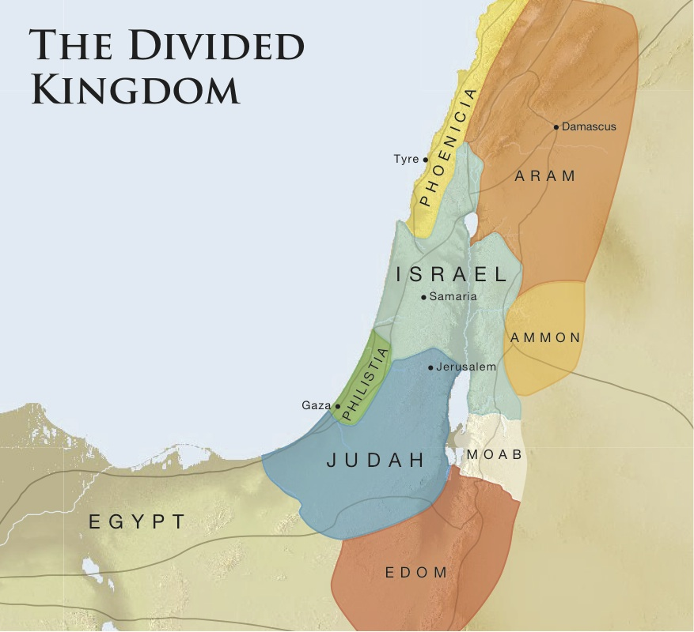

Slide 9
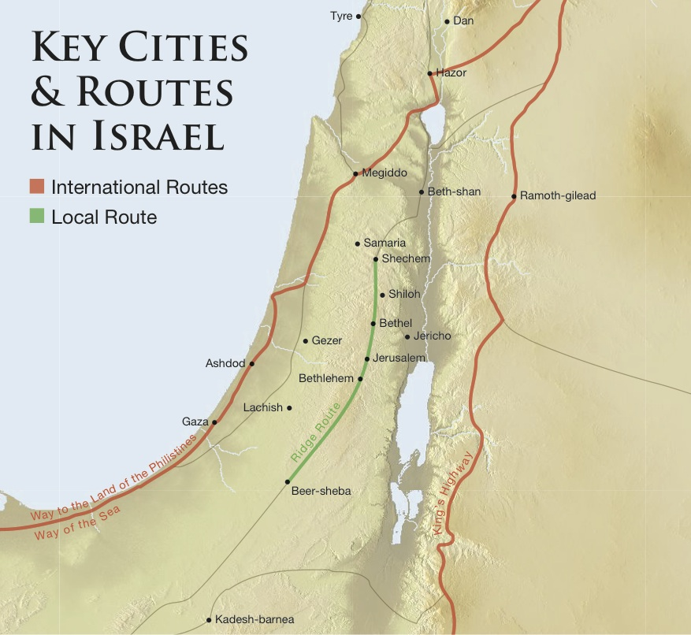

Slide 10
2. Ruth’s Moabite background
Introductory matters:
  Moab’s origin (Gen 19:36–37)
  God’s curse on Moab (Deut 23:3–4; cf. Num 22–24)
  Moab’s influence in the days of the judges (Judg 3:12–30; 10:6)

Slide 11
2. Ruth’s Moabite background
The significance of Ruth’s Moabite descent
  God wholly redeems those who repent (Deut 23:3).
  God uses broken people for great things (Ruth 4:21–22; Matt 1:5–6; cf. Josh 2:9, 11; 6:25).
  God is slowly making friends out of enemies (Gen 12:3; 22:18; Exod 12:48).

Slide 12
3. Key themes in Ruth
Yahweh treasures covenant faithfulness.
  Ruth is loyal both to her mother-in-law Naomi and to Naomi’s God (Ruth 1:16–17).
  Ruth is dependent, seeking refuge in Yahweh (2:12).
  Ruth is a “worthy” woman (3:11).
  Boaz is an ideal Israelite, a “worthy man” (2:1)
  Boaz is faithful to God’s covenant (2:20; 4:1–14; cf. Deut 25:5–10).

Slide 13
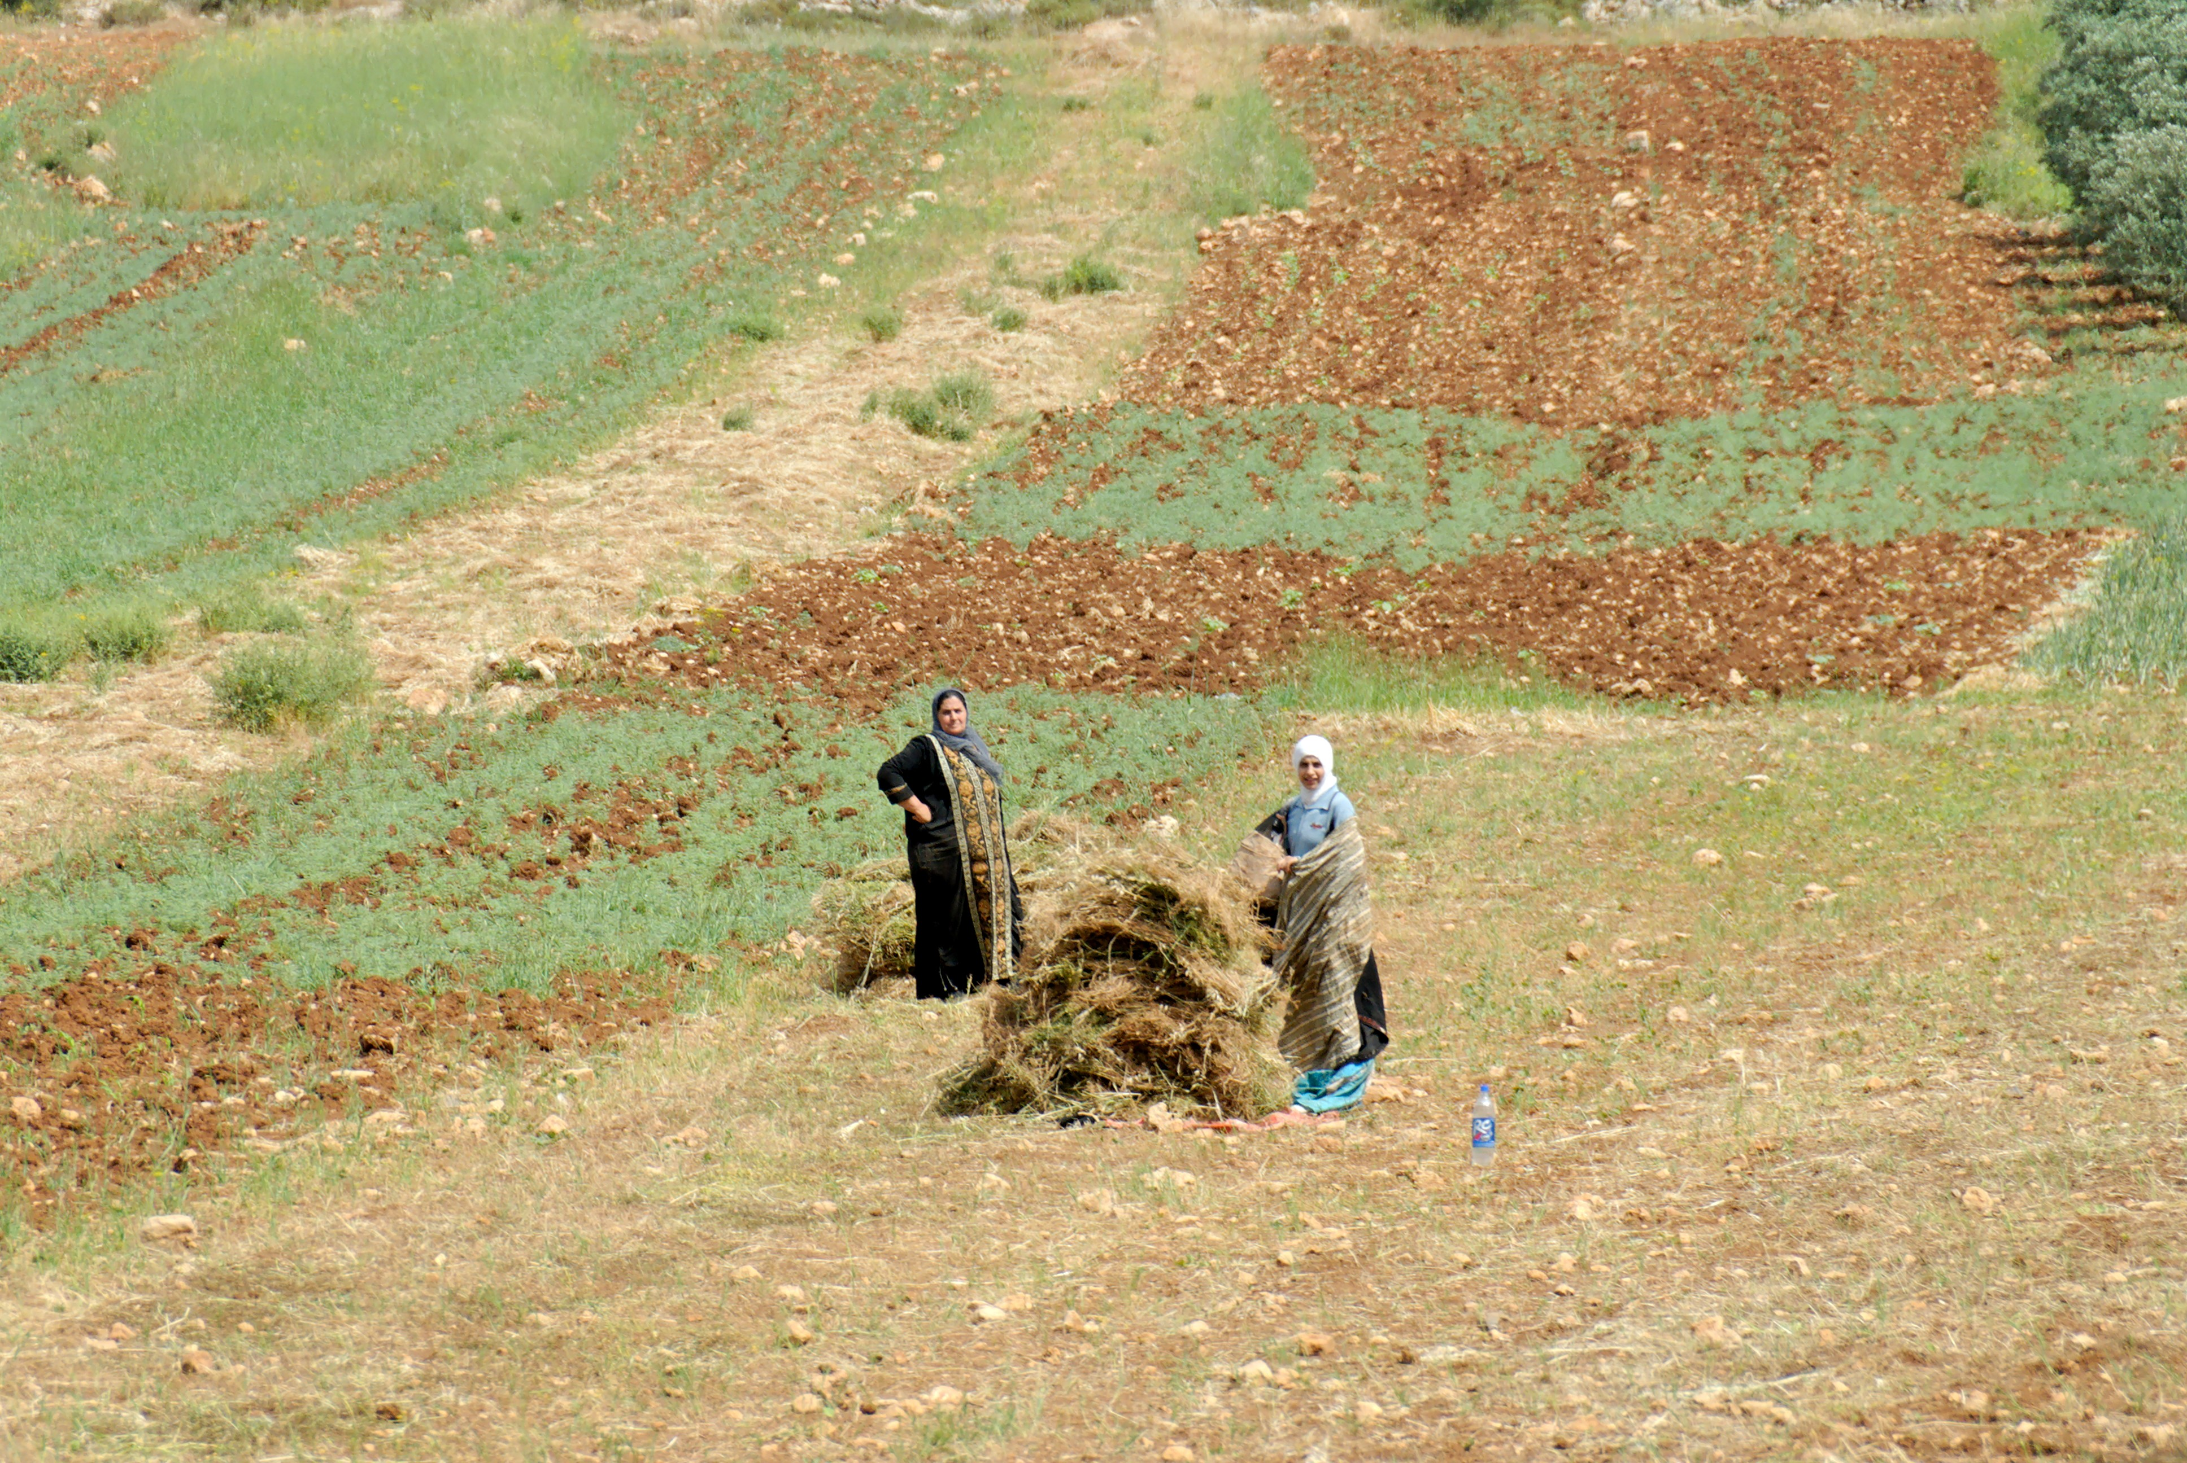
“Your people shall be my people, and your God my God” (Ruth 1:16).

Slide 14
3. Key themes in Ruth
Yahweh is a redeeming God.
  “Redeem / redeemer” = 22x (cf. Ruth 2:12, 20; 3:9)
  Backdrop for the work of Christ: Isa 54:4–5

Slide 15
3. Key themes in Ruth
Yahweh will fulfill his promises to redeem and restore Israel, ultimately through the line of David.
  Through Boaz and Ruth, God is doing something akin to reconstituting a new Israel (Ruth 4:11).
  The book’s last word “David” issues a ray of messianic hope in the midst of darkness (4:22).
  The ending recalls messianic promises in Genesis (4:18–22; cf. Gen 3:15; 49:8, 10).

Slide 16
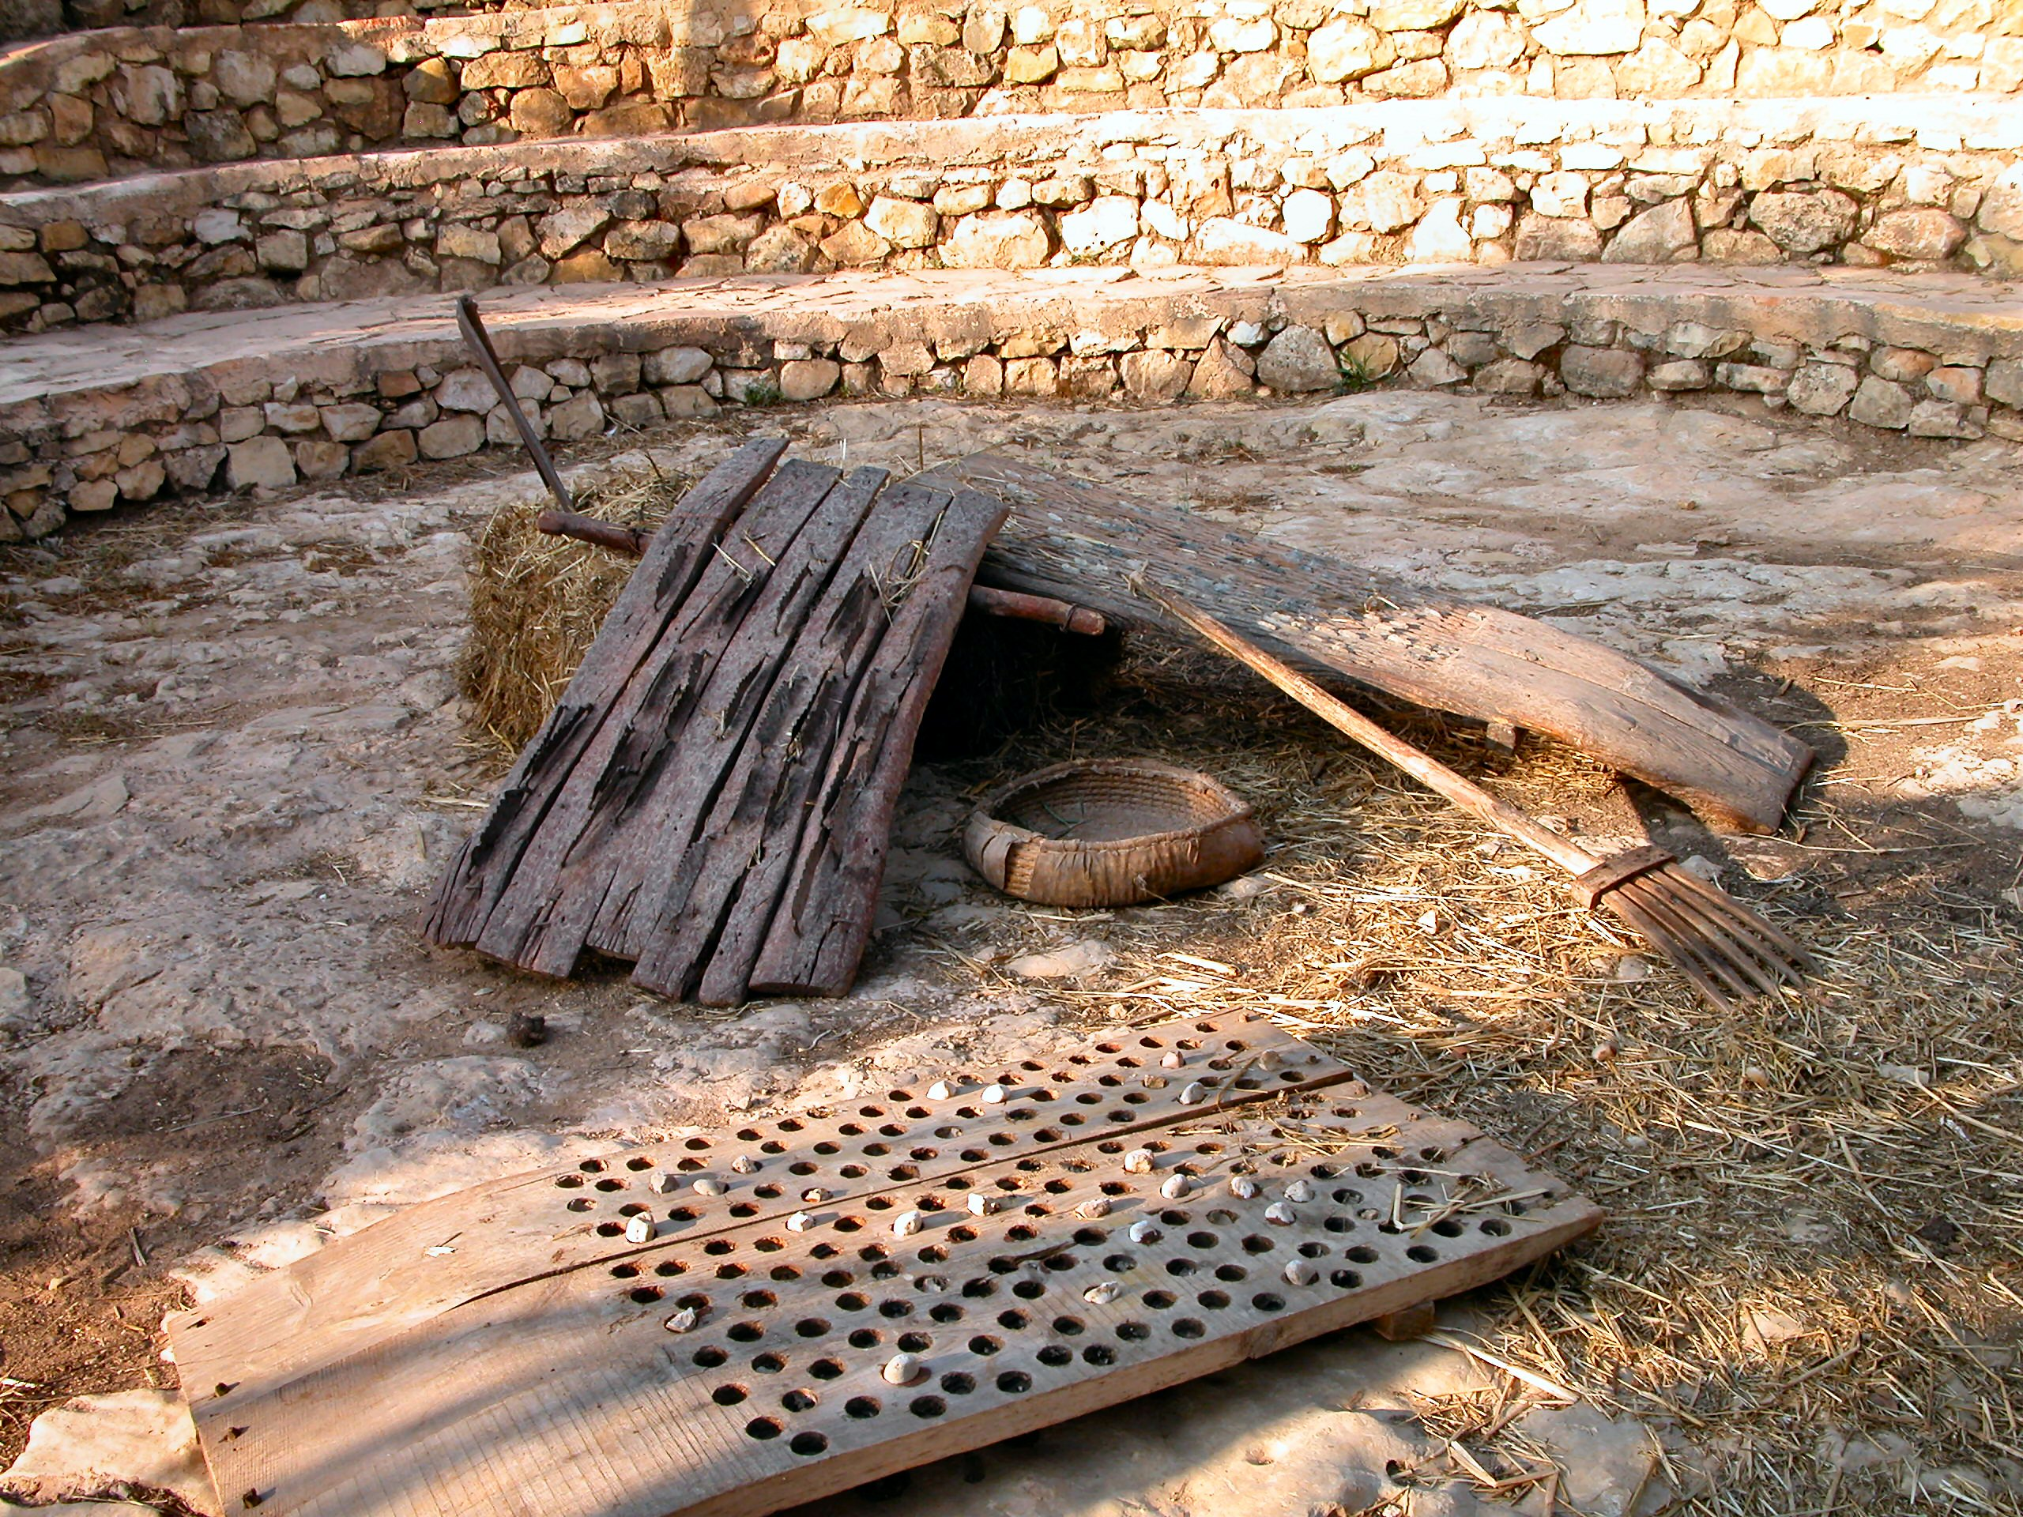
4. Conclusion

